Slide 1
Hierarchical Scheduling Algorithms
ECE 1545
This presentations uses some slides by H. Zhang

Slide 2
Hierarchical Resource Sharing over a Single Link
Resource contention/sharing at different levels
Resource management policies should be set at different levels, by different entities
  resource owner
  service providers
  organizations
  applications
Link
40 Gbps
25 Gbps
15 Gbps
Provider 1
Provider 2
15 Gbps
10 Gbps
UofT
York U.
2 Gbps
1 Mbps
ECE
Math
Residences
Video
Voice
Remote lectures
Web
Control
Audio
Video

Slide 3
Hierarchical Resource Scheduling
Requirements:
  Guarantees
    QoS for leaf classes (e.g., delay, bandwidth)
  Link-Sharing
    Service to a class should be similar to a dedicated link (with varying capacity)
    Excess capacity should be shared between sibling classes
  Priorities
    Preferential treatment of some classes over other classes (e.g., voice over Web)
Link
40 Gbps
25 Gbps
15 Gbps
Provider 1
Provider 2
15 Gbps
10 Gbps
UofT
York U.
2 Gbps
1 Mbps
ECE
Math
Residences
Video
Voice
Remote lectures
Web
Control
Audio
Video

Slide 4
Examples
(to get an intuition)

Slide 5
Determine a link sharing allocation
Root
50
Numbers in circles show the bandwidth guarantees
Traffic arrives only to leaf classes
Requested rates are:
  X_{A1}= 30
  X_{A2}= 15
  X_{B1}= 15
  X_{B2}= 0
A
20
B
30
A1
10
A2
10
B1
5
B2
25
Notes:
Allocation: Y_{A1}= 25, Y_{A2}= 15, Y_{B1}= 15, Y_{B2}= 0

Slide 6
Determine a link sharing allocation
Root
50
Class B2 becomes active
Requested rates are:
  X_{A1}= 30
  X_{A2}= 15
  X_{B1}= 15
  X_{B2}= 20
A
20
B
30
A1
10
A2
10
B1
5
B2
25
Notes:
Allocation: Y_{A1}= 10, Y_{A2}= 10, Y_{B1}= 10, Y_{B2}= 20

Slide 7
Determine a link sharing allocation
Root
50
Now we add upper bounds on bandwidth allocation (“ceiling rates”)
ceiling rates in red
Requested rates are:
  X_{A1}= 30
  X_{A2}= 15
  X_{B1}= 15
  X_{B2}= 0
A
20 30
B
30 40
A1
10 15
A2
10 15
B1
5 10
B2
25 30
Notes:
Allocation: Y_{A1}= 15, Y_{A2}= 15, Y_{B1}= 10, Y_{B2}= 0

Slide 8
Hierarchical Resource Scheduling Solutions
Hierarchical Link Sharing / Class-Based Queuing (CBQ)
(V. Jacobson, S. Floyd)
Hierarchical Generalized Processor Sharing model and Hierarchical Packet Fair Queuing algorithm
(J. Bennett, H. Zhang)
Hierarchical Token Bucket (HTB)
(M. Devera a.k.a. devik)
Covered at a later time:
Hierarchical Fair Service Curve (HFSC)
I. Stoica, H. Zhang, E. Ng

Slide 9
Hierarchical Link Sharing
(Class-Based Queuing)

Slide 10
A Comment
The link sharing paper defines semantics (“rules”) for hierarchical bandwidth sharing
Link sharing objectives are presented qualitatively. More work is needed to prove (or provide counter examples) of the bandwidth sharing goals
CBQ scheduling algorithm seeks to implement the link sharing rules
Objectives:
  “rough” quantitative bandwidth commitment
  Distribution of excess bandwidth should follow some “appropriate” guidelines
  Bandwidth should be allocated over “appropriate” time intervals

Slide 11
Overview
Link sharing goals
Approach
Formal Link-Sharing Guidelines
Approximations:
  Ancestor-Only Link-Sharing Guidelines
  Top-Level Link-Sharing Guidelines

Slide 12
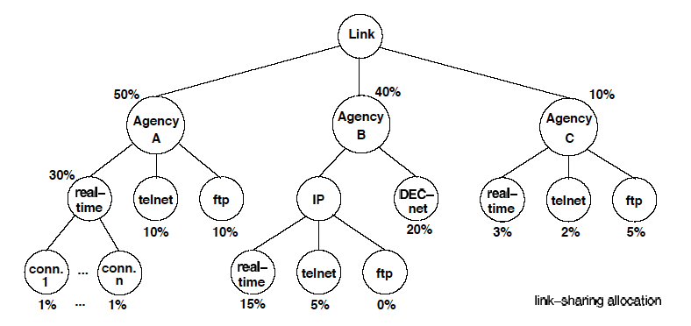
Hierarchical link sharing structure

Slide 13
Link sharing goals
Each interior or leaf class should receive roughly its allocated link-sharing bandwidth over appropriate time intervals, given sufﬁcient demand
If all leaf and interior classes with sufﬁcient demand have received at least their allocated link-sharing bandwidth, the distribution of any `excess' bandwidth should not be arbitrary, but should follow some set of reasonable guidelines
2nd objective not addressed in link sharing paper

Slide 14
Scheduler Concepts
Each leaf class has its own queue
Two schedulers: general and link sharing scheduler
  General scheduler schedules packets without regard for link sharing guidelines
  Link sharing scheduler schedules packets from leaf classes that have exceeded their allocation
Note:
  Also says: Any implementation will have a single integrated scheduler
  There is no concrete scheduling algorithm prescribed. The paper suggests to use priority scheduling with WRR for the general scheduler and rate-limiting for the link sharing scheduler

Slide 15
Concepts
At any time, a class is designated either as regulated or as unregulated:
  Unregulated: uses general scheduler
  Regulated: use a link sharing scheduler
Overlimit: class received more than allocated bandwidth
Underlimit: class received less than allocated bandwidth
At-limit: otherwise
Unsatisfied:
for leaf class: underlimit and has backlog
for non-leaf class: underlimit with a descendant with backlog
Satisfied: otherwise

Slide 16
What does “regulated” mean?
“Regulated” means that bandwidth is going to be restricted
In CBQ:
  Rate-limit (shape) each regulated flow to its allocated link-sharing bandwidth

Slide 17
Link-sharing Guidelines
The router needs to know which overlimit leaf classes should be regulated
This is done by using link-sharing guidelines:
  “Formal” link sharing guidelines
  “Approximations”:
    “Ancestor-only” link sharing
    “Top-level” link sharing
Traffic of all classes is measured

Slide 18
Formal link sharing guidelines
A class can continue unregulated if
  Class is not overlimit or
  Class has not-overlimit ancestor with no unsatisfied descendants
Otherwise the class is regulated
Alternate guidelines: A regulated class continues to be regulated until
  the class becomes underlimit, or
  Class has an underlimit ancestor at level i and there are no unsatisfied classes in the structure below level i

Slide 19
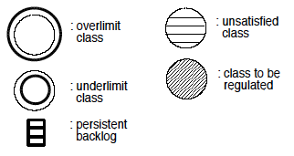
Case 1: Who is regulated?
No class is regulated

Slide 20
Case 2: Who is regulated?
Agency A is not overlimit
Both A1 and B1 are regulated
Agency A not regulated, Agency B regulated

Slide 21
Case 3: Who is regulated?
A1 is regulated
Agency A is regulated

Slide 22
Case 4: Who is regulated?
No leaf class is unsatisfied
Agency A is unsatisfied, but unregulated
B1 and Agency B are regulated

Slide 23
Ancestor-Only Link-Sharing Guidelines
A class can continue unregulated if one of the following conditions hold:
1: The class is not overlimit, or
2: The class has an underlimit ancestor

Slide 24
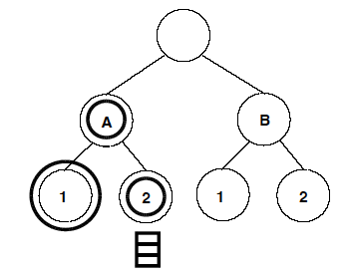
Drawbacks of Ancestor-Only Link Sharing
Suppose:
  Class A has been underlimit
  real-time class in A starts to send a large burst (and is overlimit)
  Until “A” has switched to overlimit, it continues as unregulated
Issue: With ancestor-only, A1 does not see that A2 is unsatisfied

Slide 25
Top-Level Link-Sharing Guidelines
Top-level: Highest level from which a class is allowed to “borrow” bandwidth
“… uses various heuristics to set the Top-level variable”
A class can continue unregulated if one of the following conditions hold:
1: The class is not overlimit, OR
2: The class has an underlimit ancestor whose level is at most Top-Level.

Slide 26
Summary
A class that is not overlimit will not be regulated.
When all classes are satisfied, no classes will be regulated.
As long as there exists a single class that remains unsatisfied, all regulated classes will be rate-limited to their allocated link-sharing bandwidth.

Slide 27
Ancestor-Only Link-Sharing Guidelines
A class can continue unregulated if one of the following conditions hold:
1: The class is not overlimit, or
2: The class has an underlimit ancestor

Slide 28
Drawbacks of Ancestor-Only Link Sharing
Suppose:
  Class A has been underlimit
  real-time class in A starts to send a large burst (and is overlimit)
  Until “A” has switched to overlimit, it continues as unregulated
Issue: With ancestor-only, A1 does not see that A2 is unsatisfied

Slide 29
Top-Level Link-Sharing Guidelines
Top-level: Highest level from which a class is allowed to “borrow” bandwidth
“… uses various heuristics to set the Top-level variable”
A class can continue unregulated if one of the following conditions hold:
1: The class is not overlimit, OR
2: The class has an underlimit ancestor whose level is at most Top-Level.

Slide 30
Top-Level Link-Sharing
Top-Level=∞: Top-Level link-sharing is identical to Ancestor-Only link-sharing
Top-Level= lowest level with an unsatisfied class:
Top-Level link-sharing is essentially the same as formal link-sharing
Top-Level=1: only not-overlimit classes can send packets

Slide 31
Formal Link-Sharing Guidelines: Analysis (2)
Starvation of lower-priority classes are limited:
Assume that leaf class A first becomes unsatisfied at time t. For every class C_{i} other than class A, there is a time t_{i}, with t ≤ t_{i} ≤ t+T, such that class C_{i} receives at most its allocated bandwidth over every interval [t_{i}, t_{A}] during which class A remains unsatisfied. Further, if t_{i} > t, then class C_{i} also receives at most its allocated bandwidth over the interval [t_{i}-T, t_{i}], where t_{i}-T < t.
(T is the sampling period of the estimator)

Slide 32
Class Based Queuing (CBQ) vs. Link sharing
CBQ precedes link sharing
Combines link sharing and real-time services in a single scheduler
Supports priorities
Components:
  Classifier: Classifies arrivals
  Estimator: Bandwidth estimation of classes (determines underlimit, overlimit)
  Delayer/Shaper: schedules traffic from classes that have exceeded their limits and contribute to congestion
  Selector: determines order of packets (scheduler)
General scheduler ~ Selector
Link Sharing scheduler ~ Delayer
Classifier
Estimator
Delayer (Shaper)
Selector

Slide 33
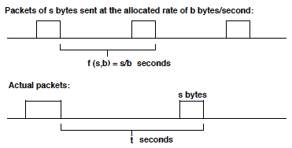
CBQ Estimator
CBQ estimates the state of a class:
  For formal link sharing: need to detect overlimit
  For ancestor and top-level: need to detect underlimit
Estimator uses exponentially weighted moving average:
b: rate allocation
s: packet size
Packet spacing: f(s,b) = s/b
Discrepancy: diff = t – f(s,b)
diff < 0: flow exceeds its allocation
Averaging of discrepancy: avg ← (1-w) avg + w × diff
avg is used to determine overlimit or underlimit

Slide 34
CBQ Selector
General Scheduler:
  Schedules packets from “higher priorities” first
  Within the same priority, use WRR with weights proportional to the allocation
  WRR ensures that unregulated classes receive bandwdith proportional to their allocation
Link-sharing Scheduler:
  Implements a traffic shaper
  For a regulated class, after a transmission of size s, next transmission is set to
  time-to-send = f(s,b) = s/b
  Packet is passed to general scheduler after time-to-send

Slide 35
Summary
A framework to integrate priority scheduling and link-sharing.
The solution is ad hoc, no firm guarantee for real-time or link-sharing requirements.
In the formal link-sharing guideline, link-sharing goal has a higher priority than real-time goal.

Slide 36
Link Sharing as a Fairness Problem

Slide 37
Definitions
root
v
Notes:
Allocation: Y_{A1}= 15, Y_{A2}= 15, Y_{B1}= 10, Y_{B2}= 0

Slide 38
Guarantees vs. Weights
50
Guarantees g_{v} of class v must satisfy
Weights φ_{v} are arbitrary
20
30
10
10
5
25
4
6
Notes:
If the gurantees g_v

Slide 39
Hierarchical Max-min Fairness
Define:
X_{n} requested rate
Y_{n} allocated rate
R_{n} available rate at node n
φ_{n} weight of node n
f_{n} fair share of node n (non-leaf
nodes only)
Leaf node n is satisfied if
Non-leaf node n is satisfied if
Leaf nodes only
root
n

Slide 40
Hierarchical Max-min Fairness
For each non-leaf node n :
  Fair share:
  Available rate:
root
n

Slide 41
Supplement to Hierarchical Packet Fair Queueing
(see separate slide set)

Slide 42
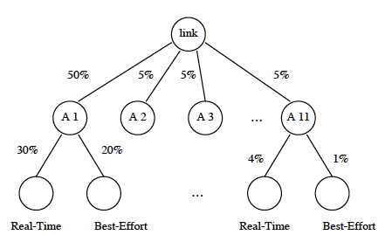
H-GPS
Root node R (physical link)
Each leaf node is a flow
Assume:
and

Slide 43
H-GPS
H-GPS is defined by:
It follows that:

Slide 44
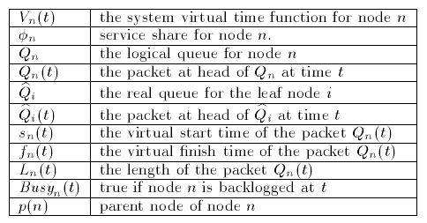
H-PFQ

Slide 45
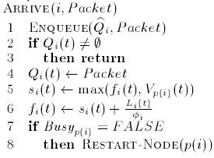
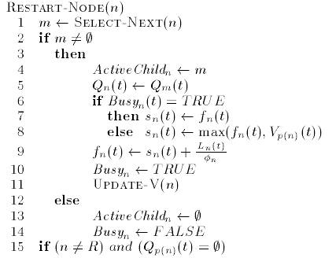

H-PFQ

Slide 46
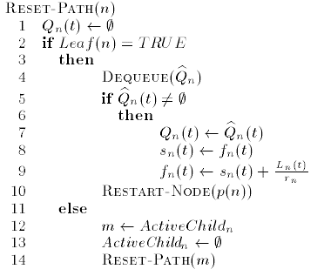
H-PFQ

Slide 47
Hierarchical Token Bucket
(HTB)

Slide 48
HTB
HTB is implemented in Linux
Uses token bucket as building block for implementation
Frequent misconception:
  HTB is not (only) a traffic shaper
  HTB is a scheduler for link sharing
Basic idea: If a node runs out of tokens, it can borrow tokens from an ancestor
HTB supports priorities

Slide 49
Token buckets at a class
For each node i :
  AR_{i} guaranteed rate
  CR_{i} ceiling (maximum) rate
  R_{i} actual rate
  Rate bucket has tokens: Can send (green) → R_{i} < AR_{i}
  Rate bucket is empty, but ceiling bucket has tokens:
  Can borrow (yellow) → AR_{i} < R_{i} < CR_{i}
  Ceiling bucket is empty: Can’t borrow (red) → R_{i} = CR_{i}

Slide 50
HTB
Implicit assumptions:
Note: Root is always green !
Assign level to a flow:
  Leaf class:
  Non-leaf class:
root
v

Slide 51
Transmission
For each transmission by a class, tokens are subtracted from own buckets as well as buckets of all ancestors
  Note: Token count can be negative
Rules for transmission:
  Green classes can always transmit
  Yellow class:
    Tries to borrow tokens from parent
    If parent is also yellow, parent tries to
    borrow from its own parent
  This continues until a parent is either green or red:
    If red: Class cannot transmit
    If green: Can transmit.
  Red classes cannot transmit

Slide 52
Token buckets of a class
For each transmission remove tokens from own buckets and
buckets of ancestors
  Yellow node can have a deficit in assured bucket
  Red node may have a deficit in both buckets
Max. deficit corresponds to 60 seconds at the given rate
Class turns to green only when token count in assured bucket becomes positive

Slide 53
Transmission order
HTB uses Deficit Round Robin (DRR) for transmission
Multiple DRR queues, only one DRR queue is active at a time
Each flow has a quantum that determines the max. bytes that can be sent at a time
      Quantum is proportional to assured rate
Green leaf classes
Yellow classes: Green classes at level 1

Slide 54
Transmission order
The green classes grouped, with classes with same level and priority in the same group.
  There is one DRR scheduler for each group
Groups are put in priority order according to:
    Level from lowest to highest
    Priority from highest to lowest
Find the top group (classes have the same level and priority)
Select a leaf class for transmission:
  If top group is from leaf level (level = 0)
    DRR over them
  If top group is not from leaf level (level ≠ 0)
    Do RR between classes in top group
    For each class in top group: Perform DRR over leaf classes that can borrow all the way up to this class
    This should be the same as a DRR over all leaf descendants of classes in the top group

Slide 55
Top Group changes
After each transmission, check if
  color of any class has changed, and
  the top group has changed
If top group has changed, switch to the DRR (RR) scheduler of the new top group

Slide 56
Examples

