Slide 1
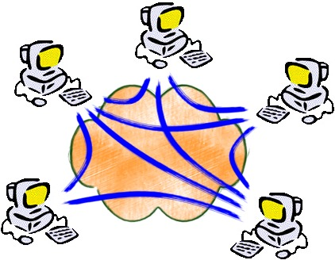
Elements of
Application-layer Internetworking
Jorg Liebeherr
University of Toronto
"Elements of Application-layer Internetworking for Adaptive Self-organizing Networks,” J. Liebeherr, M. Valipour, T. Y. Zhao, Proceedings of the IEEE, April 2019.

Slide 2
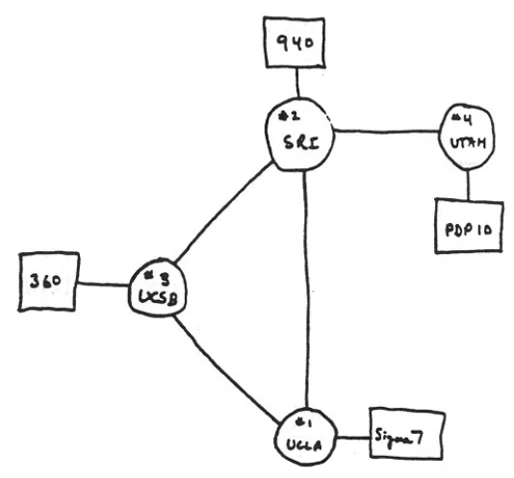
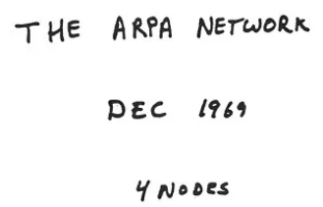
The Internet began small …

Slide 3
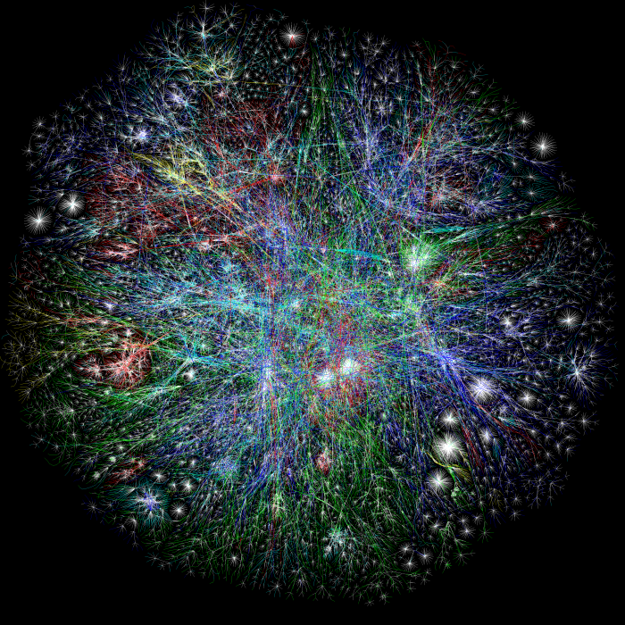
… to become one of the largest engineering artifacts in history
You are here

Slide 4


In the Beginning...
There were many competing networks & architectures.
DataPAC
DECNet
TransPAC
ARPANet

Slide 5
"Internetwork Layer"
IP started out as an overlay, designed to interconnect
all kinds of other networks – both LANs and WANs.
DataPAC
DECNet
TransPAC
IP Gateway
IP Gateway
ARPANet
K. Calvert, ICNP 2017 Panel (used with permission from author)

Slide 6
"Internetwork Layer"
"Network Layer"
As router technology matured...
...most of those underlying technologies faded away.
DataPAC
DECNet
TransPAC
ARPANet
K. Calvert, ICNP 2017 Panel (used with permission from author)

Slide 7






"Hollowing Out"
Software-Defined Networking replaces routers with
switches that are [semi]-oblivious to protocol standards.
K. Calvert, ICNP 2017 Panel (used with permission from author)

Slide 8

"Network Layer"
"Internetwork Layer"
This allows the domain owner to define the semantics of
header bits – inside the domain...
... and leaves the inter-domain interface to ossify.
K. Calvert, ICNP 2017 Panel (used with permission from author)

Slide 9
Internet Infrastructure (the way I teach it)

Slide 10
Internet Infrastructure (after a reality check)
Special purpose infrastructure 1
Special purpose infrastructure 2
5G
Net
MANET
Vehicular
Net
IoT
Net
Private IP
Net

Slide 11
The Times They Are A-Changin'
Internet-centric:
All infrastructures connect to the Internet, but not to each other
No central network:

Slide 12
Internetworking today
Internet ossification since early 2000s
  global upgrades fail or proceed at glacial speed
Proliferation of proprietary infrastructures
Networks may not need access to Internet
Global addresses not always essential
No internetworking solutions for IoT devices
Lack of internetworking for mobile networks
➔ A good time to think about new approaches to Internetworking

Slide 13
Application-layer Internetworking
Devices use available infrastructures to form a network
Separate network for each networked application
Each device can participate in arbitrarily many networks
Self-organizing:
  Devices detect and establish connectivity with other devices
  No central control
Networks may exist only for a limited time
Topology can be highly dynamic
All network nodes participate in relaying data (peer-to-peer)
No need for global deployment

Slide 14
Multi-substrate application network
Application network
Collection of substrate networks

Slide 15
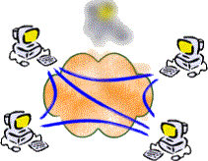
Platform: HyperCast
HyperCast is a set of protocols for large-scale self-organizing application networks
Designed in my research group at Univ. of Virginia and Univ. of Toronto
~100,000 lines of Java
Socket inspired API

Slide 16
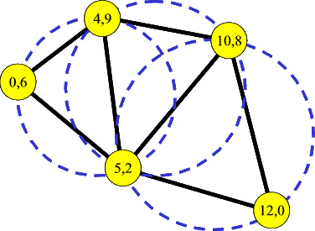
HyperCast Application Networks
Applications self-organize to form a network graph
Data is forwarded along the edges of the graph

Slide 17
Scalability Experiment
Experimental Platform: Linux PC Cluster
  up to 100 PCs
  Up to 100 nodes per PC
    → up to 10,000 network nodes

Slide 18
Experiment: Scalability
Measurement: Starting with N members, how long does it take to add M new
members?
Topology: Delaunay Triangulation
Time to Stabilize (sec)
Final number of nodes (N+M)

Slide 19
Overlay Sockets

Slide 20
Overlay Sockets
Substrate 3
Substrate 1
Substrate 2

Slide 21
Writing Programs with Overlay Sockets
Similarities to Berkeley Socket API
Programs are independent of overlay topology and substrate network
Arbitrary number of overlay sockets per applicaiton
//Generate the configuration object
OverlaySocketConfig ConfObj =
OverlaySocketConfig.createOLConfig("hypercast.xml");
//Create an overlay socket
I_OverlaySocket socket=ConfObj.createOverlaySocket(null);
//Join an overlay
socket.joinOverlay();
//Create a message
OL_Message msg = socket.createMessage(byte[] data);
//Send the message to all members in overlay network
socket.sendToAll(msg);
//Receive a message from the socket
OL_Message msg = socket.receive();
//Extract the payload
byte[] data = msg.getPayload();

Slide 22
Cross-Substrate Advertising
Notes:
Internet Protocol Television

Slide 23
Cross-substrate advertising
Example 1:
A and B prefer Substrate 1, but does not have address of A
Use Substrate 2 for rendezvous, and exchange address information about Substrate 1
Substrate 2
Hello (+ Addr_A)
Hello
A
Substrate 1
(Internet)
B
Addr_A
Hello
Notes:
Hello

Slide 24
Cross-substrate advertising
Example 2:
C joins network via Substrate 3 with B as neighbor
C prefers A as neighbor in the application network
C detects that it can talk to A via Substrate 2
Addr_A
Substrate 2
(no broadcast)
A
C
Substrate 1
B
Substrate 3

Slide 25
Cross-substrate advertising
- Outgoing -
myLA = 50,102
Source: 50,102
Adr_1
Adr_3
Adr_2
Adr_1
Adr_2
Adr_3
Adr_1
Adr_2
Adr_3
Source: 50,102
List of substrate addresses

Slide 26
Cross-substrate advertising
- Incoming -
Source: 50,102
LA | Substrate addresses
50,102 | Adr_1, Adr_2, Adr_3
Source: 50,102
Adr_1
Adr_2
Adr_3

Slide 27
Different Methods for Cross-substrate Advertisement
Gossip
Protocol-driven dissemination
Exchange address lists periodically
Attach address lists to protocol messages
“Push”
“Push Single”
“Pull”
Add address list
to each message
with info on node
Add preferred address
to each message with
info on node
Request address list when info is needed

Slide 28
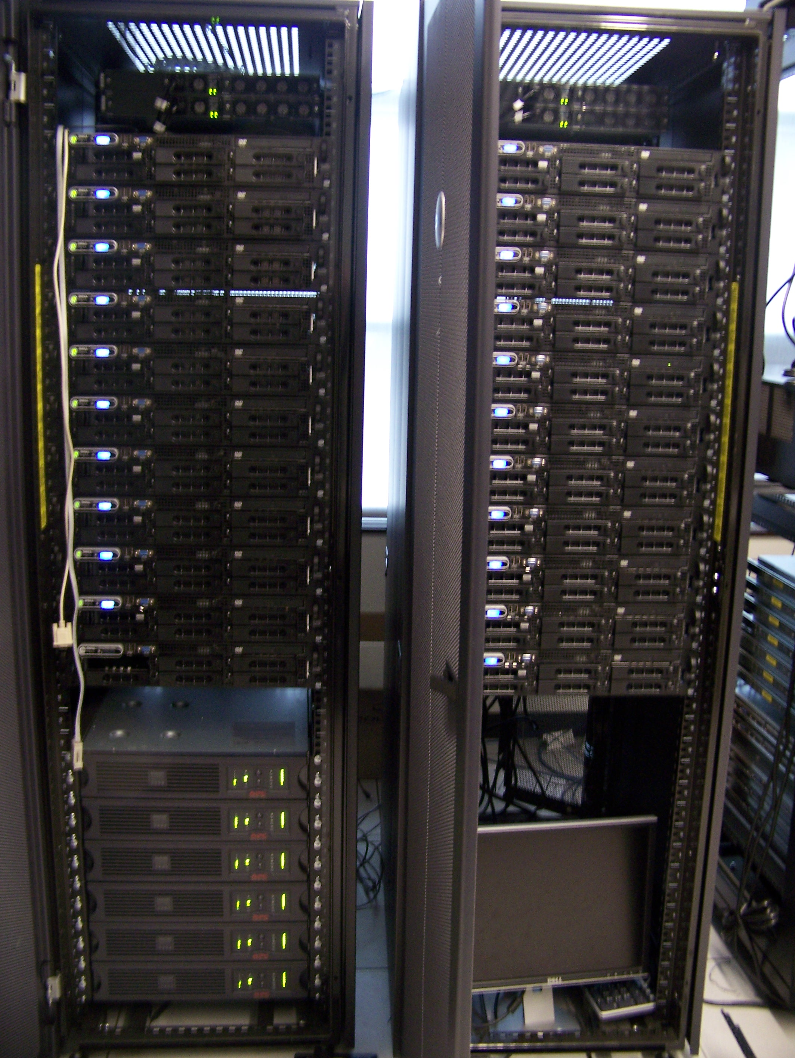
Experimental Evaluation
Local Emulab Testbed
20 Linux nodes
CPU | 2xQuad-Core Xeon 5400 (2 Ghz)
RAM | 4G DDR2
Interface | 8x1Gbps (4 Intel card, 4 NetFPGA)
Software:
  Hypercast with CSA
  Delaunay Triangulation protocol
  Multiple UDP/IP substrates

Slide 29
Experimental Evaluation
N x N substrates → (N+1) x (N+1) regions
Nodes equally distributed across regions
N=2
S₂
S₃
R₁₂
R₁₃
R₁₁
R₂₁
R₂₂
R₂₃
R₃₁
R₂₃
R₃₃
S₁
S₄

Slide 30
Mapping of Nodes to Substrates
K x K substrates → (K+1) x (K+1) regions
Nodes distributed uniformly across regions
K=2
S₂
S₃
R₁₂
R₁₃
R₁₁
R₂₁
R₂₂
R₂₃
R₃₁
R₂₃
R₃₃
S₁
S₄

Slide 31
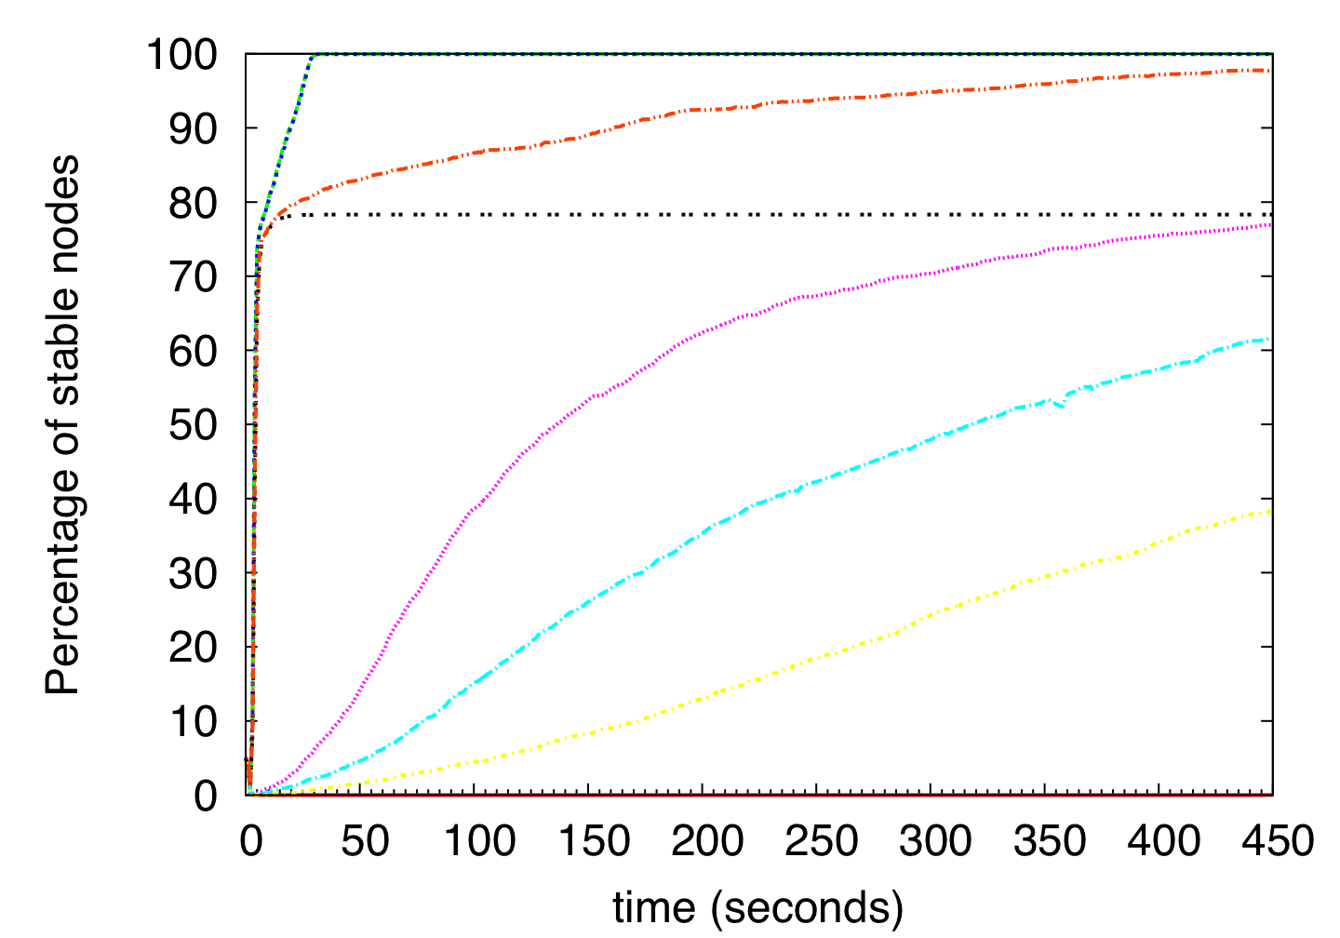
Convergence
Percentage of stable nodes: K=17(289 substrates), 2592 nodes
Push/Pull
Push-single and gossip
Push-single
250 ms
500 ms
Gossip
1000 ms
None

Slide 32
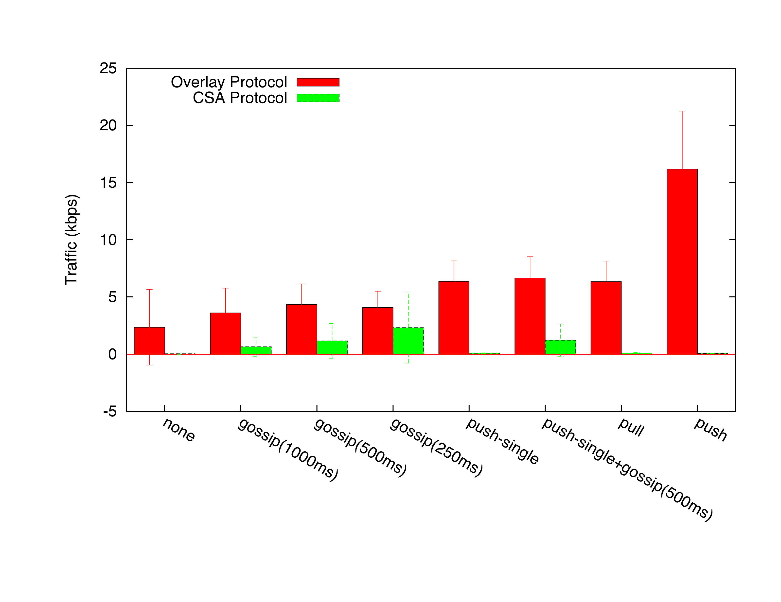
CSA Overhead
Received Traffic (average per node): K=17(289 substrates), 2592 nodes

Slide 33
Internetworking with IoT devices
Notes:
Internet Protocol Television

Slide 34
Putting Internetworking in the Internet-of-Things
Today:
  IoT networks are “shrinkwrapped” products
  Consideration of networking only between IoT device and gateway
  Wide-area solutions are proprietary
Question:
  Is it feasible to build application-layer internetworks involving low-power IoT devices?
Challenge:
  Limited capabilities of IoT devices

Slide 35
Internetworking with IoT devices
LoRa Feather board:
Microcontroller (no OS!)
<10 kbps
up to 500m with basic antenna
2K RAM
32K flash
Raspberry Pi with Lora shield:
Linux
1.2 GHz processor
1GB RAM
Modalities:
  Wifi
  Bluetooth
  LoRa

Slide 36
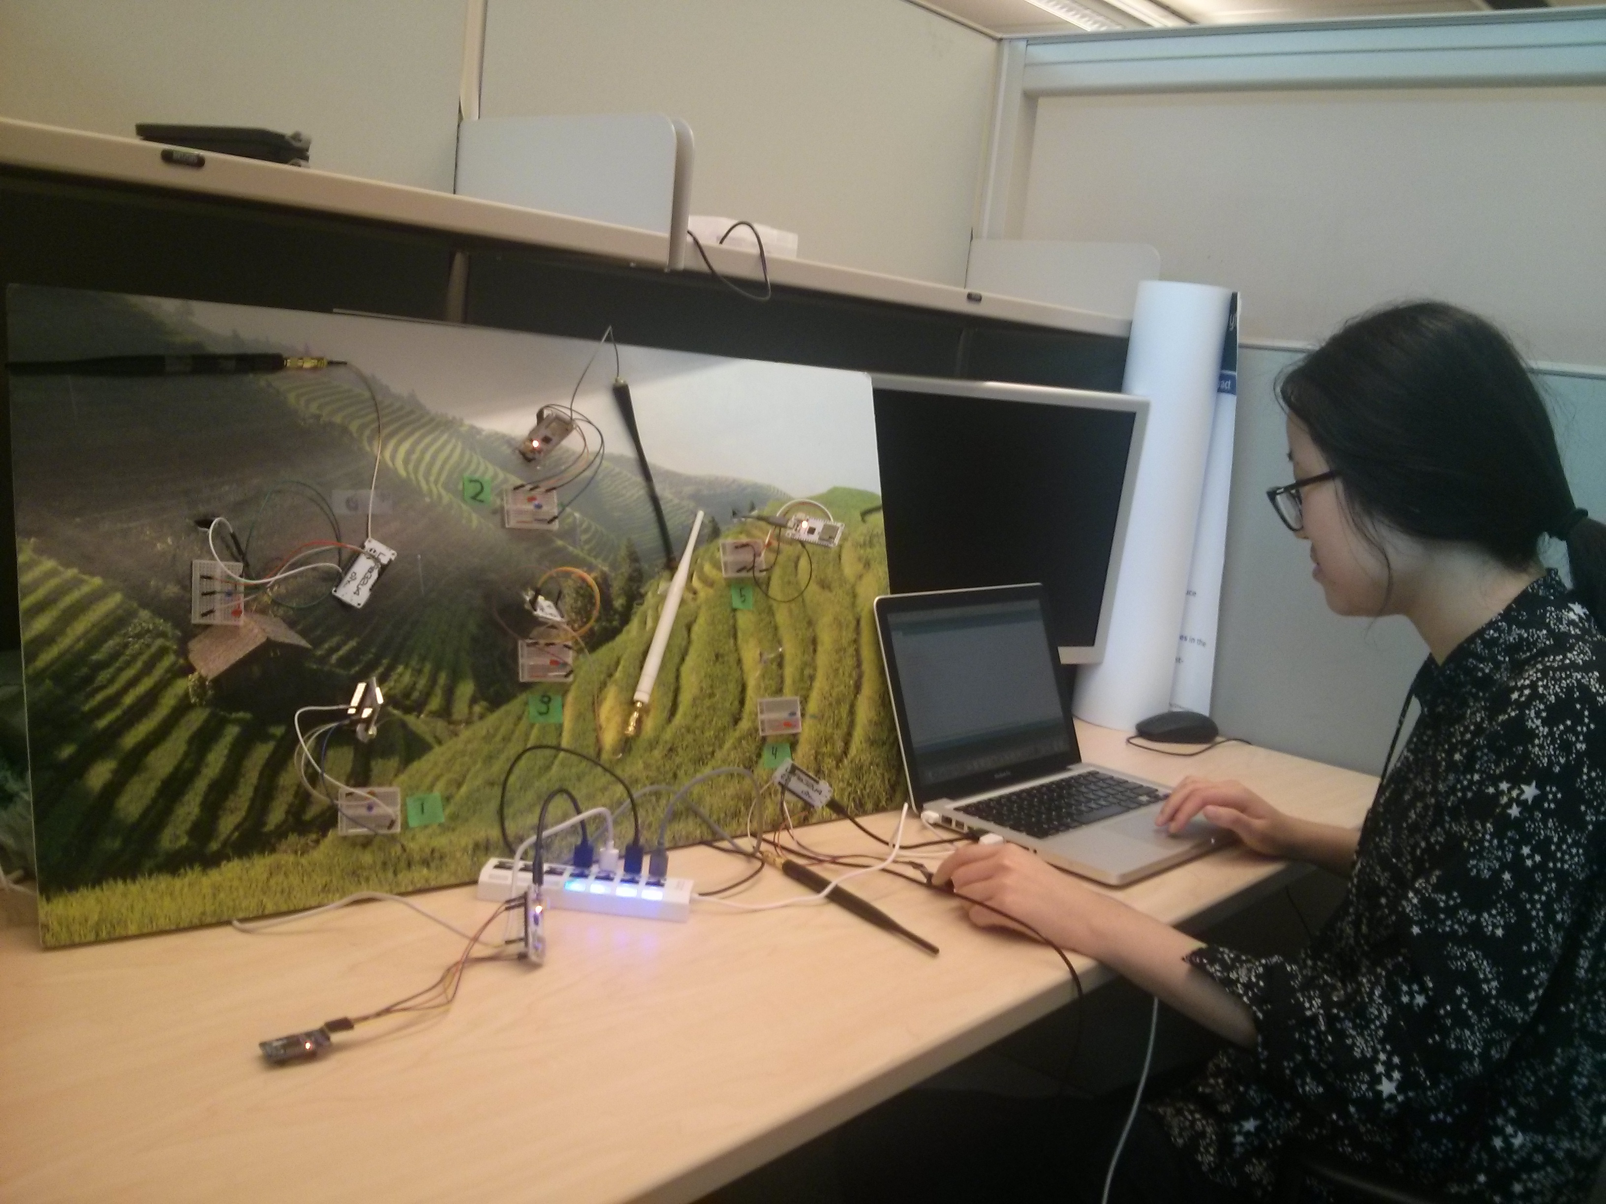
Ongoing: Self-organizing multihop networking with LoRa
Date: July 17, 2019

Slide 37
Conclusions
Application networks provide internetworking at upper layers
  easy to deploy
  self-organizing
Borrows heavily from self-organizing peer networks
Many interesting issues:
  Support in lower layers
  Adaptive services
  Limitations of IoT devices
  Security

