Slide 1
An Introduction to
IoT with AWS
IoT Workshop
Jorg Liebeherr

Slide 2
Objectives
Goal of the workshop: Hands-on exposure to Amazon cloud services for IoT
Concepts used in the workshop:
  IoT Core
  Things
  Lambda functions
  Policies and rules

Slide 3

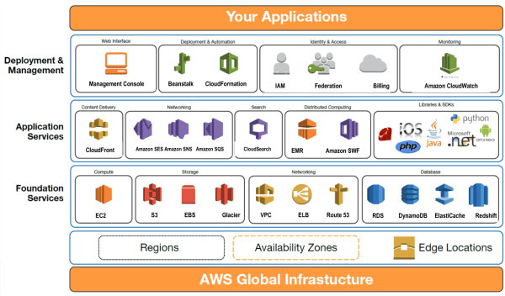
AWS (Amazon Web Services)
AWS is an on-demand cloud computing platform
  Originally (2006), AWS was the compute
  infrastructure for Amazon’s retail operation
  Soon, it became a standalone business
  Market share of ~33% for cloud services (2024)
  Provides infrastructure for Netflix, AirBnB, Spotify, etc.
AWS offers more than 200 services:
  Compute: EC2 (Virtual Servers), Lambda (Serverless)
  Storage: S3 (Object Storage), EBS (Block Storage)
  Databases: RDS (Managed SQL), DynamoDB (NoSQL)
  Networking: VPC, CloudFront (CDN)
  Security: IAM (Access Control), Shield (DDoS Protection)
  AI/ML: SageMaker, Rekognition
  ….
This workshop: AWS IoT Core
Source: amazon.com

Slide 4
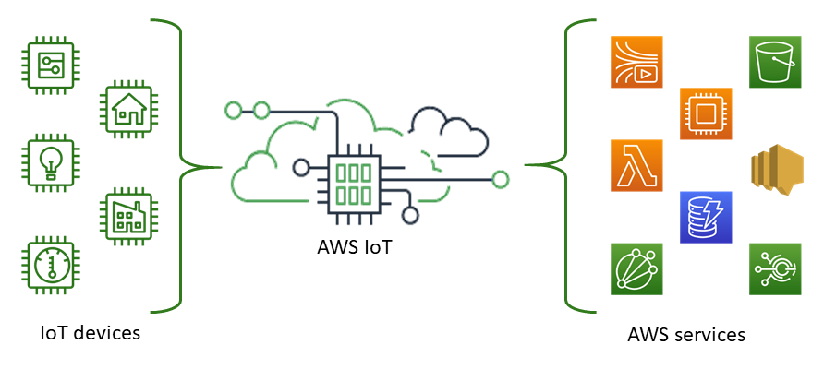
AWS IoT Core
AWS IoT Core provides cloud
services to connect IoT devices
to AWS cloud services
Supported protocols:
  MQTT
  MQTT over WSS (Websockets Secure)
  HTTPS
  LoRaWAN
Source: amazon.com

Slide 5
Simple architecture with IoT core
Lambda functions are an AWS service for running user code
  Does not require a server
  Lambda functions are triggered by events (e.g., change in a data base, HTTP Request, MQTT event)
  Automatic scaling, e.g., running multiple instances
  Written in Python, Java, Node.js

Slide 6
In this workshop
Device
IoT Core
Part 1: Set up an AWS account
Part 2: Add a device that publishes sensor data to AWS IoT Core (via MQTT)
Part 3: Add a Lambda function that processes the sensor data
Part 4: Add a subscriber that receives the processed sensor data (via MQTT)

Slide 7
Continue with workshop handout

