Slide 1
Power Profiling of IoT Devices
IoT Workshop
Jorg Liebeherr

Slide 2
Objectives
Power consumption is a primary concern for embedded IoT devices:
  Battery dependence: Devices are often battery-powered and must operate with small batteries
  Limited energy harvesting: Energy budget of Solar/vibration/wind powered devices must be carefully provisioned
  Duty cycling: Many IoT devices only need to operate periodically for a certain period of time (duty cycle) and can be set to sleep modes between duty cycles
Understanding power consumption is crucial for the design of efficient IoT systems

Slide 3
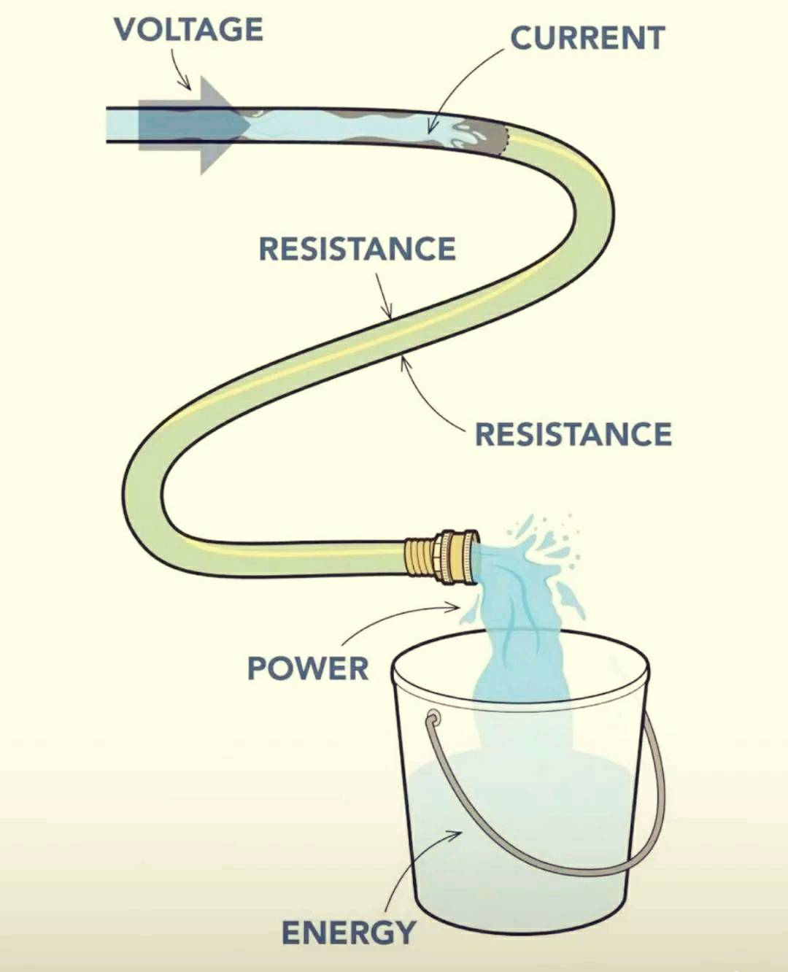
What to measure? (using water hose comparison)
Voltage ~ water pressure
Energy charge ~ water molecules
Current ~ flow rate
Power ~ product of pressure and flow rate
Energy ~ amount of water delivered over time

Slide 4
What to measure?
Voltage: measured in Volt (V)
Electrical charge:
measured in Coulomb (C) or Ampere hours (Ah)
Current: measured in Ampere (A)
Energy: measured in Joules (J) or
Watt hours (Wh)
Power: measured in Watt (W) or Joules per second (J/s)
Ohm’s law:
V = I ∙ R
Voltage = (Current) ∙ (Resistance)
P = V ∙ I
Power = (Voltage) ∙ (Current)
E = P ∙ t
Energy = (Power) ∙ (Time)
E = Q ∙ V
Energy = (Charge) ∙ (Voltage)
Important conversion:
1 A = 1 C/s
1 Ah = 3600 C

Slide 5
What to measure? Depends on what we need!
Average current draw (e.g., over a duty cycle or time period)
Peak current draw (e.g., during Wi-Fi or LoRa transmission)
Energy per operation (e.g., per sensor reading or per transmission)
Sleep current
If we measure electric current as a function of time:
  Directly from function: Peak current, average current, sleep current
  Integral of function over an interval: Charge
  Consumed energy over a time interval = Charge x Voltage

Slide 6
What to measure? Depends on what we need
For batteries, the storage capacity is given in Ah (charge) and not in terms of J or Wh (energy)
  The reason is that the voltage of a battery changes as it empties
  … and energy depends on voltage
Because of this, it is often convenient to use the (measured) charge as indicator of consumed energy of an IoT system
  Example:
  AA battery (1.5 V) has ~2000 mAh
  Suppose an IoT system (powered by an AA battery) is measured at 5 mAh for a duty cycle
  → IoT system can run ~2000 mAh / 5 mAh = 400 duty cycles on an AA battery

Slide 7
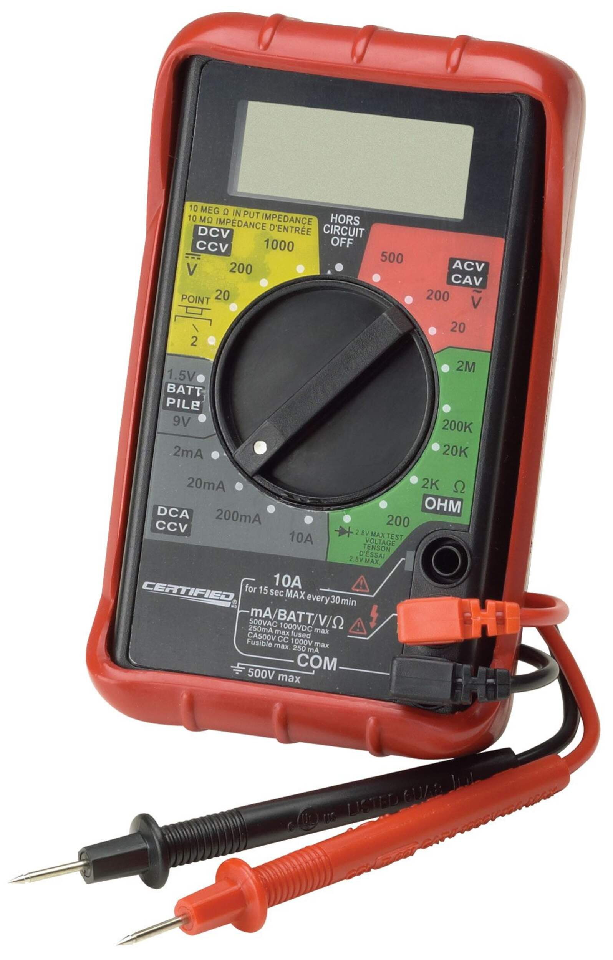
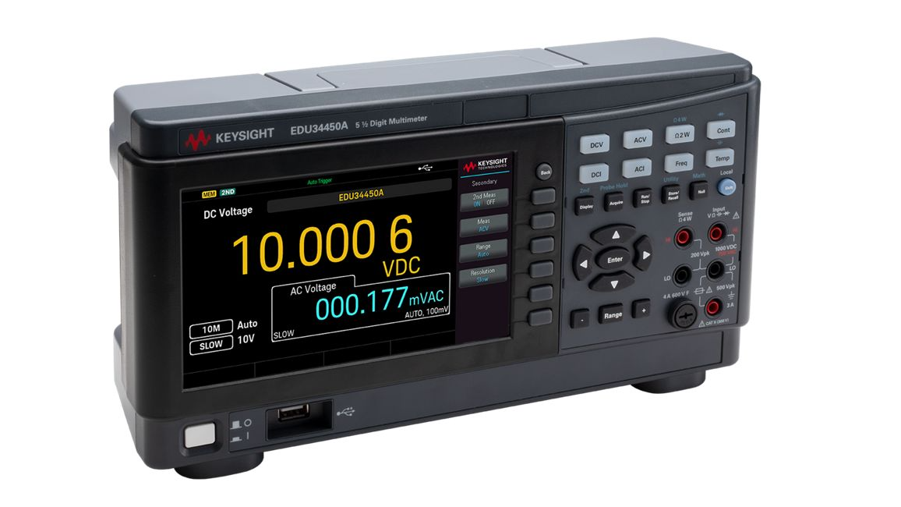
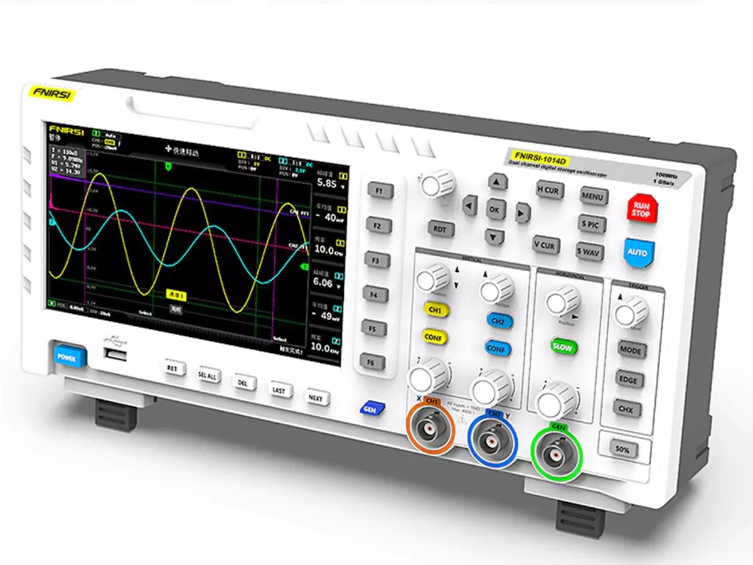
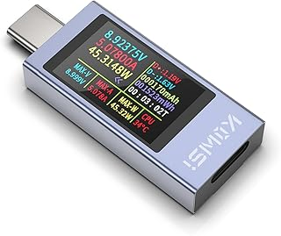
Generic Tools for Power Profiling
Digital Multimeters
(relatively) low cost
for instantaneous measurements
Digital Oscilloscopes
high-resolution visual display of
voltage and current changes over time
very high sample rate
USB power meters
- low cost, low accuracy

Slide 8
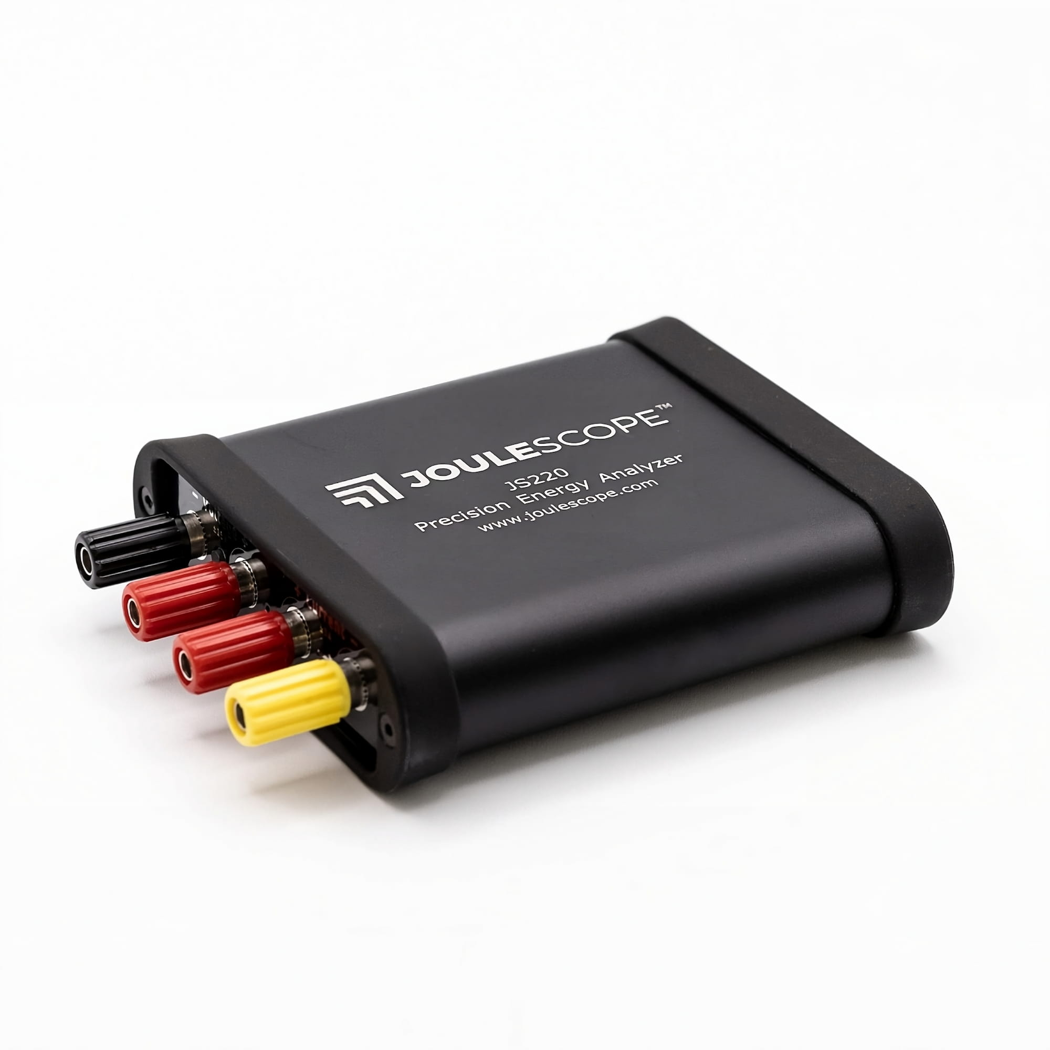
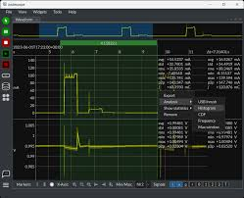
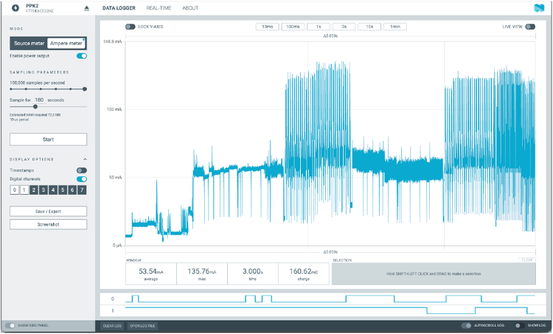
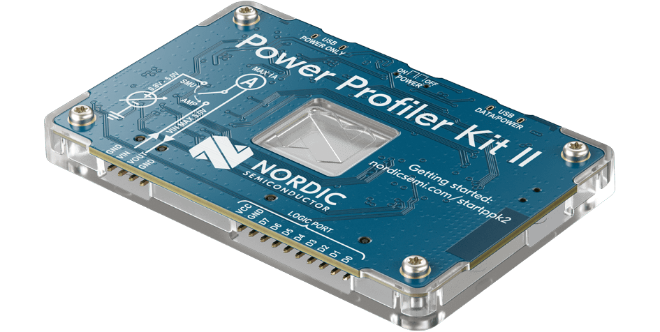
Specialized Power Profiling Tools for IoT
Joulescope JS220
Voltage Range: ±15 V
Current Range: ±3 A continuous, with ±10 A pulses
Current Resolution: 0.5 nA
Bandwidth: 300 kHz
Sampling Rate: 2 million samples per second
Cost: approx. CAD 1500
Nordic Power Profiler Kit II (PPK2)
Voltage Range: 0.8-5 V
Current Range: max. 1 A
Current Resolution: 0.5 μA
Sampling Rate: up to 100 thousand samples per second
Cost: approx. CAD 150

Slide 9
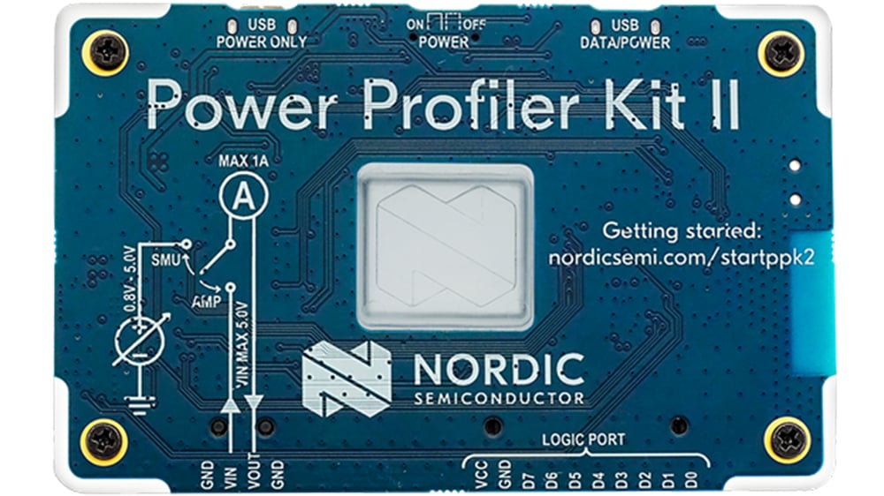
Nordic Power Profiler Kit II (PPK2)
micro USB
cable
First: Install nRF Connect for Desktop
Then:
Connect USB cable to USB Data/Power port of PPK2
Start nrF Connect and Install/Open Power Profiler
Connect cables according to mode
  Source meter mode
  Ampere meter mode
Set GUI parameters and start measurement
Notes:
https://www.nordicsemi.com/Products/Development-tools/nRF-Connect-for-Desktop

Slide 10
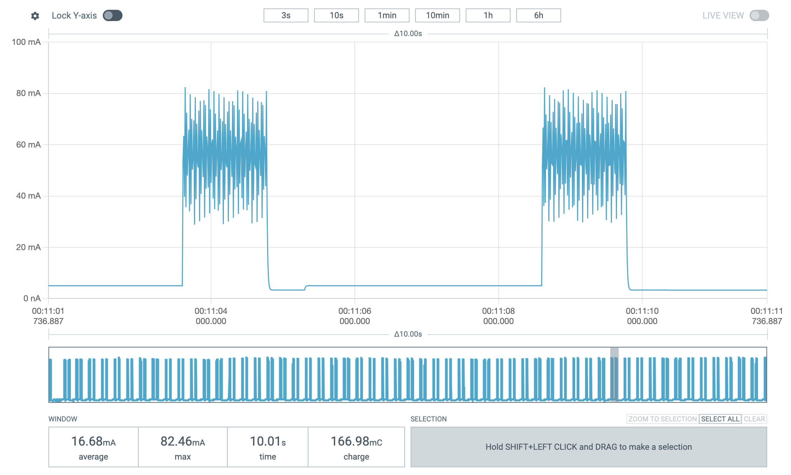
PPK2 Measurement
size of displayed window
x-axis: time
y-axis: current (in mA)
Notes:
Measurement is of a CO2 sensor

Slide 11
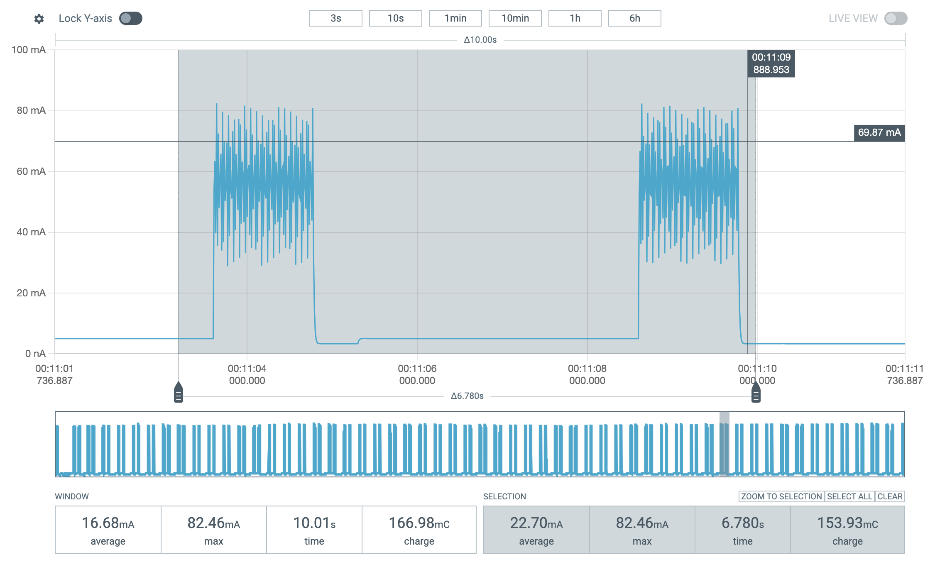
PPK2 Measurement
x-axis: time
y-axis: current (in mA)
Selected area
Current (avg., max.) and charge of selected area

Slide 12
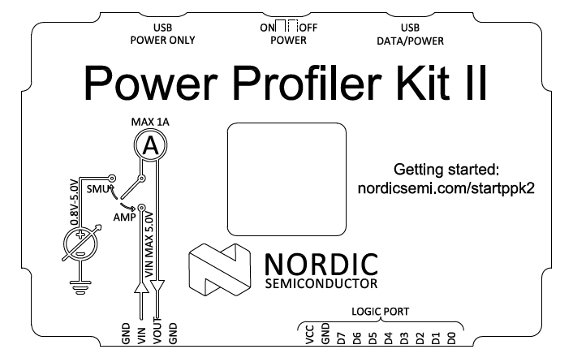
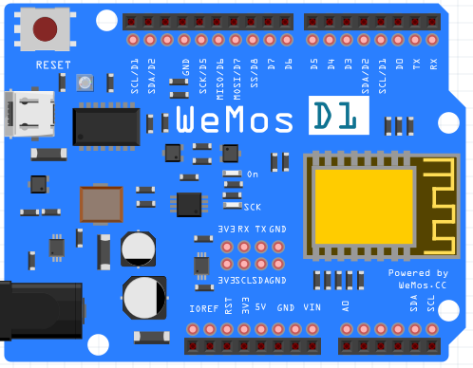
PPK2: Source meter mode
micro USB cable
Here: PPK2 acts as a power supply
Connect
Select Source Meter
Set supply voltage to 5000 mV and set sampling rate
Select “Start”
Switch “Enable power output”
When done select “Stop”
Selecting an area displays average (max.) current draw
Data can be saved:
  .csv
  .ppk2 (can be opened offline using PPK2 tool)
PPK2 | WeMoS
GND | GND
VOUT | VIN

Slide 13
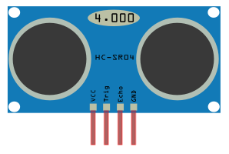
PPK2: Ampere meter mode
micro USB cable
Here: PPK2 is put between the external power source and the device that is being measured
  Ampere meter mode is useful for power profiling a sensor or actuator
Connect
Select Ampere Meter
Select “Start”
Switch “Enable power output”
When done select “Stop”
PPK2 | WeMoS | Sensor or Actuator
GND | GND
 | GND | GND
VIN | 5V
VOUT |  | VCC
to GPIO pins
of ESP8266
micro
USB cable
Voltage at VIN of PPK2 must not exceed 5V !

Slide 14
Continue with workshop handout

