Slide 1
IP-based IoT Network Architecture:
6LoWPAN and RPL
Professor Jorg Liebeherr

Slide 2
IoT protocol stack
Application
Messaging
Protocols
MQTT
COAP
AMQP
HTTP
Transport
Layer
UDP
TCP
IPv4
IPv6
Zigbee
Network
Layer
TCP/IP protocol
stack
6LoWPAN
LoRaWAN
MAC and PHY
Layer
WiFi
Bluetooth / BLE
IEEE 802.15.4
LoRa

Slide 3
6LowPAN

Slide 4
6LoWPAN
IPv6-based Low-power Wireless Personal Area Network (6LoWPAN)
IETF (Internet Engineering Task Force) standard to enable IPv6 over low-power low-rate wireless networks on simple embedded devices
Started in 2005.
Published RFCs: RFC4944, RFC6282, RFC6775
Originally designed to run over IEEE 802.15.4
There is also an RFC for IPv6 over BLE
→ RFC 7668

Slide 5
6LoWPAN architecture: 3 LoWPAN types
H
Host
Router inside LoWPAN
Edge Router
Internet Router
Internet
R
H
R
R
R
R
R
R
R
R
H
H
H
H
H
H
H
H
H
Simple LoWPAN
Extended LoWPAN
Ad-Hoc LoWPAN
H

Slide 6
6LoWPAN protocol stack
Classic TCP/IP stack
6LoWPAN stack
Application layer
HTTP
HTTP
Transport layer
UDP
TCP
UDP
Not limited to UDP, but UDP is preferred
Network layer
IP
IPv6
6LoWPAN
6LoWPAN is an adaptation layer
not limited to 802.15.4
Data link layer
WiFi MAC
802.15.4 MAC
Physical layer
WiFi PHY
802.15.4 PHY
6

Slide 7
Challenges of running IPv6 over IEEE 802.15.4
Size of IPv6 addresses and headers
  IPv6 address is 16 bytes
  IPv6 header is min. 40 bytes
  → Header compression
Packet size
  Smallest IPv6 MTU is 1280 bytes
  Largest MAC frame in 802.15.4 is 127 bytes
  Fragmentation and reassembly
Routing
  Routing in IPv6 requires multiple header compressions/fragmentations
  With routing in 802.15.4, entire LoWPAN appears as a single subnet
  Support two routing modes

Slide 8
Header compression
6LoWPAN header compression is stateless
  based “shared state within contexts”
Omit common fields of IPv6 addresses in same LoWPAN
  Version: omitted, assumed to be 6
  Traffic class, flow label: omitted, assumed to be 0
  Payload length: omitted, inferred from 802.15.4 header
  Hop limit: 2 bits, mapped to fixed value
  Next header field: only 2 bits, limited to UDP, ICMP, TCP
  Source and destination address:
    Prefix length of IPv6 addresses are known through context sharing
    Interface ID of IPv6 addresses are constructed from MAC address
    (EUI address) or constructed from 16-bit 802.15.4 address
  UDP port number: only 4 bits (limited to range 61616-61631)
✘
✘
✘
✘

Slide 9
Header Concatenation
6LoWPAN concatenates headers (dispatch = header type)
  Header compression header
  Fragmentation header
  Mesh header
  Broadcast header
Dispatch Type 1
Header 1
Dispatch Type N
Header N
1 byte
1 byte
IEEE 802.15.4 header
IPv6 header
compression
IPv6 payload
IEEE 802.15.4 header
Fragment header
IPv6 header
compression
IPv6 payload
IEEE 802.15.4 header
Mesh addressing
header
Fragment header
IPv6 header
compression
IPv6 payload

Slide 10
IPv6 header compression
Different types of compression are used depending on context
Destination in same LoWPAN → IPv6 header is compressed to 2 bytes
Destination is outside LoWPAN and prefix of external network is known:
  → IPv6 header is compressed to 12 bytes
Destination is outside LoWPAN and prefix of external network is not known:
  → IPv6 header is compressed to 20 bytes
Notes:
CID = context identifier extension (1bit)
RFC6282:
0: No additional 8-bit Context Identifier Extension is used. If context-based compression is specified in either Source Address Compression (SAC) or Destination Address Compression (DAC), context 0 is used.
1: An additional 8-bit Context Identifier Extension field immediately follows the Destination Address Mode (DAM) field.

Slide 11
Routing
Two types of routing: mesh-under and route-over
Source
Destination
Mesh-under (Layer 2) routing
Uses link layer addresses
Mesh-under network appears as
one subnet
Reassembly of fragments at destination
Route-over (Layer 3) routing
Uses IPv6 addresses
Uses RPL (“ripple”) routing protocol
Reassembly of fragments is done at
every hop
Application layer
Application layer
Transport layer
Transport layer
Network layer
Network layer
Data link layer
Data link layer
Data link layer
Data link layer
Physical layer
Physical layer
Physical layer
Physical layer
Source
Destination
Application layer
Application layer
Transport layer
Transport layer
Network layer
Network layer
Network layer
Network layer
Data link layer
Data link layer
Data link layer
Data link layer
Physical layer
Physical layer
Physical layer
Physical layer

Slide 12
RPL

Slide 13
RPL: Routing protocol for 6LoWPAN
Routing Protocol for Low-Power and Lossy Networks (RPL)
from 2011 (RFC 6550)
Proactive routing protocol based on distance vector routing
Supports unicast, multicast, and incast (many-to-one)

Slide 14
Why another routing protocol?
Classic routing protocols
(OSPF, IS-IS, RIP)
Assume stable network
Fast convergence is important
Low bit error rate
Needs of 6LoWPAN routing
Energy consumption very important
Dynamic topologies:
  Link failures
  Node failures
  Node mobility
Large-scale
Self-organizing
Multicast and anycast
Consideration of constraints:
  Energy
  Power
  Memory
Security
Ad-hoc routing protocols
(AODV, DSR, DSDV)
Often on-demand
Assumes similarity of routers
  → No consideration of constraints

Slide 15
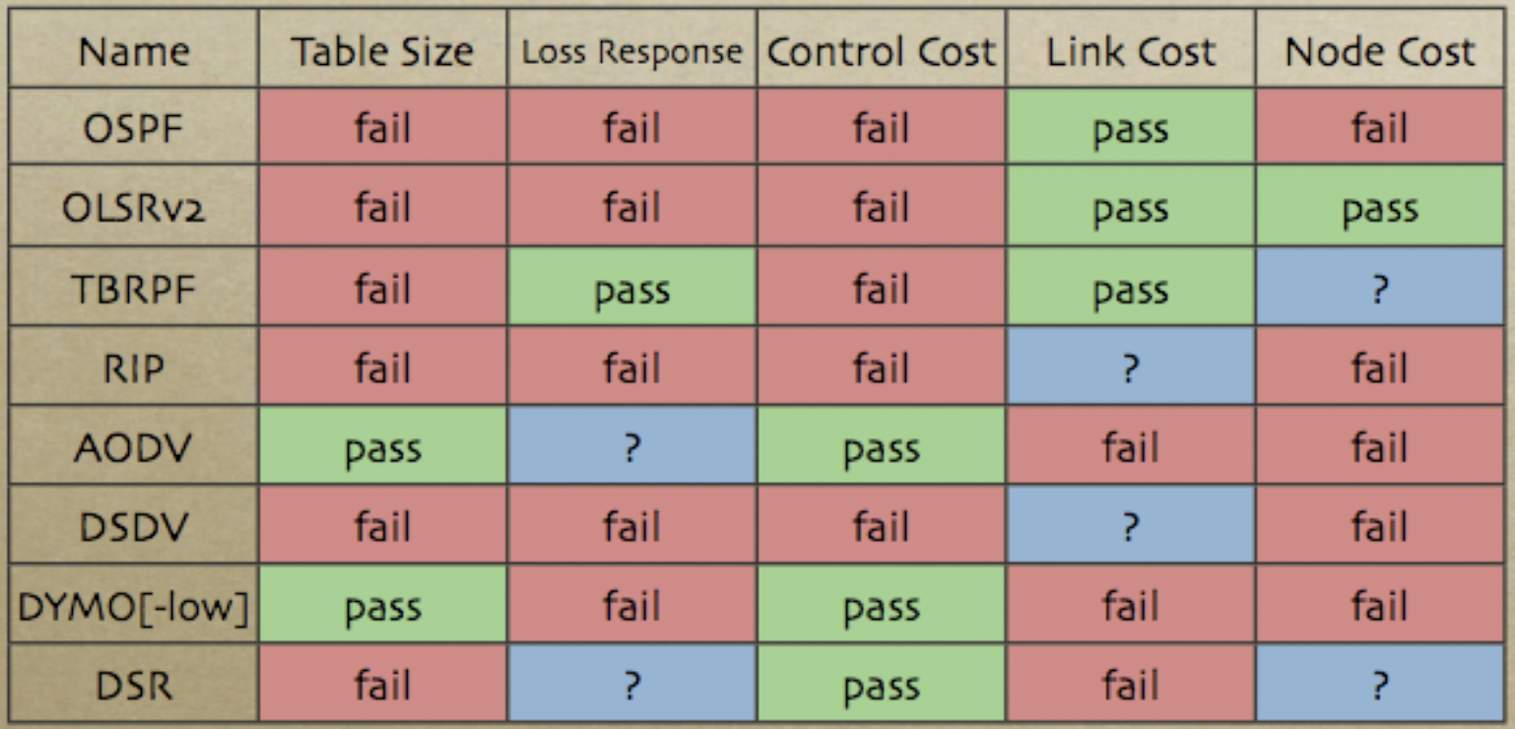
Slide from IETF-72 (2008)

Slide 16
Destination-oriented directed acyclic graph (DODAG)
RPL builds acyclic graphs towards a root node (edge router)
  It is a proactive (not: on-demand) routing protocol
  Why not a tree? DAG has redundancy!
  In extended LoWPAN, one DODAG is built for each edge router
R
R
R
R
R
R
R

Slide 17
Building the DODAG topology
Each node has a rank
  Rank can be hop count from root, but can also account for objectives such as shortest path, avoiding low power nodes, etc.
  Rank creation starts at the root and propagates downstream
  Nodes select parent node(s) based on rank (smallest rank is preferred)
  Rank of nodes must decrease toward the root
    This avoids loops
Rank: 0
Rank: 1
Rank: 3
R
R
R
Rank: 1
R
Rank: 6
R
Rank: 4
Rank: 3
R
R
Rank: 8

Slide 18
RPL: Storing and non-storing operation
RPL can operate in two modes: storing and non-storing
  Storing: each node maintains a routing entry for all destinations in the DODAG
  Non-storing: only the root maintains routing information and source routing is
  used for downstream routing
Storing mode:
R1 and R2 have next hop information for destination R3
Non-storing mode:
R1 and R2 forward data upstream to root
Root uses source routing to forward packet to destination R3
R2
R2
R1
R3
R1
R3

Slide 19
Trickle algorithm
Routing updates are sent using the trickle algorithm
  Trickle algorithm was originally designed for updating code in WSNs
  Used in RPL for controlling volume of routing traffic
  RFC 6206
Objective: Density-aware resolution of inconsistency
  Node’s information is inconsistent with neighbors:
    Increase frequency of communication to resolve inconsistency
  Node’s information is consistent with neighbors:
    Slow communication exponentially

Slide 20
Trickle algorithm
Configuration parameters
  I_{min} – minimum interval between transmissions
  I_{max} – maximum interval between transmissions
  K – redundancy constant
Variables
  I – size of the current interval
  t – timeout value with t ∈ [I/2,I]
  c – counter

Slide 21
Trickle algorithm
Initialization
  I = random (I_{min},I_{max})
  Start of interval
  c = 0
  t = random (I/2,I)
Upon receiving update:
update “consistent” → c++
update “inconsistent” → if I > I_{min} then I = I_{min} ; then start new interval
After t time units: transmit update only if c < K
End of interval: I = min (2I,I_{max}) and start new interval

Slide 22
Use of Trickle algorithm in RPL
Example of DIO message:
ICMPv6 Type: 155 (for RPL Control Messages)
RPLInstanceID: 1
VersionNumber: 10
Rank: 256 (distance from the root)
MOP: Non-storing mode
DAGID: 123456789abcd9abcdef01
Routing messages are called DIO
(DODAG Information Object) messages
  Nodes send DIO messages
  DIO is used by a nodes to select
  DODAG parent candidates
Consistency is checked with regards to the rank of nodes
Inconsistencies:
  Receiving a DIO message that triggers a change to the parent candidates
  Receiving a data message that is inconsistent with ranking of nodes

Slide 23
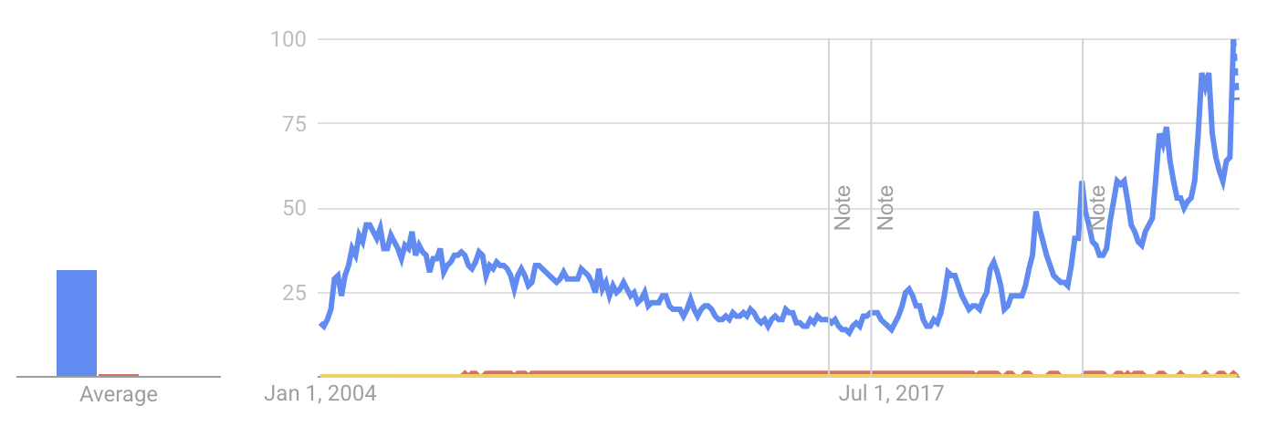
Adoption of 6LoWPAN/RPL vs. Zigbee
Market share: 2014 2019 (prediction in 2014)
Quantitative: No (current) quantitative comparison exists
Qualitatively:
  6LoWPAN has (significantly) lower adoption than Zigbee
  6LoWPAN is gaining traction through IP based IoT deployments (e.g., Threads)
Source: https://www.eetimes.com/zigbee-opens-umbrella-3-0-spec/#
Google Trends (2025):
Zigbee
6LoWPAN
RPL

