Slide 1
Kubernetes
An overview
Jorg Liebeherr

Slide 2
Container orchestration
Increased used of containerized applications (e.g., Docker) creates a need for managing groups of containers running on different servers
⟹ Container orchestration
Examples of orchestration:
  Scalability: Distributing workloads by running the same container
  on multiple servers
  Deployment: Installing containers in a computer cluster
  Management: Software updates of individual containers
  Load balancing: Equalizing load levels across a cluster
  Microservices: Applications are organized as a collection of
  small independent services (running in containers)
  Resilience: Restarting or replacing failed containers

Slide 3

Kubernetes
Kubernetes (K8s) is an orchestration system
for automating software deployment, scaling,
and management
  Released by Google in 2014 as open-source
  Since 2018, K8s is run by nonprofit
  Cloud Native Computing Foundation (CNCF)
  Currently the de-facto standard for container orchestration
  Works with most container systems
  Many commercial and open-source distributions, e.g., k3s
Kubernetes and Docker:
  Kubernetes does not directly work with Docker …
  … but Kubernetes can pull and run Docker images
  via the underlying containerd runtime
Some trivia:
Kubernetes originates from the Greek word for “pilot” or “helmsman”
K8s, since “S” is the 8th letter after “K”

Slide 4
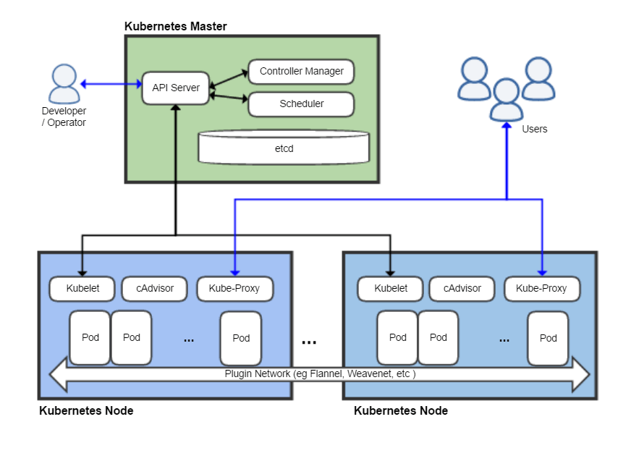
Kubernetes architecture
Source: Wikipedia

Slide 5
Kubernetes architecture
A Kubernetes Cluster consists of
a control plane (“Master”)
and worker nodes (“Kubernetes nodes”, “workers”, “nodes”, “agents”)
Control plane manages the cluster
Workers run the applications
Source: Wikipedia

Slide 6
Kubernetes architecture
Control plane:
Operator uses kubectl commands to control the cluster
API server:
  Handles kubectl commands
  Interfaces to Kubelets
Controller Manager:
  Controls state of cluster
Scheduler
  Assigns pods to nodes
Etcd
  Stores cluster data
Source: Wikipedia

Slide 7
Kubernetes architecture
Pod
Unit of deployment in Kubernetes
A pod holds one or more containers
Source: Wikipedia

Slide 8
Kubernetes architecture
Worker
Runs one or more pods
Kubelet:
  Manages pods
  Receives instructions from API server of Master
cAdvisor:
  Collects data on resource usage
KubeProxy
  Manages networking
Source: Wikipedia

Slide 9
Networking in Kubernetes clusters
Kubernetes makes extensive use of private IP addresses
… for communication between nodes:
  Each worker and master in a cluster has a private IP address
  Assigned to a server or VM that makes up a worker node
  Used by kubelets to talk with API server and other kubelets
… for pod networking:
  Each pod has its own private IP address
  Used by pods of a cluster to communicate with each other
  This creates a flat network

Slide 10
How Kubernetes works?
Developer creates a “Deployment”
Kubernetes schedules pods on Worker Nodes
Pods communicate using Services
If a Pod fails, Kubernetes restarts it automatically
Scaling happens automatically based on demand (automatically adds/removes pods)

Slide 11
After k3s and helm installation
$ kubectl get pods --all-namespaces
NAMESPACE NAME READY STATUS RESTARTS AGE
default my-helloworld-8d5687f77-5pndl 1/1 Running 0 14s
kube-system coredns-ccb96694c-tgxts 1/1 Running 0 2m47s
kube-system helm-install-traefik-bx2hf 0/1 Completed 1 2m47s
kube-system helm-install-traefik-crd-b5trw 0/1 Completed 0 2m47s
kube-system local-path-provisioner-5cf85fd84d-xplb7 1/1 Running 0 2m47s
kube-system metrics-server-5985cbc9d7-6grtt 1/1 Running 0 2m47s
kube-system svclb-traefik-eb473f06-cg9zf 2/2 Running 0 2m6s
kube-system traefik-5d45fc8cc9-6nljv 1/1 Running 0 2m6s
List of all pods
Status of pods:
Running
Pending
Succeeded
Failed
Unknown

Slide 12
Helm: Packet manager for Kubernetes
Kubernetes configurations can be complex, involving many (YAML) files
Helm simplifies the configuration of complex applications through “Helm charts”
Helm chart = collection of files that describe Kubernetes application
With Helm, applications can be deployed with a single command
An analogy:
A Dockerfile describes how to set up a container image
A Helm chart describes how to set up Kubernetes pods

Slide 13
How does Helm work?
Install Helm
Helm CLI tool is installed and configured to communicate with a Kubernetes cluster
2. Search for Charts
Charts are stored in public repositories (RabitMQ, Elasticsearch, etc.)
3. Deploy a Chart (Install a Release)
Deploy an application in a Kubernetes cluster with helm install, e.g.,
helm install rabbitmq bitnami/rabbitmq ...
Manage the Release
Helm supports updates and rollbacks (helm upgrade, helm rollback)

Slide 14
Chart.yaml for RabbitMQ
annotations:
category: Infrastructure
licenses: Apache-2.0
images: |
- name: os-shell
image: docker.io/bitnami/os-shell:12-debian-12-r39
- name: rabbitmq
image: docker.io/bitnami/rabbitmq:4.0.6-debian-12-r3
apiVersion: v2
appVersion: 4.0.6
dependencies:
- name: common
repository: oci://registry-1.docker.io/bitnamicharts
tags:
- bitnami-common
version: 2.x.x
description: RabbitMQ is an open source general-purpose message broker that is …..
home: https://bitnami.com
icon: https://dyltqmyl993wv.cloudfront.net/assets/stacks/rabbitmq/img/rabbitmq-stack-220x234.png
keywords:
- rabbitmq
- message queue
- AMQP
maintainers:
- name: Broadcom, Inc. All Rights Reserved.
url: https://github.com/bitnami/charts
name: rabbitmq
sources:
- https://github.com/bitnami/charts/tree/main/bitnami/rabbitmq
version: 15.3.2

Slide 15
Kubernetes beyond the NoTE Labs
Kubernetes is intended for clusters with many servers
NoTE labs run Control plane and workers on the same VM
To experience features of Kubernetes on a distributed system, you may want to install minikube
  With minikube, you can run a Kubernetes cluster on your laptop
  Recommended resources: min. 2 CPUs, min. 2GB available RAM, 20 GB disk space
  Go to: https://minikube.sigs.k8s.io/docs/start/?arch=%2Fmacos%2Fx86-64%2Fstable%2Fbinary+download

