Slide 1
ECE 461
Internetworking
Fall 2020
All lectures will start 10 minutes past the hours (16:10)
Instructor will be online and available for questions at 16:00 (quick questions only please) and for any question after 17:00.
Professor Jorg Liebeherr

Slide 2
Welcome !

Slide 3
Objective of today’s lecture
Go over the syllabus (available on Quercus)
Overview of the virtual labs

Slide 4
Physical lab setup
The labs are the main experience of this course
Students complete labs on their own on an equipment rack:
  4 routers
  4 PCs
  4 Ethernet switches
We have virtualized the labs:
  Lab equipment is running
  on your laptop

Slide 5
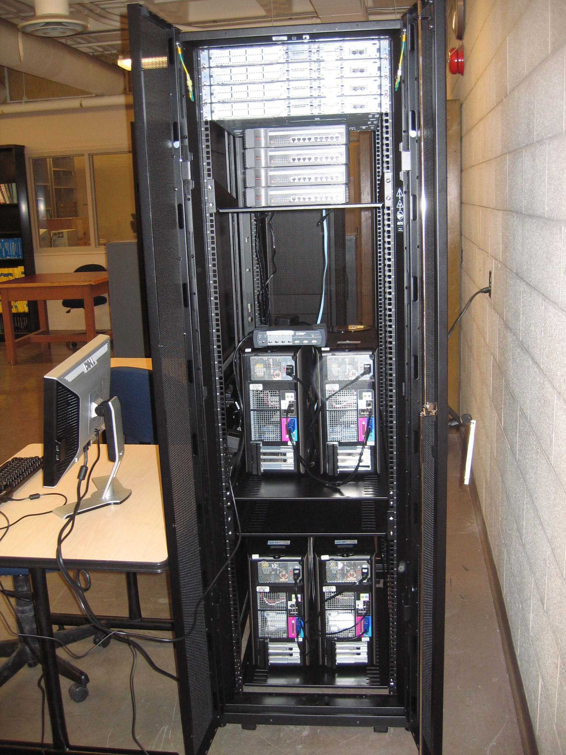
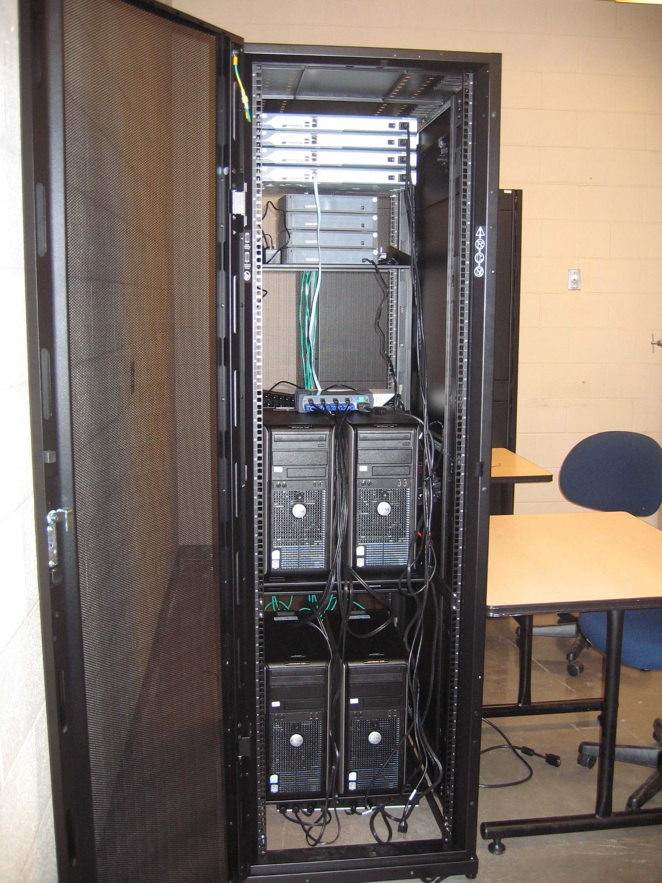
Equipment rack of physical lab
Back
Front

Slide 6
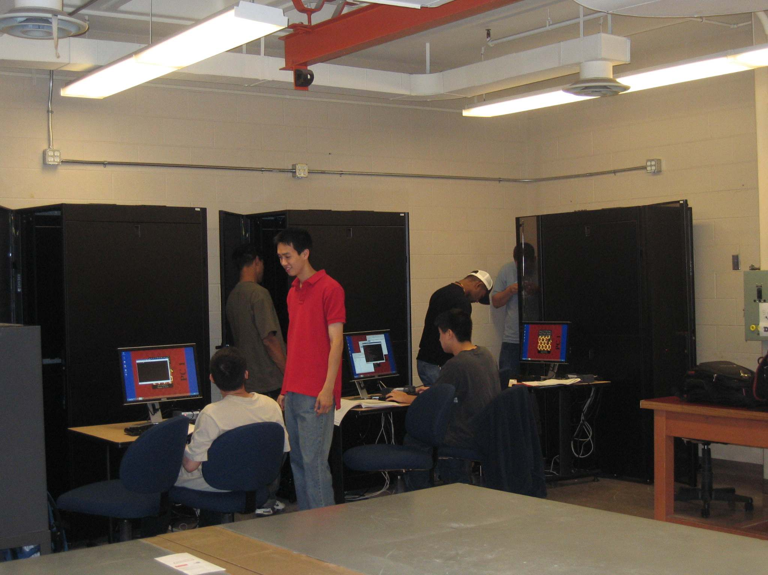
Working on physical labs

Slide 7
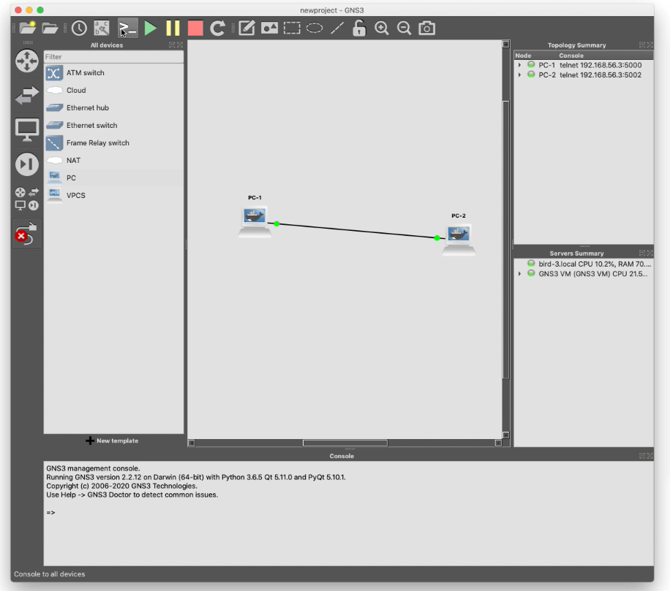

Virtual labs
Virtual labs give the same lab experiments as physical labs
Based on GNS3, a widely used network emulator
Demo: https://play.library.utoronto.ca/ad0c42150dc6255a1e7daf7d4bebed43

Slide 8
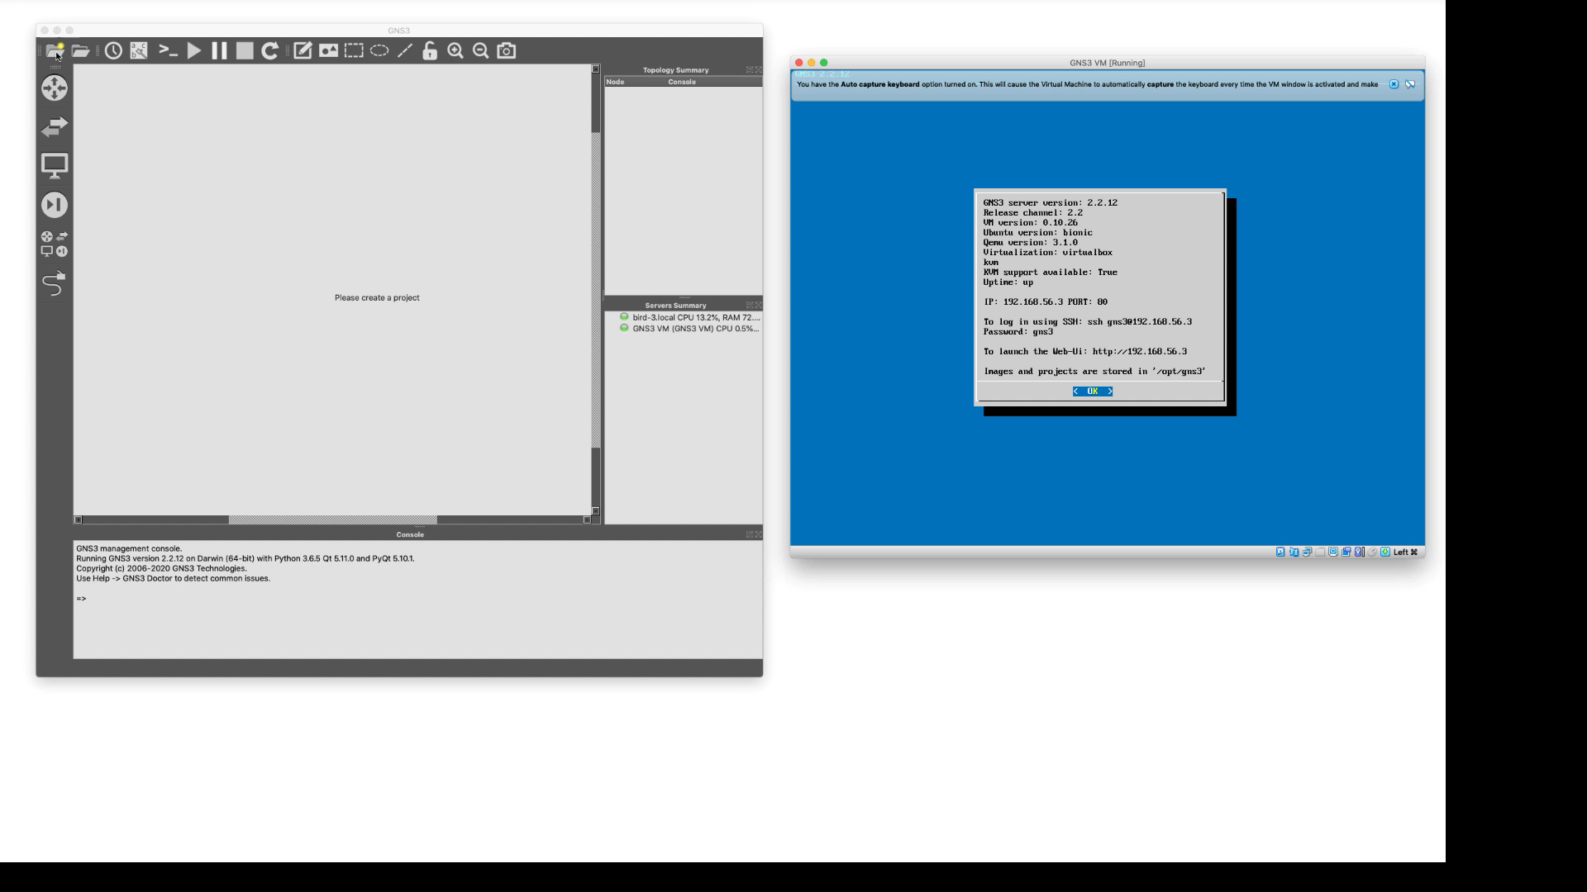

Slide 9
Install software for virtual labs
You need to install software on your desktop/computer to run the labs
  3 components: Virtualbox, GNS3, GNS3 VM
  All components are free software
  Works on Windows and Mac
Installation is described in Lab 0
  There are videos demonstrating the steps of the installation
Start early with Lab 0:
  Work in teams
  Post questions on Piazza

