Slide 1
IP Addresses
ECE 461
Professor Jorg Liebeherr

Slide 2
Takeaways
There are two versions of IP: IPv4 and IPv6
An IP address …
  … identifies a network interface
  … contains information to locate the interface
  … has 2 parts: network prefix and interface identifier
Dotted decimal notation of IPv4 addresses
CIDR notation of IP addresses
Network prefix + prefix length describe an address block

Slide 3
Internet Protocol: Which version?
There are currently two versions of the Internet Protocol in use today:
IPv4 (IP Version 4)
    Specified in 1980/81
    Four byte addresses
    Universally deployed
    Problem: Address space almost exhausted
IPv6 (IP Version 6)
    Specification from 1998 (RFC 2460)
    16-byte addresses
    Several differences to IPv4, but no fundamental changes
    Problem: Not widely used (yet?)

Slide 4
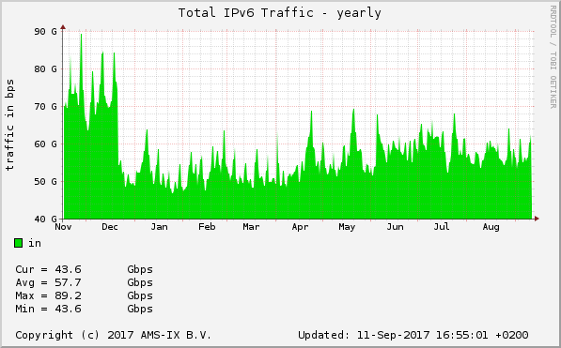
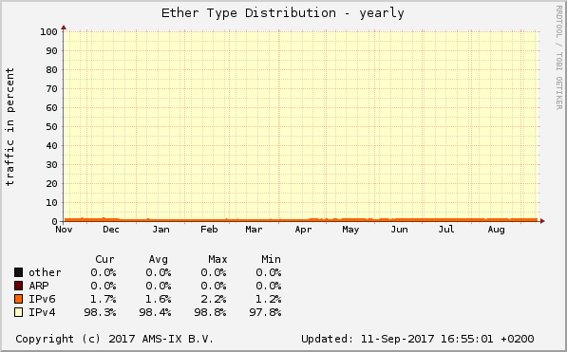
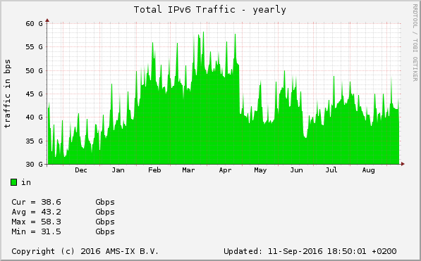
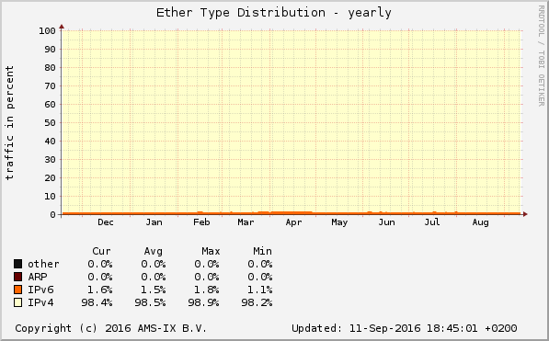
Slow adoption of IPv6
IPv6 is available since >20 years and is supported on almost all devices
But IPv6 is still a small fraction of the total Internet traffic
Measurements at an Internet Exchange Point in Amsterdam:
IPv6 traffic as a percentage
IPv6 traffic (total volume)
Notes:
https://stats.ams-ix.net/sflow/index.html?type=;interval=yearly;counter=bps

Slide 5
Terminology 1
A communication network has two types of devices: end systems and switches
End systems are senders and receivers of data
Switches relay data
Internet terminology:
  “Host” = end system
  “Router” = “Gateway” = switch
Convention:
“Device” = host or router
End system
Communication
Network
Switch

Slide 6
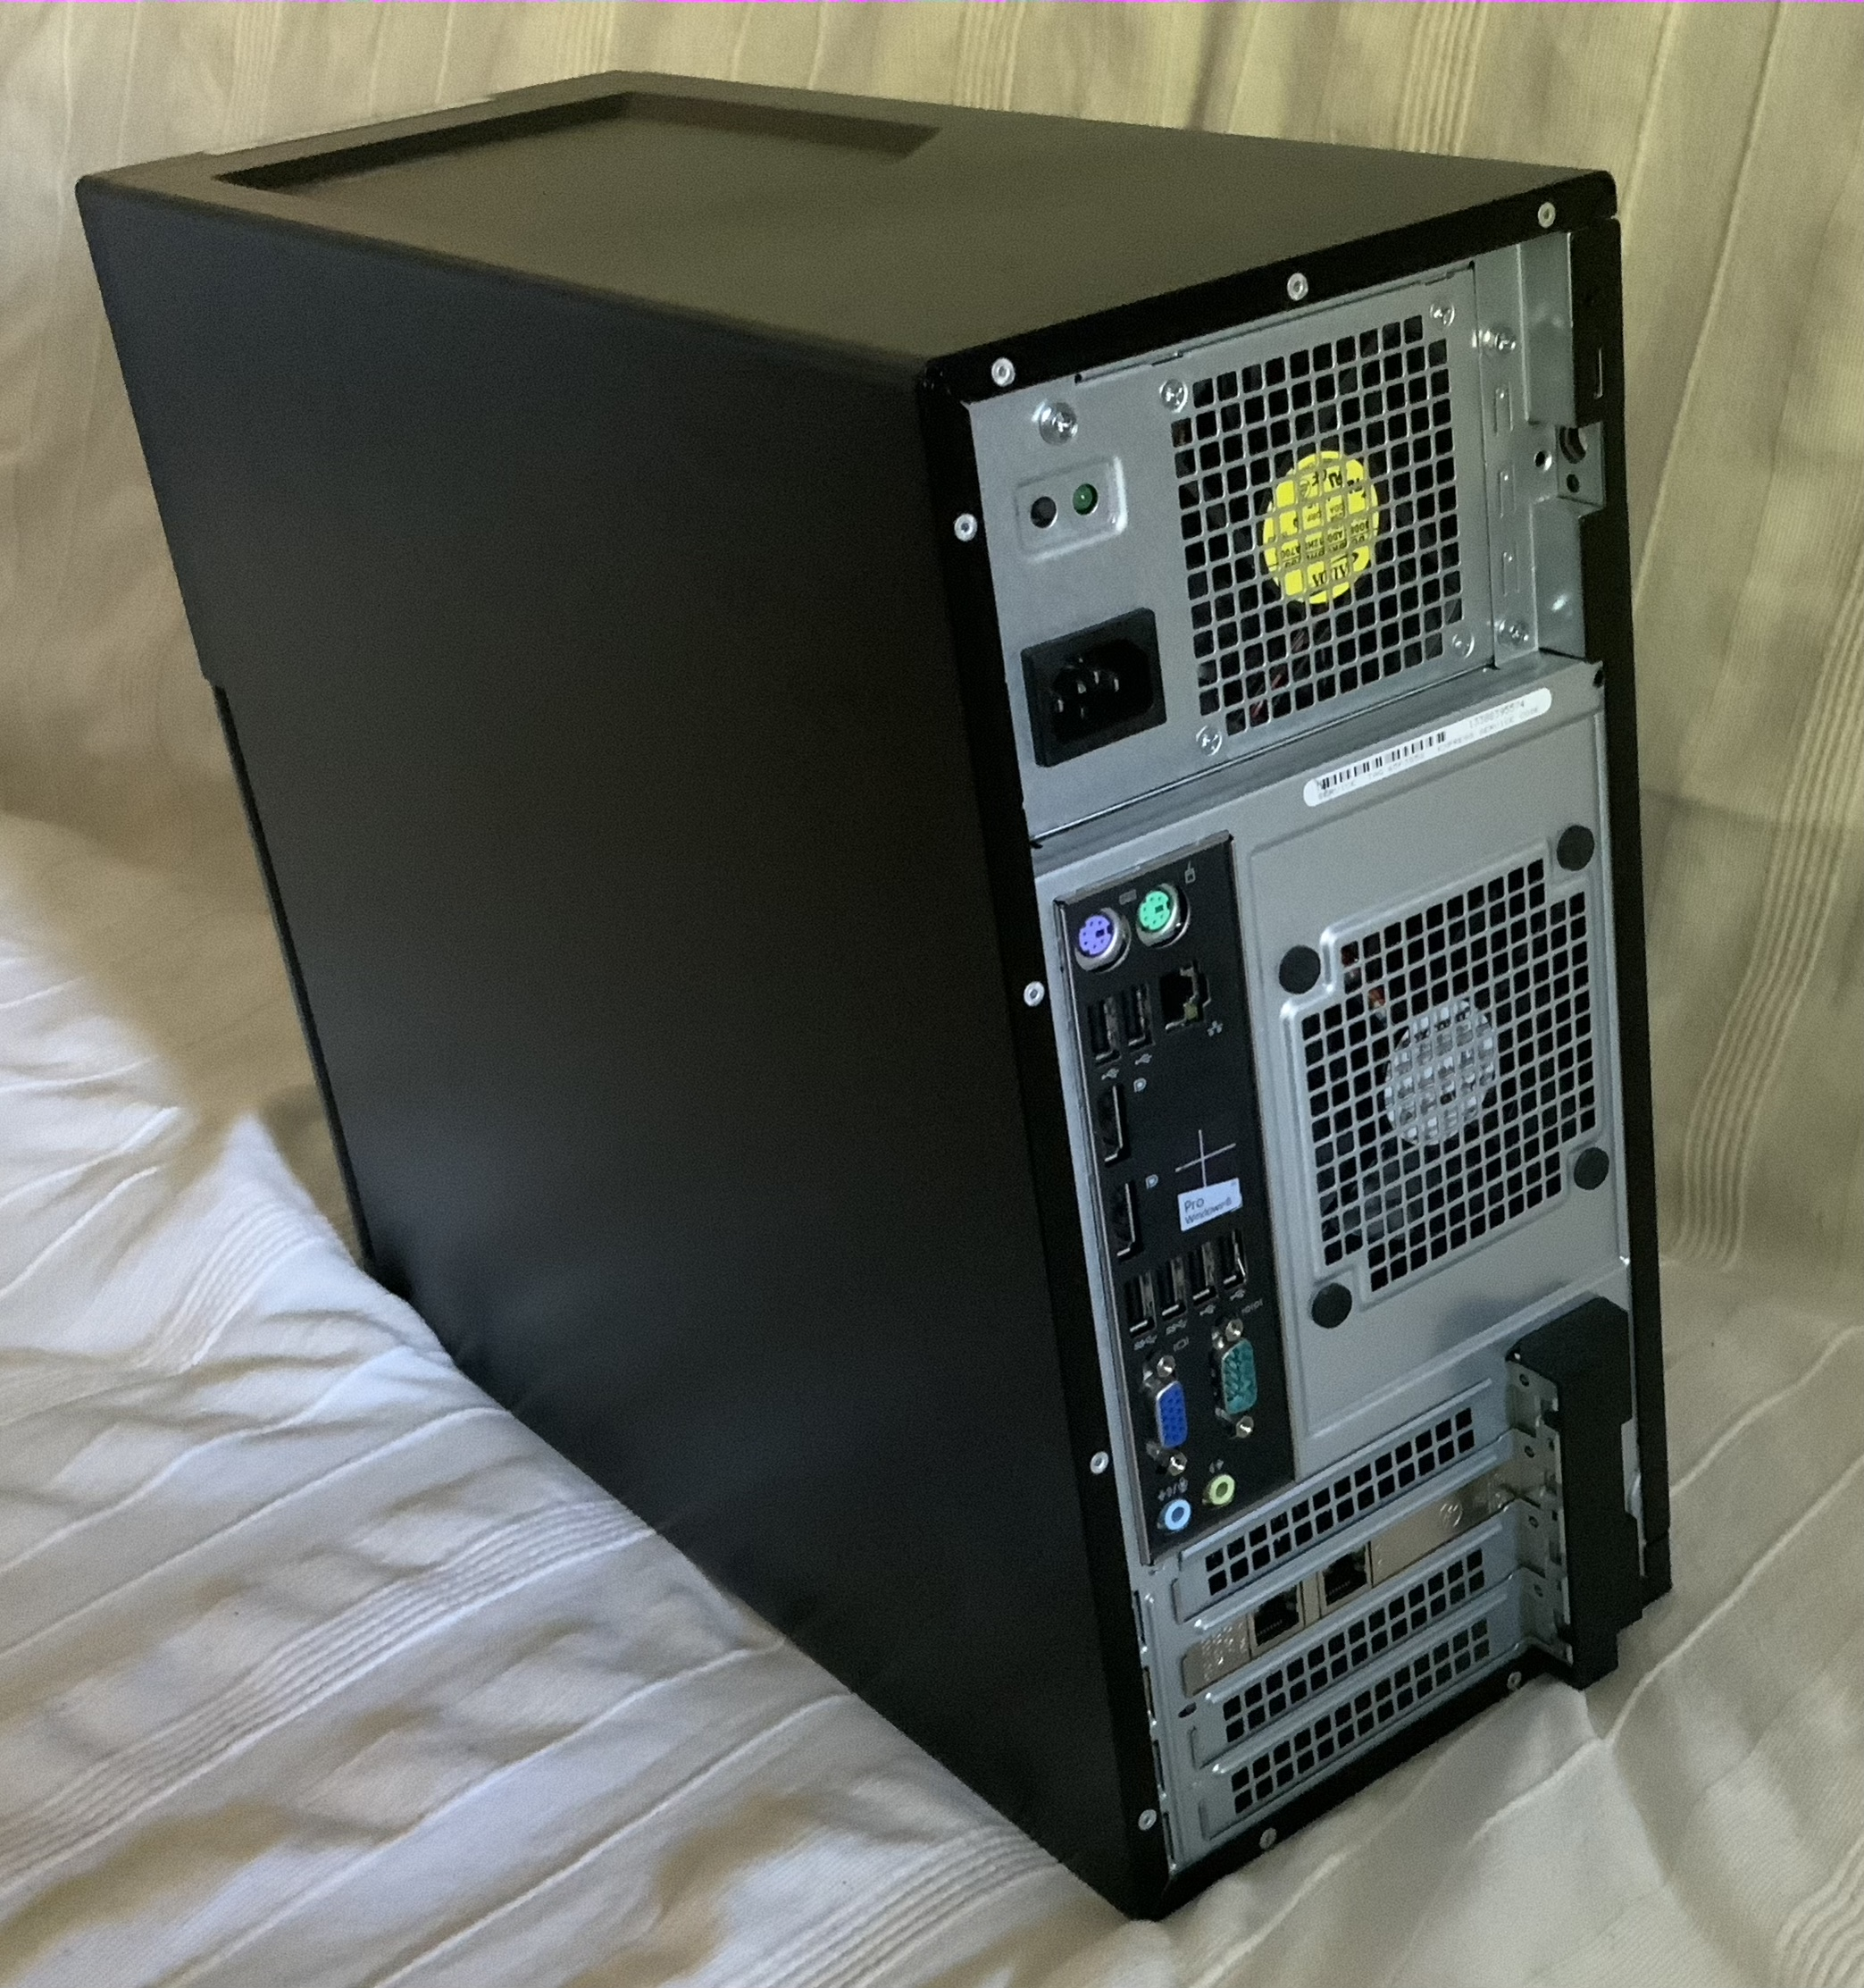
Terminology 2
Network interface is an attachment point to a network
It is convenient to think about a network interface as a port where a network cable is connected
But:
  There are wireless network interfaces, e.g., Wifi
  Network interfaces can be logical
Network interfaces
PC
Convention: “network interface” = “interface”

Slide 7
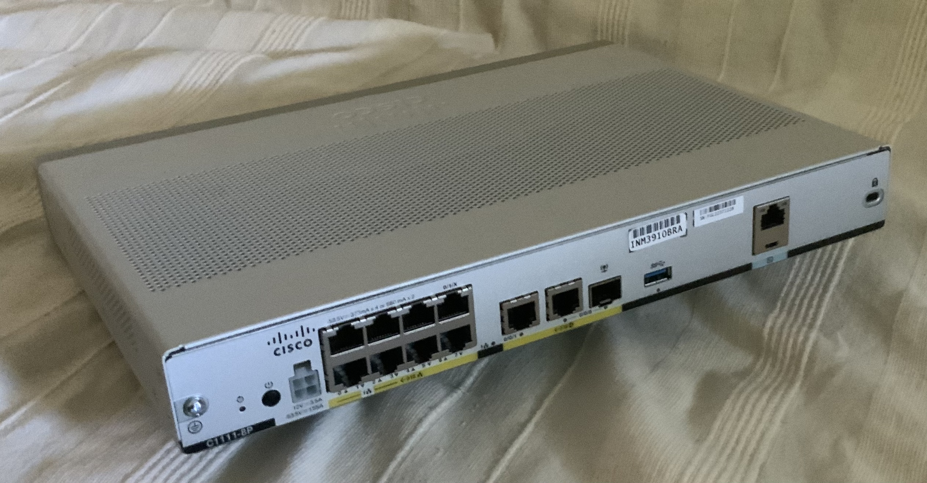
Terminology 2
Network interface is an attachment point to a network
It is convenient to think about a network interface as a port where a network cable is connected
But:
  There are wireless network interfaces, e.g., Wifi
  Network interfaces can be logical
Network interfaces
Network interfaces
Cisco ISR 1111
Convention: “network interface” = “interface”

Slide 8
IPv4 addresses
An IPv4 address is an address of the Internet Protocol Version 4.
(When the version is understood from the context we only say “IP address”)
An IPv4 address is 32 bits (4 bytes) long
An IP address identifies a network interface
The IP address is used by hosts and routers for delivery of IP datagrams

Slide 9
IPv4 datagrams
Each IPv4 datagram contains two IPv4 addresses:
source address, destination address

Slide 10
Dotted decimal notation
IPv4 addresses are written using dotted decimal notation:
      Each byte is written as a decimal number in the range [0..255], separated by periods (`dots’).
Example:
10000000
01100100
00001011
00111100
1st Byte
2nd Byte
3rd Byte
4th Byte
= 128
= 100
= 11
= 60
128.100.11.60

Slide 11
Structure of an IPv4 address
IP address consists of a network prefix and an interface identifier:
      Network prefix determines an IP network (subnet)
      Interface identifier determines a network interface
The delivery of a packet proceeds in 2 steps:
      Use network prefix to deliver packet to the right subnet
      Once the subnet is found, use the interface identifier to deliver packet to the right interface
Issue: How to determine the length of the network prefix?
network prefix
interface identifier

Slide 12
Length of network prefix
The prefix length must be provided with an IP address
There are two conventions for indicating the prefix length:
    Add the prefix length measured in bits (CIDR notation, prefix notation, slash notation)
    Provide a bitmask of the prefix length in dotted decimal notation (netmask, subnetmask)
32 bits
network prefix
interface identifier
Prefix length

Slide 13
Notation of IP address
Example: Suppose the prefix length is 16 bits
CIDR notation: 128.100.11.60/16
Netmask notation: 128.100.11.60, 255.255.0.0

Slide 14
Special IP addresses
IP address of a subnet
      Interface identifier set to all zeros
      128.100.0.0 is the IP address of the subnet for 128.100.11.60/16
Broadcast address
      Interface identifier is set to all ones, e.g., 128.100.255.255
      Broadcast goes to all interfaces on the subnet
      The address 255.255.255.255 is a broadcast on the local network
Convention for default gateway (but not a reserved address):
      Default gateway has interface identifier set to ‘1’, e.g., 128.100.0.1

Slide 15
Network prefix and address block
The IP address of a subnet has the interface identifier set to 0:
      128.100.0.0
A subnet IP address with prefix length designates an address block:
  128.100.0.0/16 or 128.100/16
An address block is a set of contiguous network addresses:
      128.100.0.0/16 ➔ 128.100.0.0–128.100.255.255
      Address block is also called CIDR block or network prefix (!) or just prefix
      It provides the range of addresses allowed on a subnet
      The shorter the prefix, the larger the address block

Slide 16
Prefix length and address block
To set up a network of a given size, one needs to acquire a address block with a sufficient number of addresses
Prefix length # of IP Addresses
/31 2
/30 4
… …
/24 256
/23 512
… …
/16 65,536
… …
/8 16,777,216
… …
/2 1,073,741,824
/1 2,147,483,648
/0 4,294,967,296

Slide 17
Reserved network prefixes (subset)
Loopback interfaces: 127.0.0.0/8
    Most systems use 127.0.0.1 as loopback address
    A host can send a packet to itself by sending it to address 127.0.0.1
Link Local Addresses: 169.254.0.0/16
    Also referred to as auto-configuration
    When a host cannot acquire an IP address, it selects a random address from the range (it tests whether the address is in use)
    Packets from this address are not forwarded to other subnets
Private networks: 10.0.0.0/8, 172.16.0.0/12, 192.168.0.0/16, 100.64.0.0/10
    Private networks are subnets that are not part of the public Internet
    IP addresses need to be unique only within the same private network
      Devices on different private networks can re-use addresses
    When packets cross between private network and public Internet, IP addresses in header must be modified
Notes:
Complete list is at: https://en.wikipedia.org/wiki/Reserved_IP_addresses

