Slide 1
Administration of
Global IP Addresses
ECE 461
Professor Jorg Liebeherr

Slide 2
Takeaways
Understand the process of allocating IP address block

Slide 3
Some questions
Public IP addresses on the global Internet must be unique.
How is uniqueness ensured?
Customers usually get address blocks (network prefixes) from their Internet Service Provide (ISP).
Where does the ISP get its address block from?
The IPv4 address space is said to be exhausted (since 2011).
How come I can still get an IPv4 prefix from my ISP?

Slide 4
How does one get an address block?
IANA
RIR
LIR
(ISP)
allocates
allocates
assigns
assigns
End user
End user
Internet Assigned Number Authority (IANA) manages the global IP address space
IANA is a function
IANA allocates addresses to Regional Internet Registries (RIR)
  IANA allocates IPv4 addresses in /8 address blocks and IPv6 in /23 up to /12 blocks
  All available IPv4 /8 blocks have been allocated. The last one was assigned in 2011
Notes:
https://whois.arin.net
To get the networks of UofT at ARIN:
Enter “University of Toronto”.
Click on UNIVER-36
Click on “Related Networks”

Slide 5
How does one get an IPv4 address block?
IANA
RIR
NIR
LIR
(ISP)
LIR
(ISP)
allocates
allocates
allocates
assigns
assigns
assigns
End user
End user
End user
RIR allocates addresses to Local Internet Registries (LIR)
  LIRs are generally Internet Service Providers
  Block sizes are /20 or larger
End users obtain addresses from an RIR or LIR
A few countries have National Internet Registries (NIR), which are between the RIR and LIR levels

Slide 6
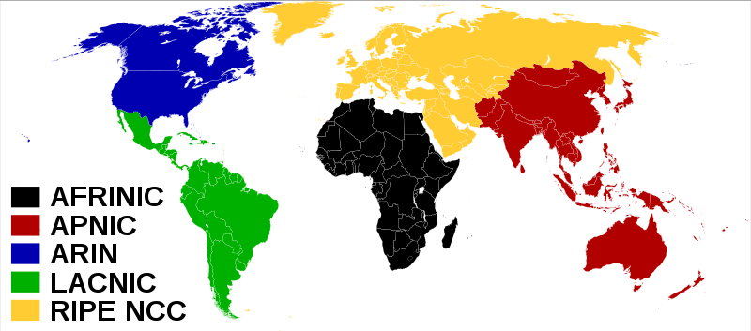
Regional Internet Registries
There are 5 Regional Internet Registries, each responsible for managing the address space of a large geographic area
Address blocks managed by the RIRs are listed at:
  http://www.iana.org/assignments/ipv4-address-space/ipv4-address-space.xml
  https://www.iana.org/assignments/ipv6-unicast-address-assignments/ipv6-unicast-address-assignments.xhtml

Slide 7
Available IPv4 addresses
RIRs are running
low on IPv4 addresses:
(one /8 address block ≈16.8 million IP addresses)
Status of remaining IPv4
addresses:
2012 | Addresses in RIR Pool (/8s) | Approximate number of Addresses
APNIC | 0.9138 | ≈ 15 million
RIPENCC | 1.1984 | ≈ 20 million
ARIN | 3.3656 | ≈ 56 million
LACNIC | 3.2246 | ≈ 54 million
AFRINIC | 4.1441 | ≈ 70 million
September 2016 | Addresses in RIR Pool (/8s) | Approximate number of Addresses
APNIC | 0.2681 | ≈ 4.5 million
RIPENCC | 0.4544 | ≈ 7.6 million
ARIN | 0.0004 | ≈ 6,700
LACNIC | 0.1148 | ≈ 1.9 million
AFRINIC | 0.4513 | ≈ 7.5 million
August 2020 | Addresses in RIR Pool (/8s) | Approximate number of Addresses
APNIC | 0.2043 | ≈ 3.4 million
RIPENCC | 0.0204 | ≈ 342,000
ARIN | 0.0002 | ≈ 3,300
LACNIC | 0.0429 | ≈ 719,000
AFRINIC | 0.1213 | ≈ 2 million
Source: http://www.potaroo.net/tools/ipv4/index.html

Slide 8
IPv4 address exhaustion
The vast majority of IPv4 addresses are used up
→ IPv4 address exhaustion
Adoption of IPv6 is driven by IPv4 exhaustion:
  Effectively, IPv4 exhaustion has occurred
  In the past, IPv4 exhaustion has come with dire warnings
  People have been creative with slowing down IPv4 exhaustion through policies and protocols
As IPv4 addresses become less available, the use of IPv6 will increase
      In the past, there was expectation that IPv6 will replace IPv4
      What has happened is that IPv4 and IPv6 coexist

Slide 9
Allocated global unicast addresses
 | Allocated IPv6 prefix
IANA | 2000::/3
RIR | Allocated IPv6 prefix
APNIC | 2400::/12
ARIN | 2600::/12
ARIN | 2800::/12
RIPE | 2A00::/12
AfriNIC | 2C00::/12
Note: Several additional smaller blocks (longer prefixes) have been assigned.

