Slide 1
IP Address Lookup
ECE 461
Professor Jorg Liebeherr

Slide 2
Takeaways
CIDR enables routing table lookup that is proportional to the size of the IP address
Trie data structure for efficient lookup in a routing table
Note: With classful addresses, all entries in the routing table must be searched for a matching entries. Then, the routing lookup is proportional to the size (=number of entries) in the routing table.

Slide 3
Modern router architecture
Output
scheduling
Routing
Table
Switch fabric
IP Forwarding
Routing
Table
IP Forwarding
Routing
Table
IP Forwarding

Slide 4
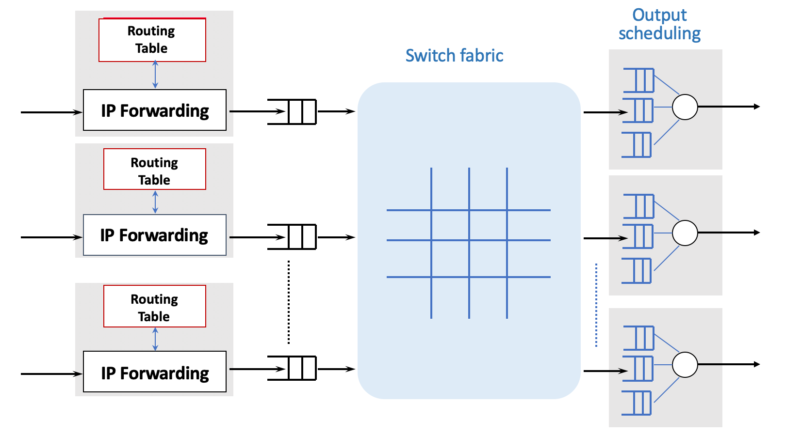
Modern router architecture

Slide 5
IPv4 routing table size
Source: Geoff Huston, APNIC, 2005

Slide 6
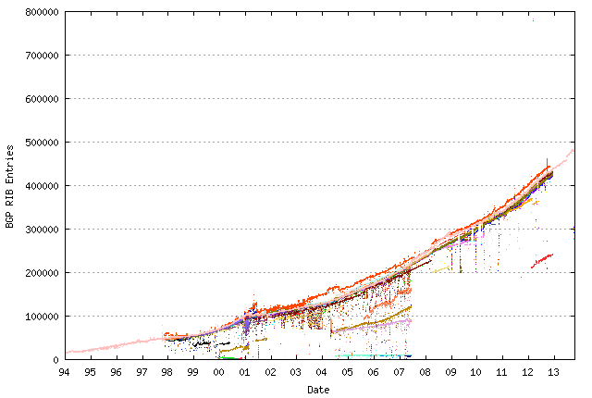
IPv4 routing table size
Source: bgp.potaroo.net, 2013

Slide 7
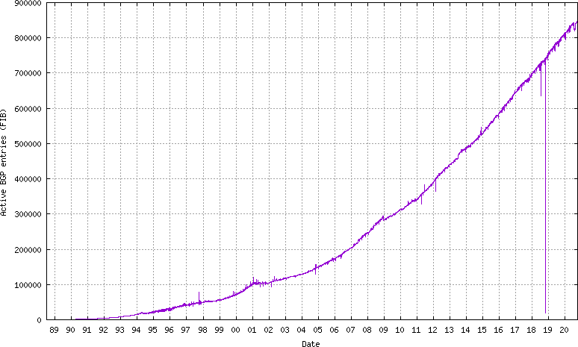
IPv4 routing table size
Source: bgp.potaroo.net, 2020

Slide 8
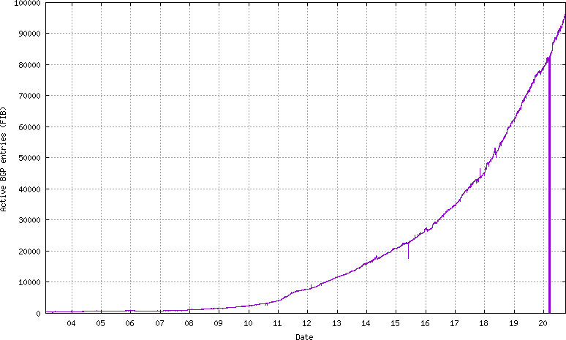
IPv6 routing table size
Source: bgp.potaroo.net, 2020

Slide 9
Routing table lookup: Longest prefix match
With CIDR, there can be multiple matches for a destination address in the routing table
Longest Prefix Match: Search for the routing table entry that has the longest match with the prefix of the destination IP address (=most specific route):
  Search for a match on all 32 bits
  Search for a match for 31 bits
  …..
  32. Search for a match on 0 bits
Needed: Data structures that support a fast longest prefix match lookup!
128.143.71.21
Destination | Next Hop
10.0.0.0/8 128.143.0.0/16 128.143.64.0/20 128.143.192.0/20 128.143.71.0/24 128.143.71.55/32 default | R1 R2 R3 R4 R4 R3
The longest prefix match for 128.143.71.21 is for 24 bits with entry 128.143.71.0/24
Datagram will be sent to R4

Slide 10
IP address lookup algorithms
The following algorithms are suitable for longest prefix match routing table lookups
  Binary search
  Hash table
  Tries
    Binary trie
    Path-compressed trie
    Disjoint-prefix binary
    Multibit trie

Slide 11
What is a trie?
A trie is a tree-based data structure for storing strings (dictionary):
  There is one node for each common prefix
  The strings are stored in extra leaf nodes
Tries can be used to store network prefixes
  Note: Prefixes are stored at internal nodes

Slide 12
Binary representation of routing tables
IPv4 routing table
IPv6 routing table
IPv4 CIDR prefix | binary
0.0.0.0/1 | 0*
64.0.0.0/5 | 01000*
96.0.0.0/3 | 011*
128.0.0.0/1 | 1*
128.0.0.0/3 | 100*
192.0.0.0/4 | 1100*
208.0.0.0/4 | 1101*
224.0.0.0/4 | 1110*
240.0.0.0/4 | 1111*
IPv6 CIDR prefix | binary
::/1 | 0*
4000::/5 | 01000*
6000::/3 | 011*
8000::/1 | 1*
8000::/3 | 100*
C000::/4 | 1100*
D000::/4 | 1101*
E000::/4 | 1110*
F000::/4 | 1111*

Slide 13
Binary trie
a | 0*
b | 01000*
c | 011*
d | 1*
e | 100*
f | 1100*
g | 1101*
h | 1110*
i | 1111*
Prefixes in the table
are marked (green)
Search:
  Traverse the tree according to destination address
  Most recently node with a match is the
  current longest prefix
  Search ends when a leaf node is reached

Slide 14
Binary trie (adding an entry)
a | 0*
b | 01000*
c | 011*
d | 1*
e | 100*
f | 1100*
g | 1101*
h | 1110*
i | 1111*
k | 1010*
Prefixes in the table
are marked (green)
Update:
  Search for the new entry
  Search ends when there is no match or a leaf node is reached
  If there is no branch to take, insert new node(s)

Slide 15
Compressed binary trie
Goal: Eliminate long sequences of 1-child nodes
Path compression → collapses 1-child branches
a | 0*
b | 01000*
c | 011*
d | 1*
e | 100*
f | 1100*
g | 1101*
h | 1110*
i | 1111*
Path compression
Requires to store additional information with nodes
→ bit number field is added to node
Bit string of prefixes must be explicitly stored at internal nodes
  Need to make comparisons when searching the tree

Slide 16
Compressed binary trie (lookup)
Search: “010110”
Root node: Inspect 1st bit and move left
“a” node:
  Check with prefix of a (0*) and find a match
  Inspect 3rd bit and move left
“b” node:
  Check with prefix of b (01000*) and determine that there is no match
  Search stops. Longest prefix match is with a

Slide 17
Disjoint-prefix binary trie
Multiple matches in longest prefix rule complicate lookup
Goal: Transform tree as to avoid multiple matches
a | 0*
b | 01000*
c | 011*
d | 1*
e | 100*
f | 1100*
g | 1101*
h | 1110*
i | 1111*
Nodes are split so that there is only one match for each prefix (leaf pushing)
Results:
  a (0*) is split into: a₁ (00*), a₃ (010*), a₂ (01001*)
  d (1*) is represented as d₁ (101*)

Slide 18
Variable-stride multibit trie
Goal: Accelerate lookup by
inspecting more than one bit
at a time
Stride= number of bits
inspected at one time
With k-bit stride, node has
up to 2^{k} child nodes
a | 0*
b | 01000*
c | 011*
d | 1*
e | 100*
f | 1100*
g | 1101*
h | 1110*
i | 1111*
2-bit stride
  1-bit prefix for a (0*) is split into 00* and 01*
  1-bit prefix for d (1*) is split into 10* and 11*

Slide 19
Complexity of the Lookup
Complexity is expressed with O(.) (“Big–O”) notation:
  describes an asymptotic upper bound for the magnitude of a function in terms of another, usually simpler, function.
W: length of the address (32 or 128 bits)
N: number of prefixes in the routing table
k: stride
  O(n) : growth is linear with n
  O(n²): growth is quadratic with n
  O(log n): logarithmic growth in n

Slide 20
Complexity of the lookup
Complexity is computed for
  Look-up time: What is the longest lookup time?
  Update time: How long does it take to change an entry?
  Memory: How much memory is required to store the data structure?
Scheme | Lookup | Update | Memory
Binary trie | O(W) | O(W) | O(NW)
Path-compressed trie | O(W) | O(W) | O(NW)
k-stride multibit trie | O(W/k) | O(W/k+2^{k}) | O(2^{k}NW/k)

