Slide 1
Policy Based Routing
ECE 461
Professor Jorg Liebeherr

Slide 2
Takeaways
Infrastructure terms: Tier 1,2,3 networks, IXP, peering
Classification of autonomous systems
What is a routing policy
Relationships between autonomous systems: customer/provider, peer
Rules for transit

Slide 3
Internet Infrastructure

Slide 4
Internet Infrastructure
Three levels of internet service providers:
  Tier 1: Usually global networks
  Tier 2: Typically regional (country wide) networks
  Tier 3: Local internet service providers
The precise definitions depend on routing policy:
  Tier 1: Do not pay for traffic delivered through other networks (=paid transit)
  Tier 2: Mix of paid and payless transit
  Tier 3: Only paid transit
Locations where Tier-1 or Tier-2 networks exchange traffic are called peering points
  Public peering: Traffic is swapped in a specific location, called Internet exchange points (IXPs)
  Private peering: Two networks establish a direct link to each other.

Slide 5


IXP – Internet exchange point
IXPs are places where network service and content providers exchange traffic
Located in a carrier hotel
IXPs operate a fast local network
  Public peering occurs in IXPs
  IXPs are often not-for-profit
IXPs are clearing houses for Internet traffic

Slide 6
Global IP Network of a Tier-1 ISP

Slide 7
Autonomous systems
An autonomous system (AS) is a region of the Internet that is administered by a single entity and that has a unified routing policy
Each autonomous system is assigned an Autonomous System Number (ASN)
Examples of autonomous systems:
    University of Toronto (ASN 239)
    Bell Canada Backbone (ASN 577)
    TekSavvy (ASN 5645)
ASN numbers:
  16-bit or (after 2007) 32-bit identifier
  Allocated through RIR’s

Slide 8
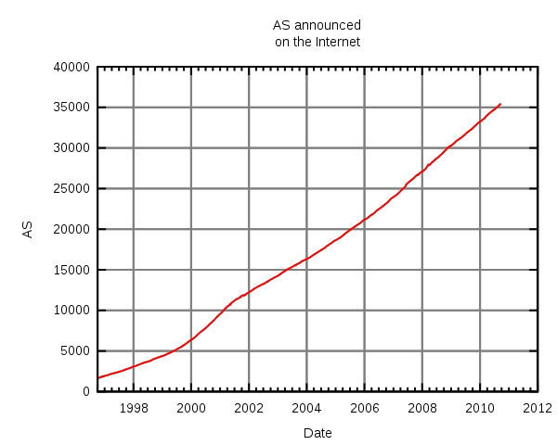
Growth of autonomous systems

Slide 9
Growth of autonomous systems

Slide 10
Connections between autonomous systems
Connections between ASes form a complex global network
Most ASes are connected only to their service provider
Tier-1 networks are connected to many thousand ASes

Slide 11
Interdomain and intradomain routing
Routing protocols for intradomain routing are called interior gateway protocols (IGP)
  Objective: best (shortest) path
Routing protocols for interdomain routing are called exterior gateway protocols (EGP)
  Objective: satisfy routing policies

Slide 12
EGP and IGP
Interior Gateway Protocol
  Routing is done based on metrics
  Routing domain is one autonomous system
Exterior Gateway Protocol
  Routing is done based on policies
  Routing domain is the entire Internet

Slide 13
Interdomain routing
Interdomain routing is based on connectivity between autonomous systems
Interdomain routing can ignore many details of router interconnection

Slide 14
Classification of autonomous systems
Local traffic = traffic with source or destination in AS
Transit traffic = traffic that passes through the AS
Stub AS = has connection to only one AS,
only carries local traffic
Multihomed Stub AS = has connection to >1 AS,
but only carries local traffic
Transit AS = has connection to >1 AS and
carries transit traffic

Slide 15
Stub and transit networks
Distinction between stub and transit networks does not result from connections between AS’s
Distinction is based on how the AS’s treat non-local traffic
AS 1 is a multihomed stub network
AS 3 and AS 4 are transit networks
AS 2 and AS 5 are stub networks

Slide 16
Selective transit
Example:
AS 3 carries traffic
between AS 1 and AS 4 and between AS 2 and AS 4
But AS 3 does not carry traffic between AS 1 and AS 2
The example shows a routing policy

Slide 17
Customer/provider relationship
A stub network typically obtains access to the Internet through a transit network
A transit network that is a provider may be a customer for another network
Customers pays providers for service

Slide 18
Peer relationship
Transit networks can have a peer relationship
Peers provide transit between their respective customers
Peers do not provide transit between peers
Peers normally do not pay each other for service

Slide 19
Shortcuts through peering
Note that peering reduces upstream traffic
Peering can reduce delays
But: Peering may not generate revenue

