Slide 1
Layer-2 Switching
ECE 461
Professor Jorg Liebeherr

Slide 2
Takeaways
Layer-2 vs. Layer-3 interconnection
Forwarding at Layer-2 switches
Learning bridges

Slide 3
Routers: Interconnection at Layer 3
Routers operate at the Network Layer (Layer 3)
Interconnection of subnets
Forwarding is based on IP addresses
subnet
subnet
subnet

Slide 4
Interconnection at Layer 2
Layer 2 switches (a.k.a. L2 switches, a.k.a. LAN switches, a.k.a. bridges) interconnect local area networks
Forwarding is based on MAC addresses

Slide 5
Terminology
There are different terms to refer to data-link layer interconnection devices:
The term bridge was coined in the early 1980s
Today, the terms Layer-2 switch or LAN switch or L2 switch are used
  In the context of Ethernet: Ethernet switch
  In the context of WiFi: access point
Convention:
Many concepts, configuration commands, and protocols for layer-2 switches were developed in the 1980s. In the context of these protocols and configurations, we use the old term bridge

Slide 6
Layer-2 switches versus routers
An enterprise network (e.g., university, corporation) with a large number of local area networks (LANs) can use routers or bridges
  1980s: LANs interconnection via bridges
  Late 1980s and early 1990s: increasingly use of routers
  Since mid-1990s: L2 switches replace most routers
  Today: Enterprise switches often support IGP routing
      Such switches are referred to as L3 switches
      Provides flexibility with regards to routing vs. L2 switching

Slide 7
Routed enterprise network
Internet
Router
Switch
FDDI
FDDI is a backbone
LAN technology from the early 1990s
FDDI

Slide 8
Switched enterprise network
Router
Internet
Switch

Slide 9
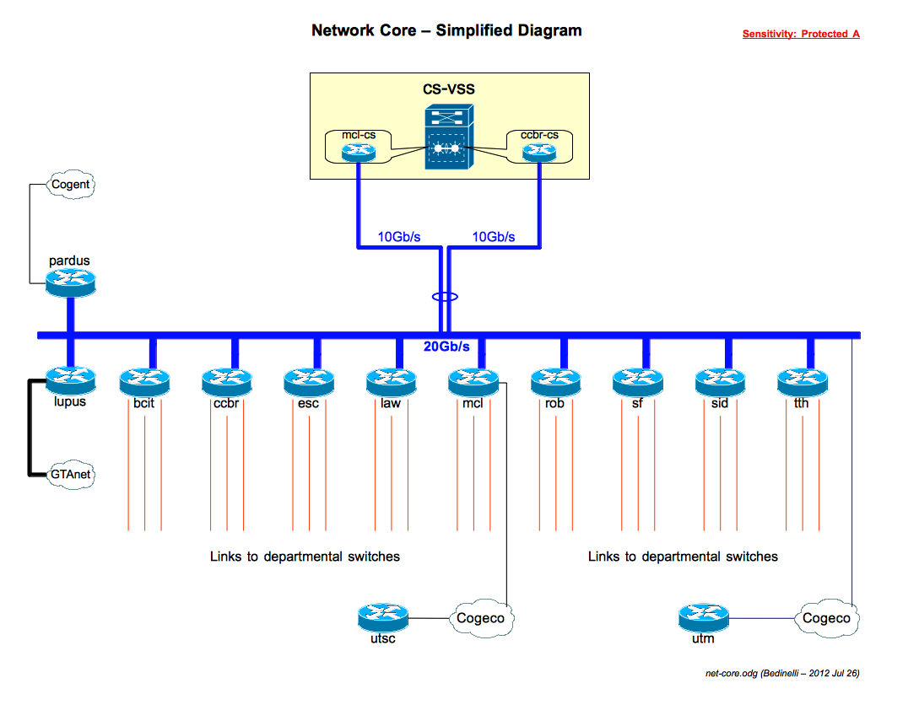
Example: UofT Network (2012)
All of UofT has <20 routers

Slide 10
Interconnecting LANs:
Routers vs. layer-2 switches
Routers
Each host’s IP address must be configured
If network is reconfigured, IP addresses may need to be reassigned
Routing done via RIP or OSPF
Each router manipulates IP header (e.g., reduces TTL field)
Layer-2 switches
MAC addresses of hosts are hardwired
No network configuration needed
Routing done by
  learning bridge algorithm
  spanning tree algorithm
Frames are not manipulated

Slide 11
Bridges
Overall design goal: Transparency
    “Plug-and-play”
    Self-configuring without hardware or software changes
    Bridges should not impact operation of existing LANs
Three parts to understanding bridges:
    (1) Forwarding of frames
    (2) Learning of addresses
    (3) Spanning tree algorithm

Slide 12
Need for a forwarding between networks
Some LANs are reachable only in multiple hops
Path between two LANs is not unique
Note:
Today, Layer-2 switches are not connected by a broadcast LAN. They are connected directly, e.g., by an Ethernet cable
The abstraction of the LAN remains valid: View each cable as a LAN, where each LAN has only 2 switches

Slide 13
Frame forwarding
Each bridge maintains a Forwarding Information Base (FIB), also called MAC table
The MAC table plays the same role as the routing table of an IP router
Entries have the form (MAC address, port, age), where
    MAC address: unicast address
    port: port number of bridge
    age: aging time of entry (in seconds)
with interpretation:
    a frame whose destination address matches the MAC address is forwarded on port. The entry is age time units old.
MAC address | port | age
a0:e1:34:82:ca:34 45:6d:20:23:fe:2e | 1 2 | 10 20
MAC table

Slide 14
Frame forwarding
Assume a frame arrives on port x
Is MAC address of
destination in MAC
table for ports A, B, or C ?
Not
found?
Found?
Forward the frame on the
appropriate port
Flood the frame,
i.e.,
send the frame on all
ports except port x

Slide 15
Address learning (Learning bridges)
MAC tables entries are populated automatically with a simple heuristic:
    The source field of a frame that arrives on a port tells which hosts are reachable from this port
Src=x, Dest=y
Src=x, Dest=y
Src=y, Dest=x
Port 1
Port 4
Src=x, Dest=y
MAC address | Port
Src=x, Dest=y
Port 2
x 3
Port 5
Src=x, Dest=y
y 4
Src=x, Dest=y
Src=x, Dest=y
Src=x, Dest=y
Src=y, Dest=x
Port 3
Port 6

Slide 16
Address learning (Learning bridges)
Learning Algorithm:
For each received frame, the bridge stores the source address in the MAC table, together with the port where the frame was received
All entries are deleted after some time (default is 15 seconds).

Slide 17
Example
Consider the following packets:
(Src=A, Dest=F), (Src=C, Dest=A), (Src=E, Dest=C)
What have the bridges learned?
Bridge 1
Bridge 2

Slide 18
Danger of loops
Consider the two LANs that are connected by two bridges.
Assume host n is transmits a
frame F with unknown destination.
What will happen?
Bridges A and B flood the frame
to LAN 2.
Bridge B sees F on LAN 2 (with
unknown destination), and copies
the frame back to LAN 1
Bridge A does the same.
The copying continues
Where is the problem? What is the solution ?
F
F
F
F
F
F
F

