Slide 1
Spanning Tree Protocol
Example
ECE 461
Professor Jorg Liebeherr

Slide 2
Example
Assume that all bridges send out their BPDU’s once per second, and assume that all bridges send their BPDUs at the same time
Assume that all bridges are turned on simultaneously at time T=0 sec.

Slide 3
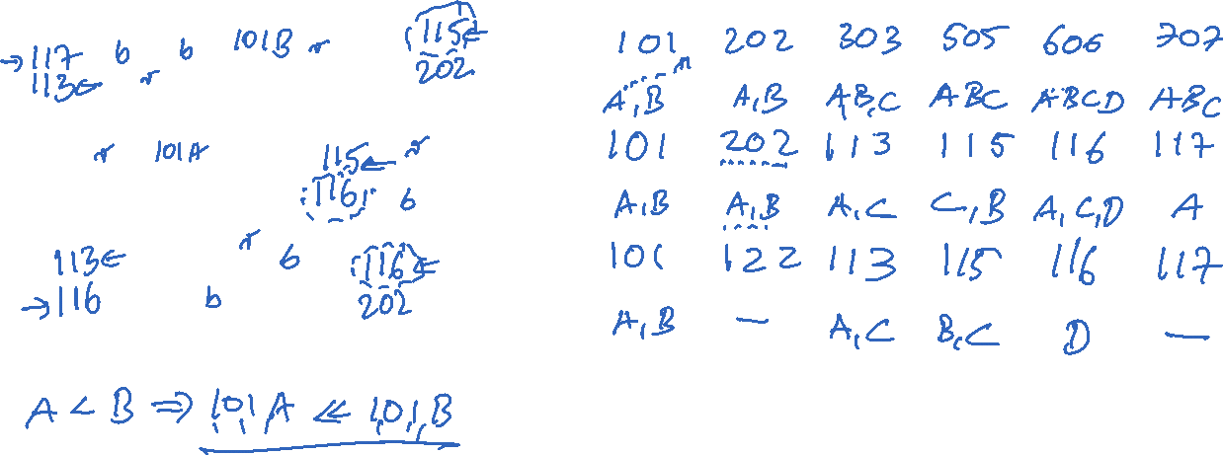
Example: BPDU’s sent by the bridges
 | Bridge 1 | Bridge 2 | Bridge 3 | Bridge 5 | Bridge 6 | Bridge 7
T=0 sec
T=1 sec
T=2 sec

Slide 4
Example: BPDU’s sent by the bridges
 | Bridge 1 | Bridge 2 | Bridge 3 | Bridge 5 | Bridge 6 | Bridge 7
T=0 sec | (1,0,1,port) sent on ports: A,B | (2,0,2,port) ports A,B | (3,0,3,port) ports A,B,C | (5,0,5,port) ports A,B,C | (6,0,6,port) ports A,B,C,D | (7,0,7,port) ports A,B,C
T=1 sec | (1,0,1,port) A,B | (2,0,2,port) A,B | (1,1,3,port)A,C | (1,1,5,port) B,C | (1,1,6,port) A,C,D | (1,1,7,port) A
T=2 sec | (1,0,1,port) A,B | (1,2,2,port) none | (1,1,3,port) A,C | (1,1,5,port) B,C | (1,1,6,port) D | (1,1,7,port) none
In the table (1,0,1,port) means that the BPDU is (1,0,1,A) if the BPDU is sent on port A and (1,0,1,B) if it is sent on port B
At T=1, Bridge 7 receives two BPDUs from Bridge 1: (1,0,1,A) and (1,0,1,B). We assume that A is numerically smaller than B. If this is not true, then the root port of Bridge 7 changes

Slide 5
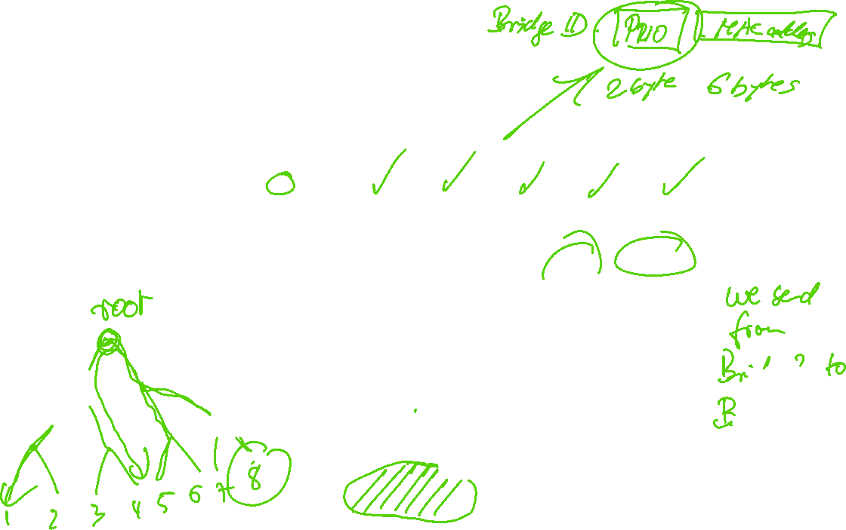
Example: Settings after convergence
 | Bridge 1 | Bridge 2 | Bridge 3 | Bridge 5 | Bridge 6 | Bridge 7
Root Port | - | A | B | A | B | B
Designated Ports | A,B | - | A,C | B,C | D | -
Blocked ports | - | B | - | - | A,C | A,C
Resulting spanning tree:

