Slide 1
Transport Protocols
ECE 461
Professor Jorg Liebeherr

Slide 2
Takeaways
Difference between TCP and UDP
Role of port numbers
Existence of other transport protocols

Slide 3
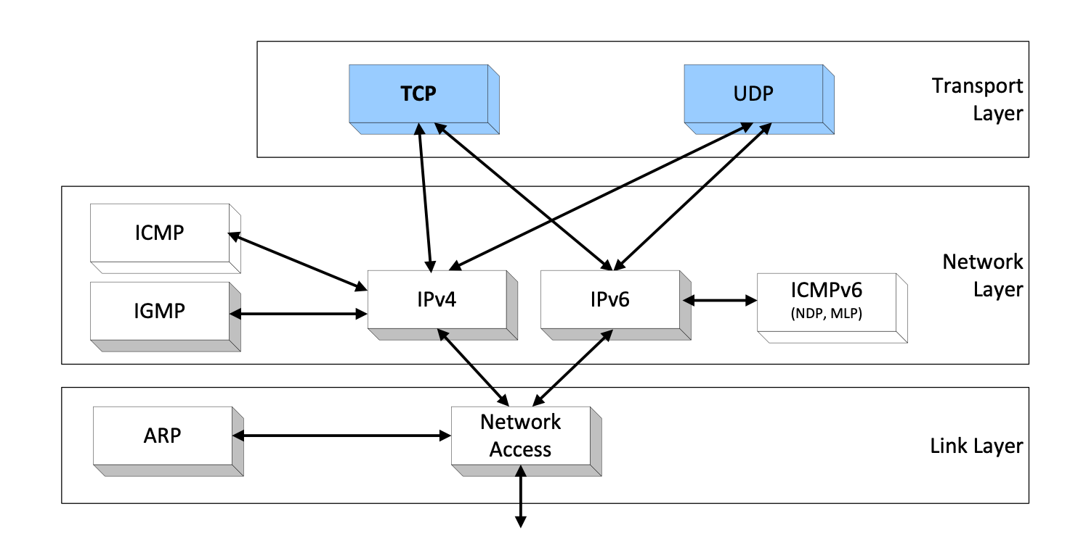
Orientation
We move one layer up and look at the transport layer.

Slide 4
Orientation
Transport layer protocols are end-to-end protocols
They only involve endsystems (hosts)

Slide 5
Transport Protocols in the Internet
The two main transport protocols of the Internet:
UDP - User Datagram Protocol
datagram oriented
unreliable, connectionless
simple
unicast and multicast
used for support services
  network management (SNMP), routing (RIP), naming (DNS), etc.
Increasingly used for application-layer protocols
  QUIC
TCP - Transmission Control Protocol
stream oriented
reliable, connection-oriented
complex
only unicast
used for most Internet applications:
  web (http), email (smtp), file transfer (ftp), terminal (telnet), etc.

Slide 6
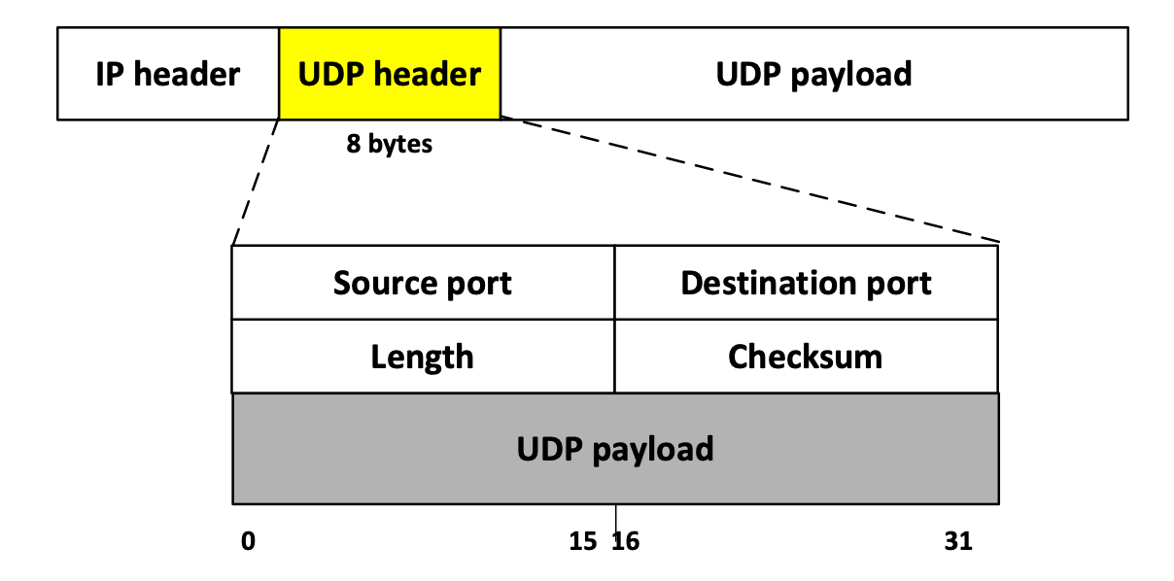
UDP header
Port numbers: Identifies sending and receiving applications (processes)
Length: UDP header and payload in bytes (8 ≤ Length ≤ 2¹⁶-1)
Checksum: Computed over parts of IP header, UDP header and UDP payload and some of the IP header fields). Uses same algorithm as for IPv4 header

Slide 7
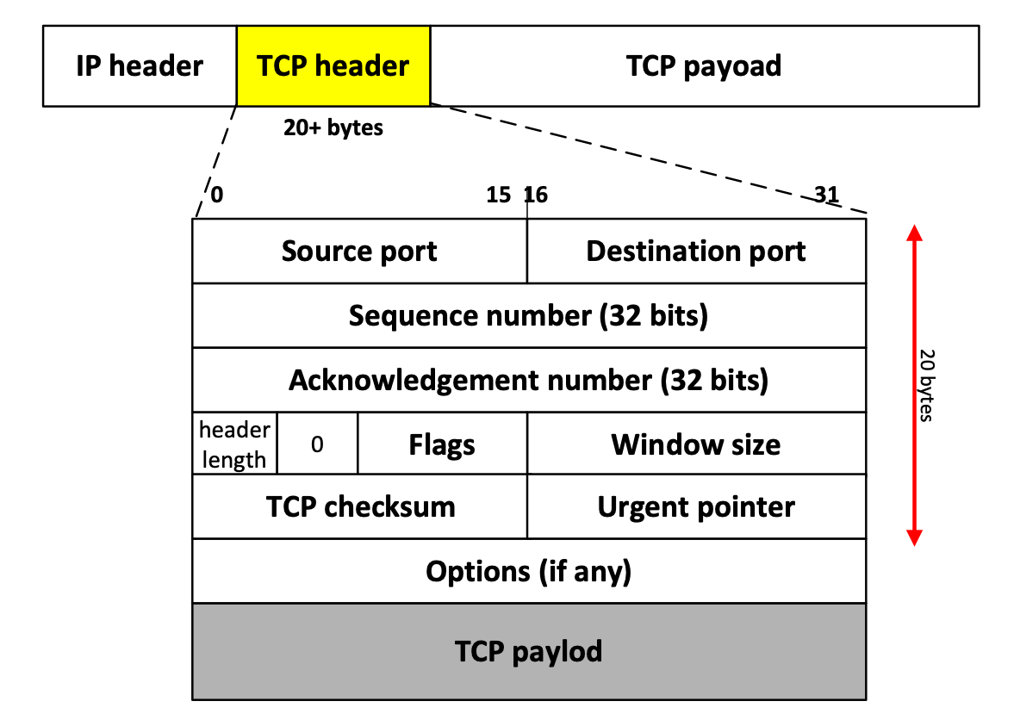
TCP header
TCP segments have a min. 20 byte header with ≥ 0 bytes of data.

Slide 8
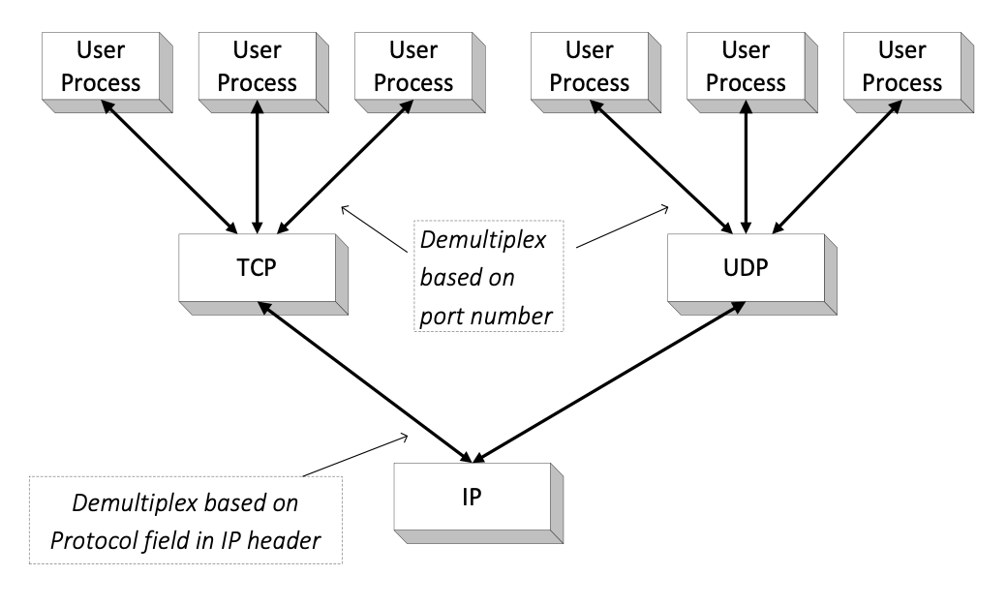
Port numbers
UDP and TCP use port numbers to identify applications
Application (user process) binds to a port number
Globally unique address for an application
<IP address, protocol type, port number>
Example: <128.100.2.11, TCP, 80>
65,535 ports per protocol:
  below 1024: well-known ports
Port number is used for demultiplexing

Slide 9
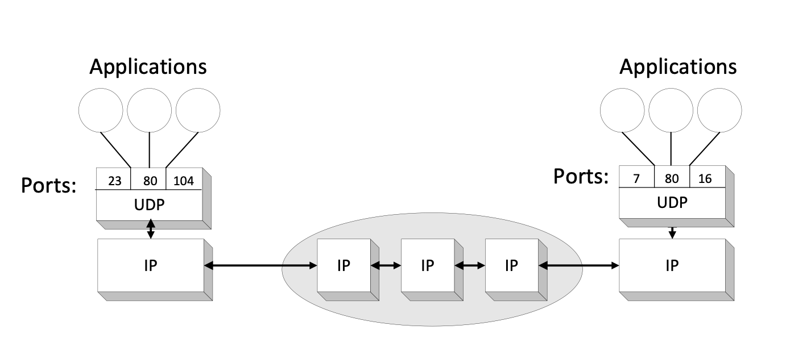
UDP - User Datagram Protocol
UDP supports unreliable transmissions of datagrams
Main function: Extend the host-to-to-host delivery service of IP to an application-to-application service (by adding port numbers)

Slide 10
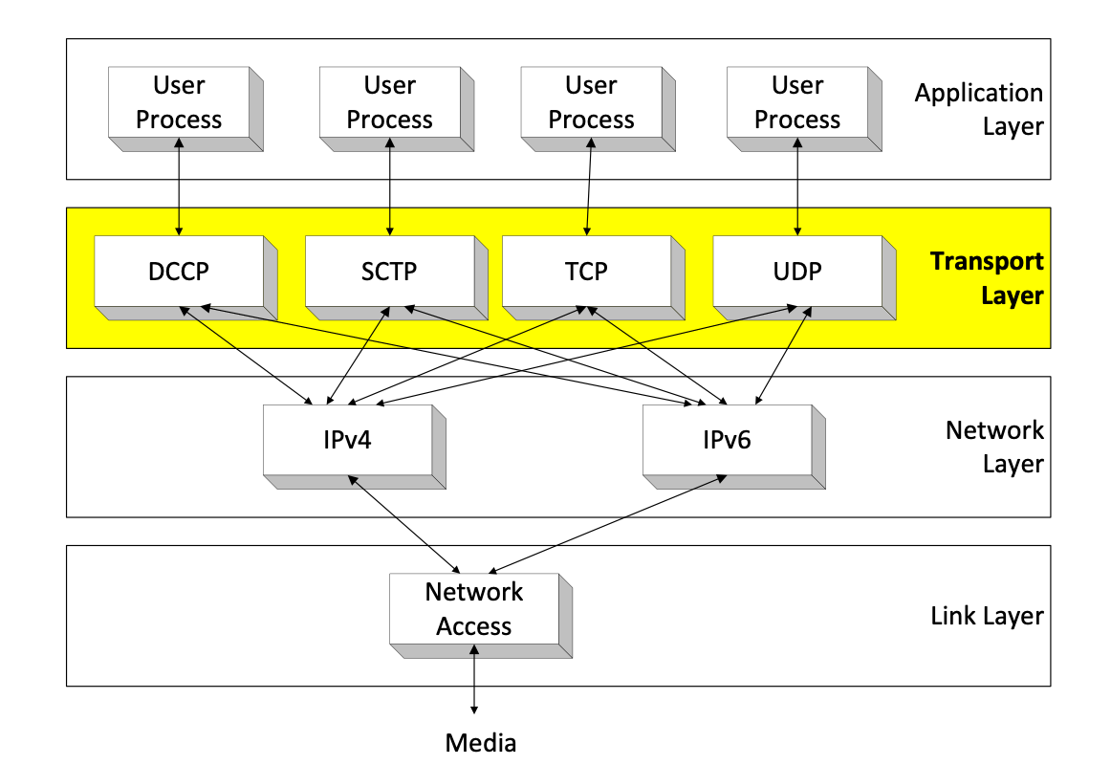
New Transport Protocols
  DCCP (2006): Datagram Congestion Control Protocol
  SCTP (2000): Stream Control Transmission Protocol

Slide 11
DCCP and SCTP
These protocols provide more service than UDP, but less than TCP
SCTP
“TCP for datagrams”
connection-oriented (full duplex)
more delivery options than TCP
message-oriented
  preserves message boundaries
supports multiple flows (“streams” per connection)
unreliable or reliable
ordered or partially ordered
congestion control
support for multi-homing
DCCP
“UDP with congestion control”
“TCP without reliable byte stream”
connection-oriented
message-oriented
unreliable
unordered
congestion control
intended for applications that transfer large volumes of data

Slide 12
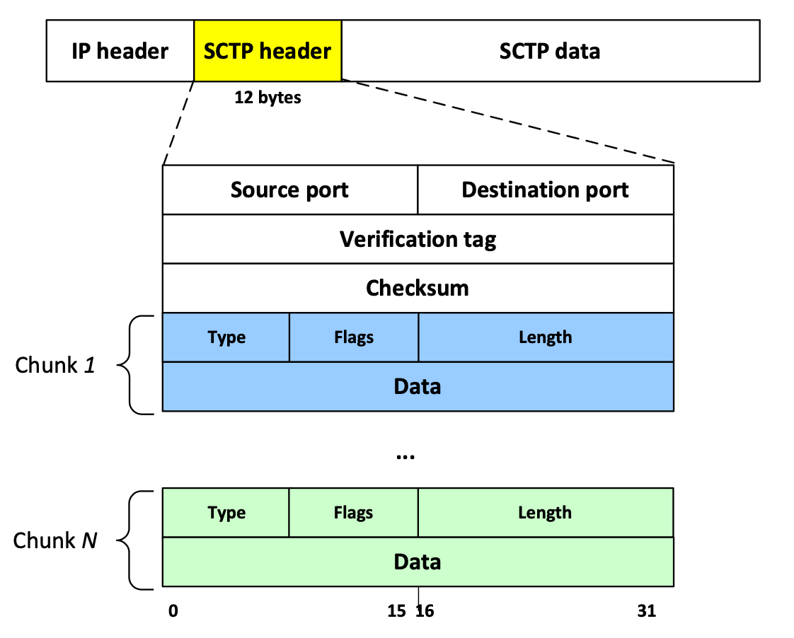
SCTP format
Many different chunk types
  Data chunks
  Control chunks
Each chunk has a type-dependent header

Slide 13
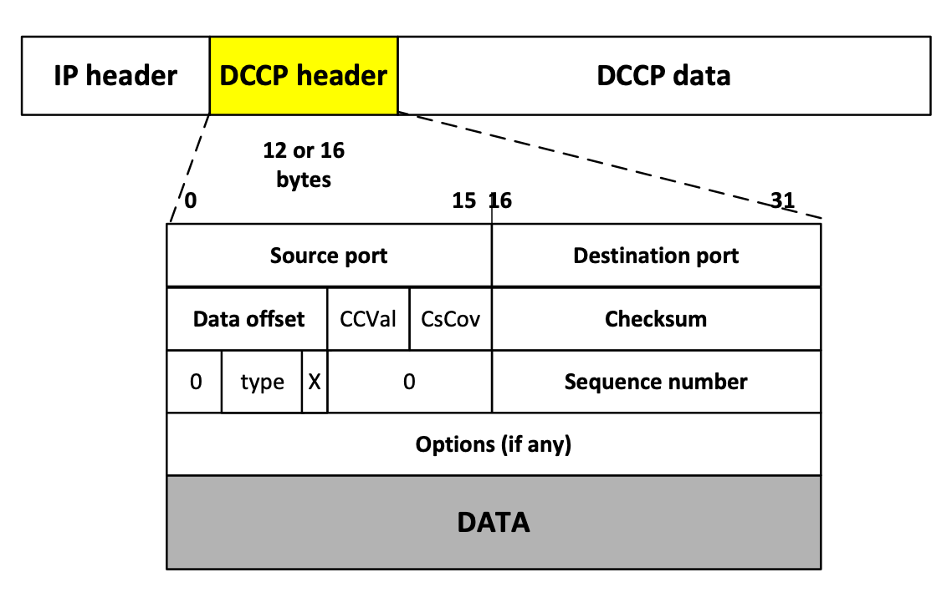
DCCP format

Slide 14
Status quo (2020)
DCCP never caught on
Some saw SCTP as the “TCP of the future”, but it is not used
There are many reasons for the failure of these protocols:
    Kernel level implementation
    Middleboxes (firewalls, intrusion detection systems, NAT routers, etc.) need to be aware of protocol
    Application code must be modified to switch to new protocol
    Almost all Internet traffic is HTTP/TCP
More promising approach:
  Accept HTTP/TCP dominance
  Focus on adding features, improve web performance
  Build protocol features above TCP or UDP
  Integrate protocol into application (both client and server)

Slide 15
QUIC
QUIC = Quick UDP Internet Connection
  ➔ QUIC is a transport protocol that runs on top of UDP
Main features:
  Runs in application layer
  Flow control, congestion control, error control
  Supports multiple data streams
  Security (authentication, encryption) of headers and payload
  Fast connection setup
Developed by Google and running in Chrome browser
Status:
  Still considered experimental, but increasingly supported by (non-Chrome) browsers
  Internet (IETF) standardization is in progress
Notes:
On Chrome: About:flags
chrome://net-internals/#quic

