Slide 1
TCP
Part 1: Header Format
ECE 461
Professor Jorg Liebeherr

Slide 2
Takeaways
The content of this lecture is mostly for use as a reference
Things to remember:
  Byte stream service
  Sequence numbers and acknowledgements in TCP header

Slide 3
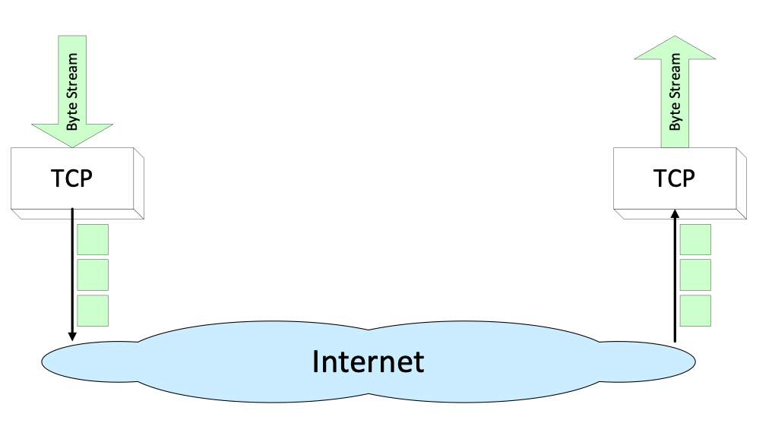
Overview
TCP = Transmission Control Protocol
TCP is a connection-oriented protocol that provides a reliable unicast end-to-end byte stream over an unreliable internetwork

Slide 4
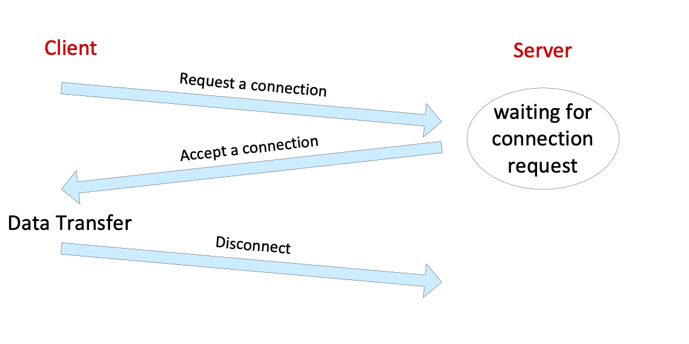
Connection-oriented
Before data transfer, TCP establishes a connection:
    A TCP server waits for a connection request from a TCP client
    TCP client contacts the server
Once a connection is established, the data exchange is full duplex

Slide 5
Reliable
Byte stream from user is broken up into chunks, which are called segments
  Receiver of a segment sends acknowledgement (ACK) to the sender
  If an ACK is not received in time, the segment is retransmitted
Causes of errors:
  Buffer overflow at router or receiver:
    This is detected through missing ACKs
  Corruption of data:
    TCP has checksums for header and data. Segments with invalid checksums are discarded

Slide 6
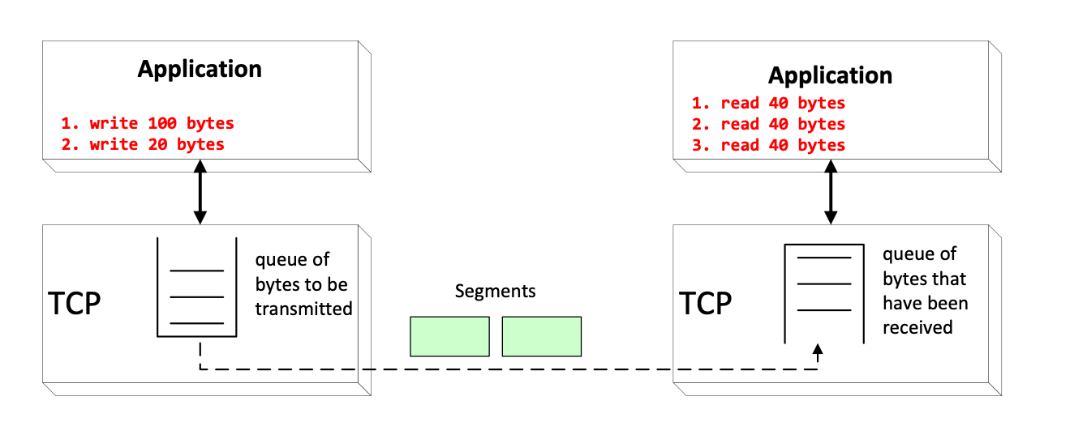
Byte stream service
To the lower layers, TCP handles data in chunks, the segments.
To the application, TCP handles data as a sequence of bytes and does not identify boundaries between bytes
→ Applications do not know about the beginning and end of segments !

Slide 7
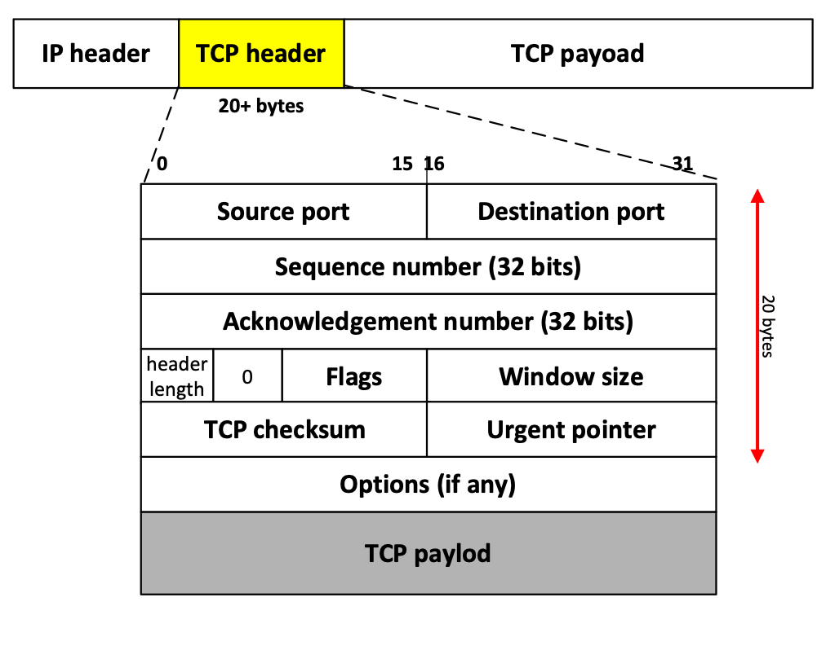
Format of TCP segments

Slide 8
Format of TCP segments
Source port, destination port
A port number identifies the endpoint of a connection
Two pairs (client IP address, client port number) and (server IP address, server port number) identify a TCP connection

Slide 9
Format of TCP segments
Sequence number (SeqNo)
Sequence number of the first byte in the payload
Sequence numbers are based on bytes
Range: 0 ≤ Sequence number ≤ 2³² -1 ≈ 4.3 Gbyte
The client and the server each select an Initial Sequence Number (ISN) randomly during connection establishment

Slide 10
Format of TCP segments
Acknowledgement number (AckNo)
The AckNo contains the next sequence number that the sender of this segment wants to receive
If a host sends an AckNo in a segment it sets the ACK flag
Note: In a segment that is sent from A to B, the AckNo acknowledges data that was earlier sent from B to A
Example:
The acknowledgement for a segment with sequence numbers 0-1500 has AckNo=1501

Slide 11
Format of TCP segments
Header length (4 bits)
Length of TCP header in multiple of 4 bytes

Slide 12
Format of TCP segments
9 bit flags
NS
CWR
ECE
URG - indicates that urgent pointer is significant
ACK - indicates that AckNo field is significant
PSH - asks receiver to push data to application
RST - resets the TCP connection
SYN - synchronizes sequence number
(only used in first segment from each end)
FIN - set by each end to indicate that they do
not send more data in this connection
NS
CWR
ECE
URG
ACK
PSH
RST
SYN
FIN
used for ECN (Explicit Congestion Notification)

Slide 13
Format of TCP segments
Window size
Number of bytes that the other end of the connection can send
Each end of the connection advertises a window size
Maximum value: 2¹⁶-1= 65535 bytes
Window size can be scaled using a TCP option
  Ubuntu 20.04 scales window size by a factor 2⁷

Slide 14
Format of TCP segments
TCP checksum
TCP checksum covers both TCP header and TCP data (also covers some parts of the IP header)
Urgent pointer
Urgent data always follows the header
Urgent pointer is the sequence number of the last byte of the urgent data
Urgent pointer is valid only if URG flag is set

Slide 15
Format of TCP segments
TCP options
Options have multiple roles
Enable optional features of TCP during connection setup
Selective acknowledgement
Timestamps
Null data to ensure that TCP header length is a multiple of 4

Slide 16
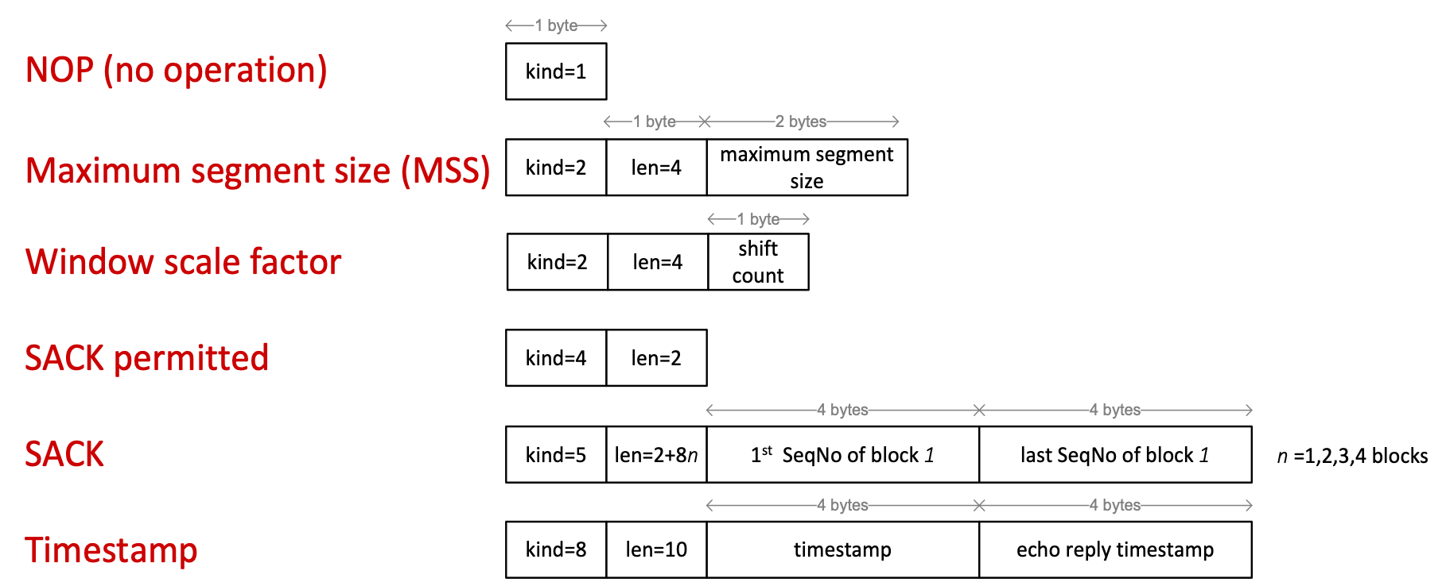
TCP header fields: Options
Almost all TCP headers have options

Slide 17
TCP header fields: Options
NOP : Filler to ensure that TCP header length (in bytes) is a multiple of 4
Maximum Segment Size (MSS): Max. size of a TCP segment. The value follows from the MTU
Window scale factor: A value of N means that the window size value should be multiplied by 2^{N}
SACK permitted: Informs the other end of the connection that it may use selective acknowledgement (SACK)
Selective Acknowledgement (SACK): Up to four pairs of (start, end) of acknowledged ranges of sequence numbers
Timestamp: Contains 2 timestamps: (1) timestamp of sender and (2) echo of last received timestamp. Can be used to assert sequence of segments when sequence numbers wrap around
Only sent in the first segment (SYN segment) during connection establishment

