Slide 1
TCP
Part 2: Connection Management
ECE 461
Professor Jorg Liebeherr

Slide 2
Connection management in TCP
Opening a TCP Connection
Closing a TCP Connection
State Diagram

Slide 3
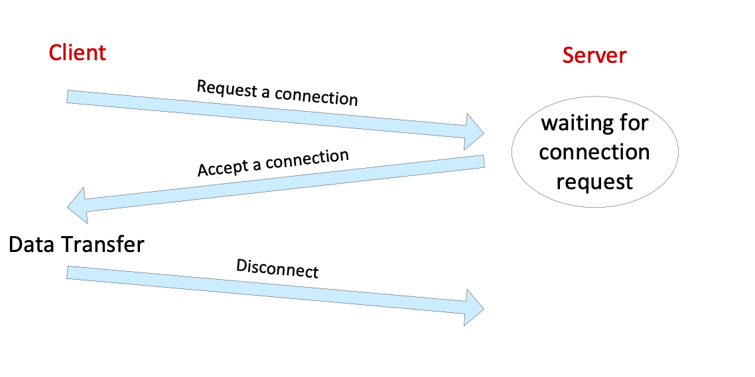
TCP connection
Before data transfer, TCP establishes a connection:
    A TCP server waits for a connection request from a TCP client
    TCP client contacts the server
Once a connection is established, the data exchange is full duplex

Slide 4
TCP connection establishment
TCP uses a three-way handshake to open a connection:
Client sends a segment with
      SYN bit set
      SeqNo is initial sequence number (ISN) of client
Server responds with a segment with
      SYN bit and ACK bit set
      SeqNo initial sequence number (ISN) of server
      AckNo acknowledges ISN of client
Client replies with a segment with:
      ACK bit set
      AckNo acknowledges ISN of server
      Client can send data

Slide 5
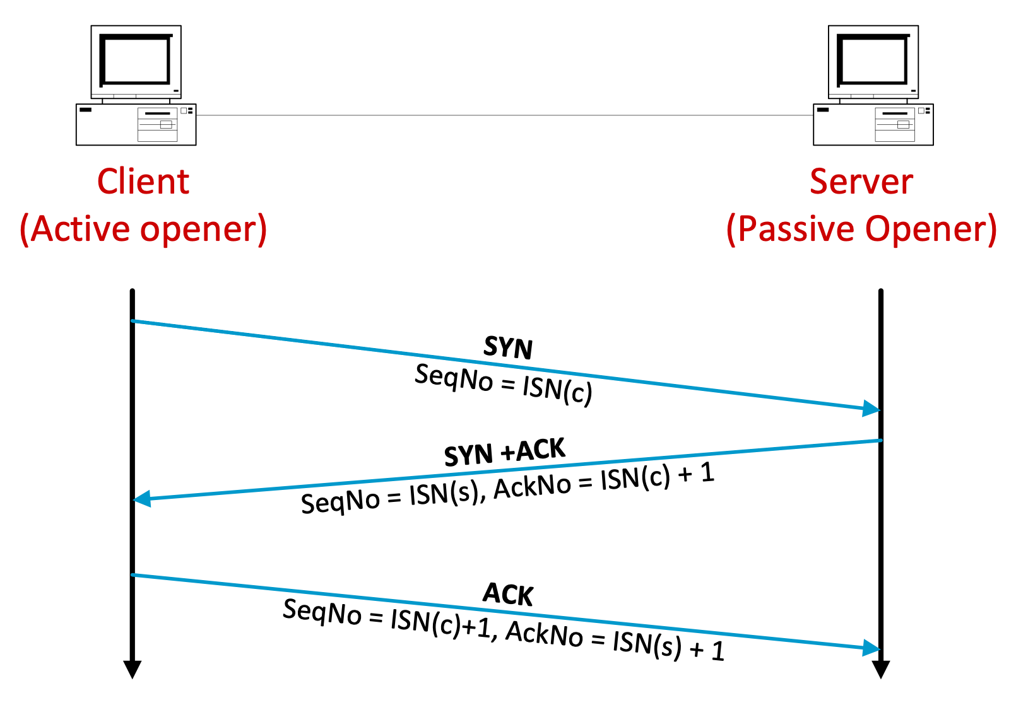
Three-way handshake
Client is called active opener and server is called passive opener
SYN segments do not carry data (only a TCP header)
  Sequence number treats SYN segment as if it had a one byte payload
Options in SYN segments contain information used for the connection
  MSS
  SACK
  Window scaling
Bidirectional data exchange begins with the ACK segment

Slide 6
TCP connection termination
Each end of the data flow must be close the connection (half-close)
Connection termination can be initiated by client or by server
  Send a FIN segment
  Sender of a FIN segment cannot send any more data
  To close the connection, the other end of the connection must also send a FIN segment
  FIN segments must be acknowledged
Four steps for terminating a connection:
  X sends a FIN to Y (active close)
  Y ACKs the FIN
  At this time: Y can still send data to X, but X cannot send data to Y
  Y sends a FIN to X (passive close)
  X ACKs the FIN

Slide 7
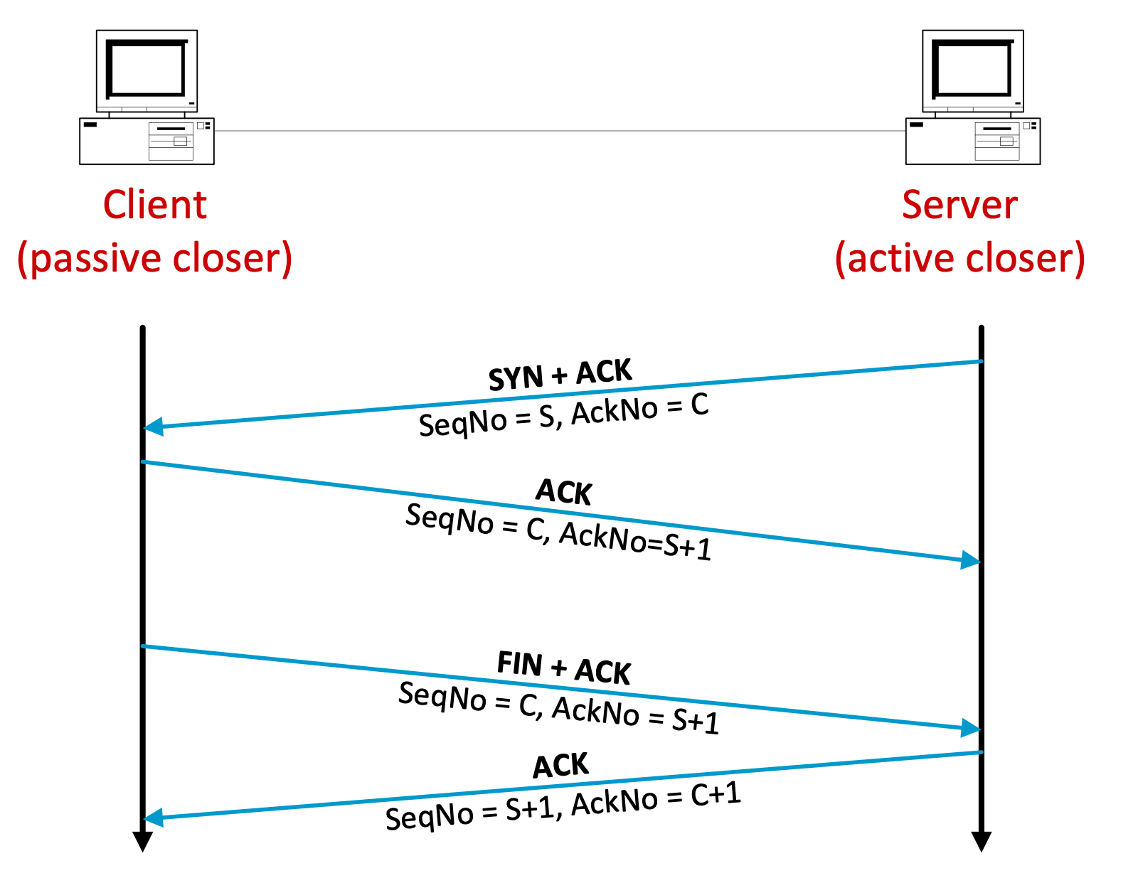
TCP connection termination
Here: Server is active closer
Normally, FIN segments do not carry data (only a TCP header)
  Sequence number treats FIN segment as if it had a one byte payload

Slide 8
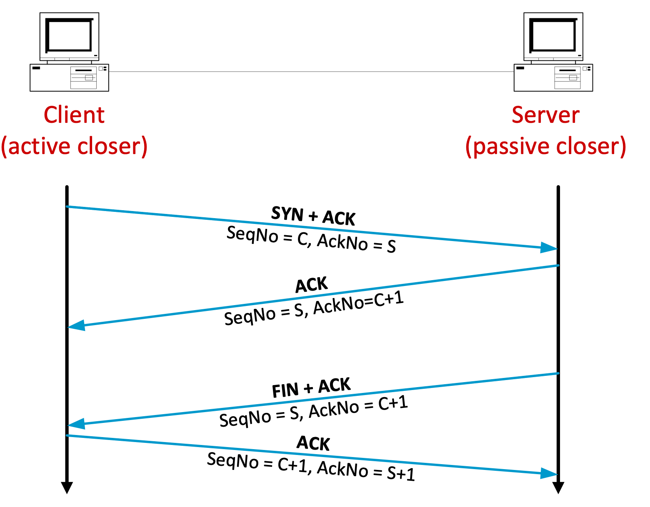
TCP connection termination
Here: Client is active closer
Issue: What if the final ACK is lost?
  Passive closer does not close the connection and retransmit the FIN+ACK segment
  This means that the active closer must wait for for possible retransmissions after it sends the final ACK
  How long should it wait?

Slide 9
States of a TCP connection
State | Description
CLOSED | No connection is active or pending
LISTEN | The server is waiting for an incoming call
SYN RCVD | A connection request has arrived; wait for Ack
SYN SENT | The client has started to open a connection
ESTABLISHED | Normal data transfer state
FIN WAIT 1 | Client has said it is finished
FIN WAIT 2 | Server has agreed to release
TIMED WAIT | Wait for pending packets (“2MSL wait state”)
CLOSING | Both Sides have tried to close simultanesously
CLOSE WAIT | Server has initiated a release
LAST ACK | Wait for pending packets

Slide 10
TCP States in “normal” connection lifetime

Slide 11
TCP state transition diagram: Opening a connection

Slide 12
TCP state transition diagram: Closing a connection

Slide 13
TIME_WAIT state
When the active closer sends its final ACK, it must stay in the TIME_WAIT state for twice the maximum segment lifetime (MSL)
The MSL is typically set to 60 seconds
By waiting in this state, the active closer remains available if the passive closer retransmits the FIN segment
  The retransmission happens if the FIN segment of the passive closer or the final ACK by the active closer are lost, and the passive closer has a timeout on the FIN segment

Slide 14
Resetting connections
Resetting connections is done by setting the RST flag in the TCP header
When is the RST flag set?
  Connection request arrives and no server process is waiting on the destination port
  Abort a connection
  Causes the receiver to throw away buffered data. Receiver does not acknowledge the RST segment

