Slide 1
TCP
Part 3: Acknowledgements
ECE 461
Professor Jorg Liebeherr

Slide 2
Takeaways
Protocol mechanisms for sending acknowledgments in TCP
  Cumulative acknowledgements
  Selective acknowledgments
Rules for sending acknowledgments in TCP
  Delayed ACK
  Nagle’s rule

Slide 3
What is flow/congestion/error control ?
Flow control: Prevent that the sender overruns the receiver with information
Error control: Recover or conceal the effects from packet losses
Congestion control: Prevent that the sender overloads the network
→ The goal of each of the control mechanisms are different
→ In TCP, the implementation of these mechanisms is combined. They all involve the acknowledgement

Slide 4
Acknowledgements in TCP
TCP receivers use acknowledgments (ACKs) to confirm the receipt of data to the sender
Acknowledgment can be added (“piggybacked”) to a data segment that carries data in the opposite direction
ACK information is included in the TCP header
ACKs play a role in flow control, error control, and congestion control
Data for B
A
Data for A
ACK
B
ACK

Slide 5
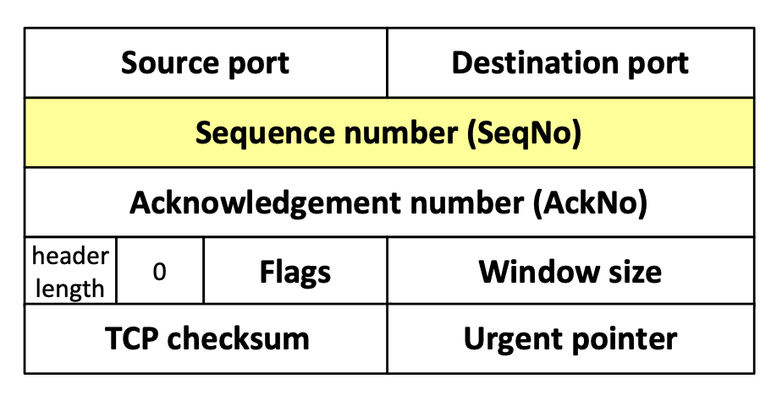
Sequence numbers and acknowledgments in TCP
TCP uses sequence numbers to keep track of transmitted and acknowledged data
Each transmitted byte of payload data is associated with a sequence number
Sequence numbers count bytes and not segments
Sequence number of first byte in payload is written in SeqNo field
Sequence numbers wrap when they reach 2³²-1
The sequence number of the first sequence number (Initial sequence number or ISN) is negotiated during connection setup

Slide 6
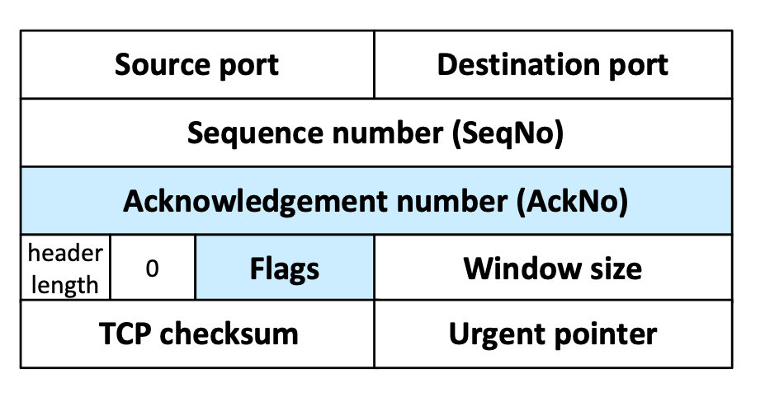
Sequence numbers and acknowledgments in TCP
An acknowledgment is a confirmation of data delivery
When a TCP receiver wants to acknowledge data, it
  writes a sequence number in the AckNo field, and
  sets the ACK flag
An acknowledgment confirms receipt for all unacknowledged data that has a smaller sequence number than given in the AckNo field
Example:
AckNo=5 confirms delivery for 1,2,3,4 (but not 5)

Slide 7
Cumulative acknowledgements
TCP has cumulative acknowledgements: An acknowledgment confirms the receipt of all unacknowledged data with a smaller sequence number
SeqNo=20
10 bytes
SeqNo=10
10 bytes
SeqNo=90
10 bytes
SeqNo=0
10 bytes
SeqNo=30
10 bytes
SeqNo=40
10 bytes
SeqNo=50
10 bytes
SeqNo=60
10 bytes
SeqNo=70
10 bytes
SeqNo=80
10 bytes
Sender
Receiver
ACK 10
ACK 20
ACK 40
ACK 70
ACK 100

Slide 8
Cumulative acknowledgements: lost segment
With cumulative ACKs, the receiver can only acknowledge a segment if all previous segments have been received
Timeout
SeqNo=20
10 bytes
SeqNo=10
10 bytes
SeqNo=0
10 bytes
SeqNo=30
10 bytes
SeqNo=40
10 bytes
SeqNo=50
10 bytes
SeqNo=10
10 bytes
SeqNo=20
10 bytes
SeqNo=60
10 bytes
Sender
Retransmission
Retransmission
Receiver
ACK 10
ACK 10
ACK 10
ACK 60
ACK 10
ACK 10
ACK 60
ACK 70

Slide 9
Cumulative Acknowledgements: lost segment
What happens in the example?
2nd segment is lost
When later segments arrive, receiver continues to acknowledge 1st segment (ACK 10)
When timeout occurs for 2nd segment, sender retransmits starting at 2nd segment
When 2nd segment arrives at receiver, receiver can acknowledge all data that has been received so far (ACK 60)
The use of cumulative ACKs imposes a constraints on the retransmission scheme:
  In case of an error, the sender may need to retransmit all data that has not yet been acknowledged

Slide 10
Rules for sending Acknowledgments
TCP has rules that influence the transmission of acknowledgments
Rule 1: Delayed Acknowledgments
  Goal: Avoid sending ACK segments that do not carry data
  Implementation: Delay the transmission of (some) ACKs
Rule 2: Nagle’s rule
  Goal: Reduce transmission of small segments
  Implementation: A sender cannot send multiple segments with a 1-byte payload (i.e., it must wait for an ACK)

Slide 11
Observing delayed acknowledgements
Remote terminal application Telnet sends typed characters to a server.
The server interprets the character and sends an echo of the character (or output) to the client.
For each character typed, you see three packets:
  Client → Server: Send typed character
  Server → Client: Echo of character (or user output) and acknowledgement for first packet
  Client → Server: Acknowledgement for second packet

Slide 12
Observing delayed acknowledgements
This is the output of typing 3 (three) characters :
Time 44.062449: Argon → Neon: 1 byte data, SeqNo 1
Time 44.063317: Neon → Argon: 1 byte data, SeqNo 1, AckNo 2
Time 44.182705: Argon → Neon: No data, AckNo 2
Time 48.946471: Argon → Neon: 1 byte data, SeqNo 2, AckNo 2
Time 48.947326: Neon → Argon: 1 byte data, SeqNo 2, AckNo 3
Time 48.982786: Argon → Neon: No data, AckNo 3
Time 55.116581: Argon → Neon: 1 byte data, SeqNo 3, AckNo 3
Time 55.117497: Neon → Argon: 1 byte data, SeqNo 3, AckNo 4
Time 55.183694: Argon → Neon: no data, AckNo 4
Telnet session from Argon (client) to Neon (server)
Argon and Neon are in same location

Slide 13
Why 3 segments per character?
We would expect four segments per character:
But we only see three segments per character:
This is due to delayed acknowledgements

Slide 14
Delayed acknowledgement
TCP delays transmission of ACKs for up to 500ms
  <1 ms in recent Ubuntu distributions
Goal: Avoid sending ACK segments that do not carry data.
  The hope is that, within the delay, the receiver will have data ready to be sent to the receiver. Then, the ACK can be piggybacked with a data segment
  In Example:
    Delayed ACK explains why the “ACK of character” and the “echo of character” are sent in the same segment
    The duration of delayed ACKs can be observed in the example when Argon sends ACKs
Exceptions:
ACK should be sent for every second full sized segment
Delayed ACK is not used when packets arrive out of order

Slide 15
Delayed acknowledgement
Because of delayed ACKs, an ACK is often observed for every other segment
SeqNo=20
10 bytes
SeqNo=10
10 bytes
SeqNo=80
10 bytes
SeqNo=0
10 bytes
SeqNo=30
10 bytes
SeqNo=40
10 bytes
SeqNo=50
10 bytes
SeqNo=60
10 bytes
SeqNo=70
10 bytes
Sender
Receiver
ACK 20
ACK 40
ACK 50
ACK 70
ACK 90
Max. Delay for an ACK

Slide 16
Observing Nagle’s rule
This is the output of typing 7 characters :
Time 16.401963: Argon → Tenet: 1 byte data, SeqNo 1
Time 16.481929: Tenet → Argon: 1 byte data, SeqNo 1, AckNo 2
Time 16.482154: Argon → Tenet: 1 byte data, SeqNo 2, AckNo 2
Time 16.559447: Tenet → Argon: 1 byte data, SeqNo 2, AckNo 3
Time 16.559684: Argon → Tenet: 1 byte data, SeqNo 3, AckNo 3
Time 16.640508: Tenet → Argon: 1 byte data, SeqNo 3, AckNo 4
Time 16.640761: Argon → Tenet: 4 bytes data, SeqNo 4-7, AckNo 4
Time 16.728402: Tenet → Argon: 4 bytes data, SeqNo 4-7, AckNo 8
Telnet session from argon.cs.virginia.edu (client)
to tenet.cs.Berkeley.edu (server)
Client and server are 3000 miles apart

Slide 17
Observing Nagle’s rule
Observation: Transmission of segments follows a different pattern, i.e., there are only two segments per character typed
Delayed acknowledgment does not kick in at Argon
The reason is that there is always data at Argon ready to sent when the ACK arrives
Why is Argon not sending the data (typed characters) as soon as it is available?

Slide 18
Observing Nagle’s rule
Observations:
  Argon never has multiple unacknowledged segments outstanding
  There are fewer transmissions than there are characters
This is due to Nagle’s Rule:
  Each TCP connection can have only one small (1-byte) segment outstanding that has not been acknowledged
Implementation: Send one byte and buffer all subsequent bytes until acknowledgement is received. Then send all buffered bytes in a single segment.
  Rule is enforced only if data are arriving from application one byte at a time
Goal of Nagle’s Rule:
  Reduce the amount of small segments
  The algorithm can be disabled

Slide 19
Nagle’s Rule
Only one 1-byte segment can be in transmission
(Here: Since no data is sent from B to A, we also see delayed ACKs)
Typed
characters
Sender
SeqNo=0, 1 byte
SeqNo=1, 4 bytes
SeqNo=5, 5 bytes
Receiver
ACK 1
ACK 5
ACK 10
Delayed ACK
Delayed ACK
Delayed ACK

Slide 20
Selective acknowledgment (SACK)
With selective acknowledgments, the receiver can acknowledge non-continuous blocks of data
SACK is used when an ACK is sent and the AckNo does not reflect the highest sequence number in the data receiver's queue
  → New data has been received after a lost or reordered segment
Acknowledge blocks (ranges) of sequence numbers that have been received
Up to four blocks can be acknowledged at once:
  For each block, provide the lowest sequence number (left edge) and the highest sequence number (right edge)

Slide 21
Selective acknowledgements: lost segment
With selective ACKs, the receiver can acknowledge ranges of sequence numbers
Timeout
SeqNo=20
10 bytes
SeqNo=10
10 bytes
SeqNo=0
10 bytes
SeqNo=30
10 bytes
SeqNo=40
10 bytes
SeqNo=50
10 bytes
SeqNo=10
10 bytes
SeqNo=60
10 bytes
Sender
Retransmission
Receiver
ACK 10
ACK 10
ACK 10
SACK 20-39
ACK 10
ACK 10
ACK 60
ACK 70

