Slide 1
TCP
Part 3: Acknowledgements
ECE 461
Professor Jorg Liebeherr

Slide 2
Takeaways
Protocol mechanisms for sending acknowledgments in TCP
  Cumulative acknowledgements
  Selective acknowledgments
Rules for sending acknowledgments in TCP
  Delayed ACK
  Nagle’s rule

Slide 3
What is flow/congestion/error control ?
Flow control: Prevent that the sender overruns the receiver with information
Error control: Recover or conceal the effects from packet losses
Congestion control: Prevent that the sender overloads the network
→ The goal of each of the control mechanisms are different
→ In TCP, the implementation of these mechanisms is combined. They all involve the acknowledgement

Slide 4
Acknowledgements in TCP
TCP receivers use acknowledgments (ACKs) to confirm the receipt of data to the sender
Acknowledgment can be added (“piggybacked”) to a data segment that carries data in the opposite direction
ACK information is included in the TCP header
ACKs play a role in flow control, error control, and congestion control
Data for B
A
Data for A
ACK
B
ACK

Slide 5
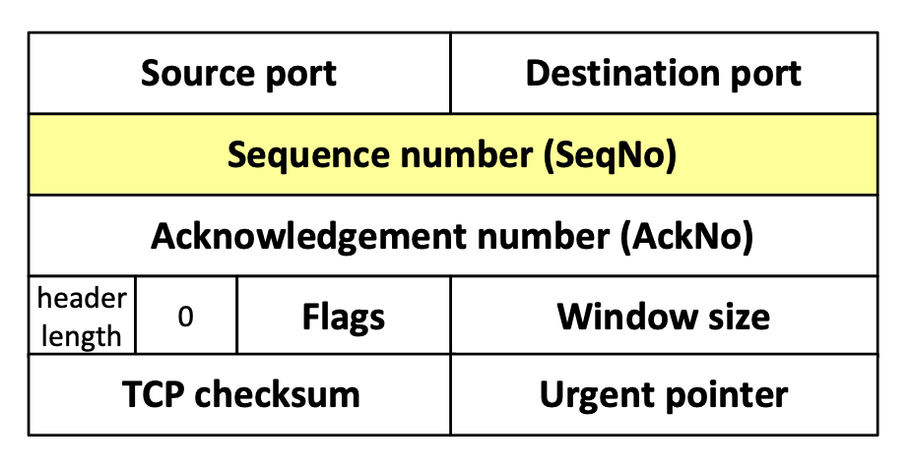
Sequence numbers and acknowledgments in TCP
TCP uses sequence numbers to keep track of transmitted and acknowledged data
Each transmitted byte of payload data is associated with a sequence number
Sequence numbers count bytes and not segments
Sequence number of first byte in payload is written in SeqNo field
Sequence numbers wrap when they reach 2³²-1
The sequence number of the first sequence number (Initial sequence number or ISN) is negotiated during connection setup

Slide 6
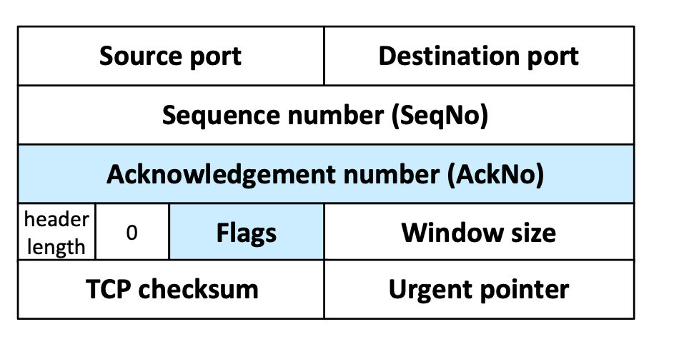
Sequence numbers and acknowledgments in TCP
An acknowledgment is a confirmation of data delivery
When a TCP receiver wants to acknowledge data, it
  writes a sequence number in the AckNo field, and
  sets the ACK flag
An acknowledgment confirms receipt for all unacknowledged data that has a smaller sequence number than given in the AckNo field
Example:
AckNo=5 confirms delivery for 1,2,3,4 (but not 5)

Slide 7
Cumulative acknowledgements
TCP has cumulative acknowledgements: An acknowledgment confirms the receipt of all unacknowledged data with a smaller sequence number
SeqNo=20
10 bytes
SeqNo=10
10 bytes
SeqNo=90
10 bytes
SeqNo=0
10 bytes
SeqNo=30
10 bytes
SeqNo=40
10 bytes
SeqNo=50
10 bytes
SeqNo=60
10 bytes
SeqNo=70
10 bytes
SeqNo=80
10 bytes
Sender
Receiver
ACK 10
ACK 20
ACK 40
ACK 70
ACK 100

Slide 8
Cumulative acknowledgements: lost segment
With cumulative ACKs, the receiver can only acknowledge a segment if all previous segments have been received
Timeout
SeqNo=20
10 bytes
SeqNo=10
10 bytes
SeqNo=0
10 bytes
SeqNo=30
10 bytes
SeqNo=40
10 bytes
SeqNo=50
10 bytes
SeqNo=10
10 bytes
SeqNo=20
10 bytes
SeqNo=60
10 bytes
Sender
Retransmission
Retransmission
Receiver
ACK 10
ACK 10
ACK 10
ACK 60
ACK 10
ACK 10
ACK 60
ACK 70

Slide 9
Cumulative Acknowledgements: lost segment
What happens in the example?
2nd segment is lost
When later segments arrive, receiver continues to acknowledge 1st segment (ACK 10)
When timeout occurs for 2nd segment, sender retransmits starting at 2nd segment
When 2nd segment arrives at receiver, receiver can acknowledge all data that has been received so far (ACK 60)
The use of cumulative ACKs imposes a constraints on the retransmission scheme:
  In case of an error, the sender may need to retransmit all data that has not yet been acknowledged

Slide 10
Selective acknowledgment (SACK)
With selective acknowledgments, the receiver can acknowledge non-contiguous blocks of data
SACK is used when an ACK is sent and the AckNo does not reflect the highest sequence number in the data receiver's queue
  → New data has been received after a lost or reordered segment
Acknowledge blocks (ranges) of sequence numbers that have been received
Up to four blocks can be acknowledged at once:
  For each block, provide the lowest sequence number (left edge) and the highest sequence number (right edge)

Slide 11
Selective acknowledgements: lost segment
With selective ACKs, the receiver can acknowledge ranges of sequence numbers
Timeout
SeqNo=20
10 bytes
SeqNo=10
10 bytes
SeqNo=0
10 bytes
SeqNo=30
10 bytes
SeqNo=40
10 bytes
SeqNo=50
10 bytes
SeqNo=10
10 bytes
SeqNo=60
10 bytes
Sender
Retransmission
Receiver
ACK 10
ACK 10
SACK 20-29
ACK 10
SACK 20-39
ACK 10
SACK 20-49
ACK 10
SACK 20-59
ACK 60
ACK 70

