Slide 1
TCP
Part 4: Flow Control
ECE 461
Professor Jorg Liebeherr

Slide 2
Takeaways
Operation of sliding window flow control in TCP
Size of window relates to available buffer space at receiver

Slide 3
TCP flow control
TCP uses a version of the sliding window flow control, where
    Sending acknowledgements is separated from setting the window size at sender
    Acknowledgements do not automatically increase the window size
During connection establishment, both ends of a TCP connection set the initial size of the sliding window

Slide 4
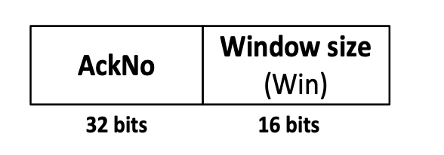
Window management in TCP
The receiver is returning two parameters to the sender
The interpretation is:
“I am ready to receive new data with SeqNo= AckNo, AckNo+1, …., AckNo+Win-1”
Receiver can acknowledge data without opening the window
Receiver can change the window size without acknowledging data

Slide 5
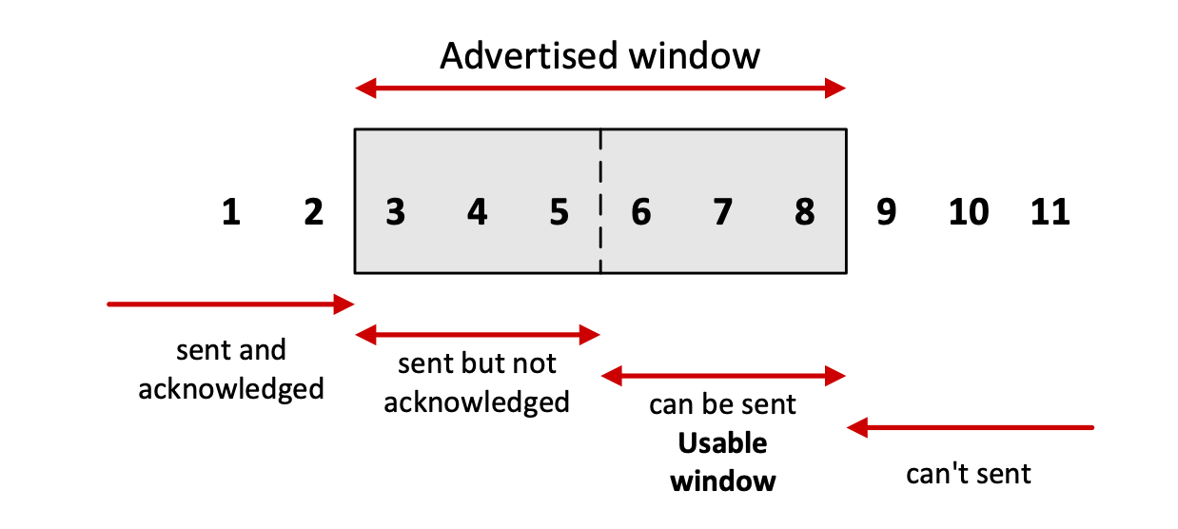
Sliding window flow control
Sliding window flow control is performed at the byte level:
Here: Sender can transmit sequence numbers 6,7,8

Slide 6
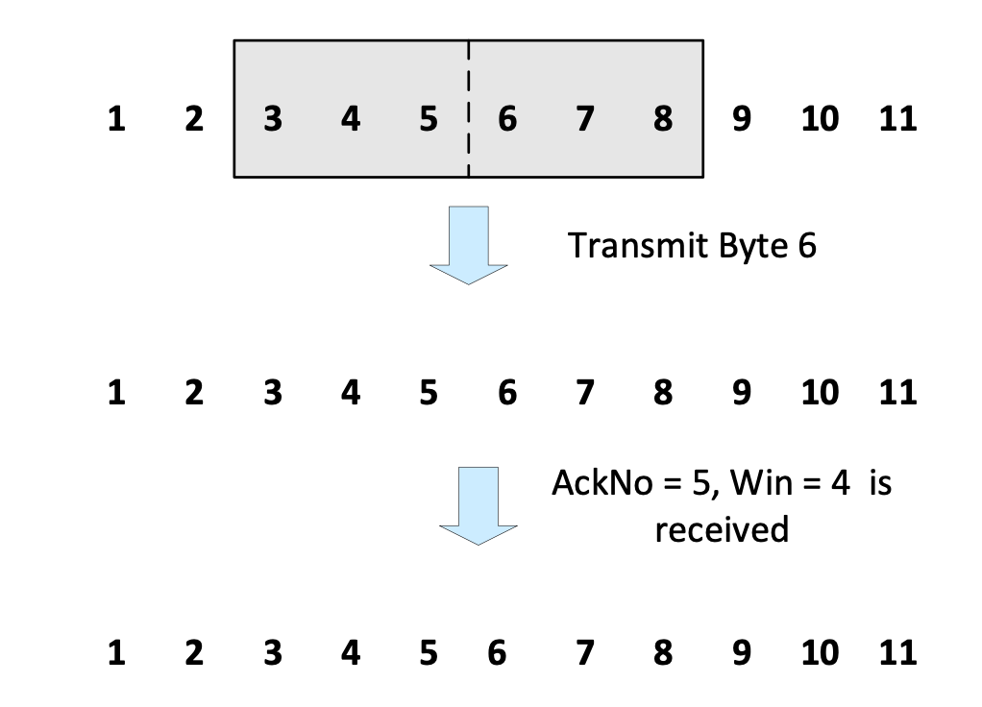
Sliding window: window closes
Transmission of a single byte (with SeqNo = 6) and acknowledgement is received (AckNo = 5, Win=4):

Slide 7
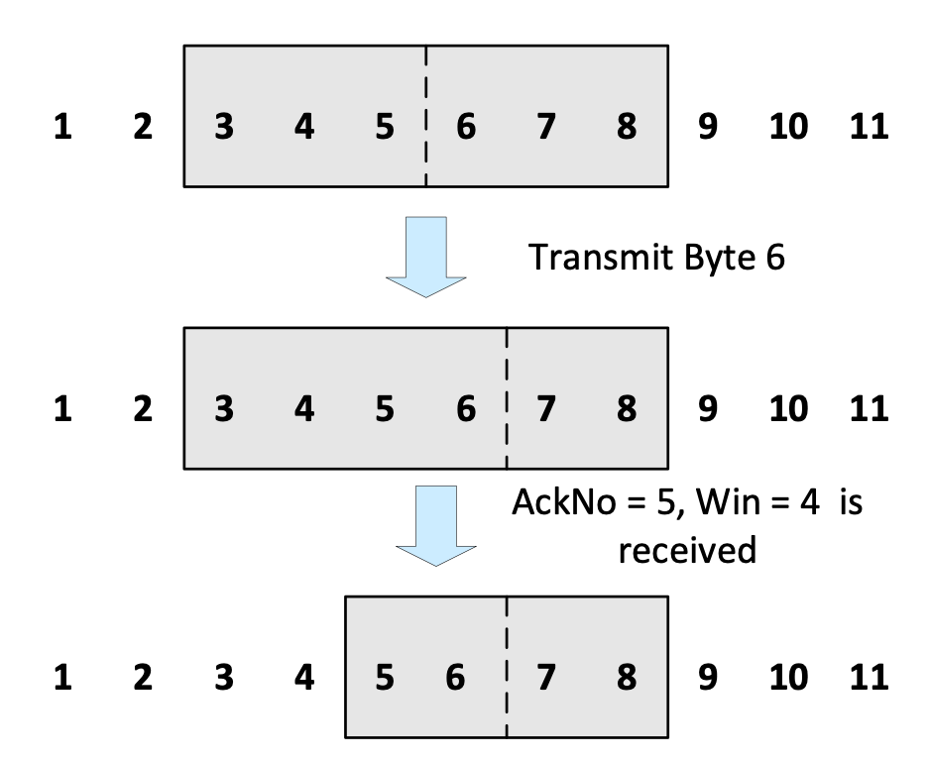
Sliding window: window closes
Transmission of a single byte (with SeqNo = 6) and acknowledgement is received (AckNo = 5, Win=4):

Slide 8
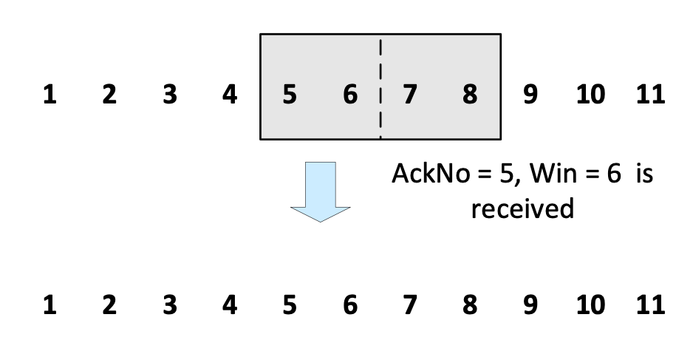
Sliding window: window opens
Acknowledgement is received that enlarges the window to the right (AckNo = 5, Win=6):
A receiver opens a window when its buffer empties
(meaning that data is delivered to the application).

Slide 9
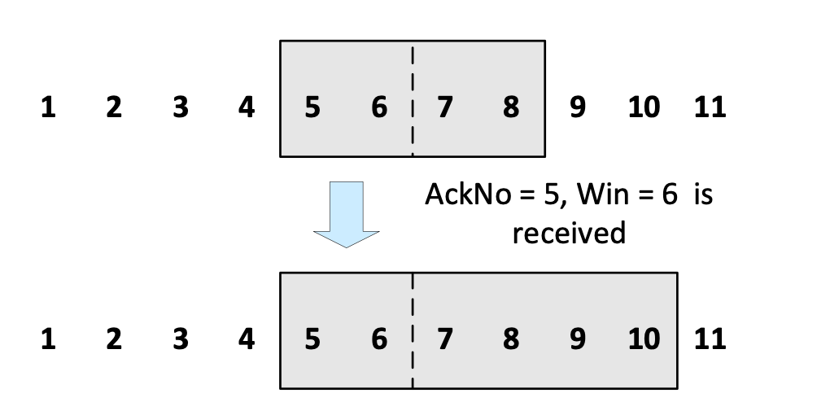
Sliding window: window opens
Acknowledgement is received that enlarges the window to the right (AckNo = 5, Win=6):
A receiver opens a window when TCP buffer empties (meaning that data is delivered to the application).

Slide 10
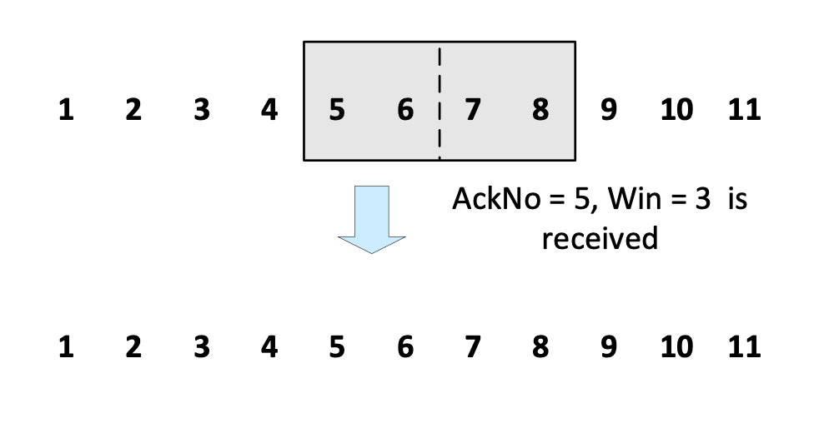
Sliding window: window shrinks
Acknowledgement is received that reduces the window from the right (AckNo = 5, Win=3):
Windows should not never shrink. Why?

Slide 11
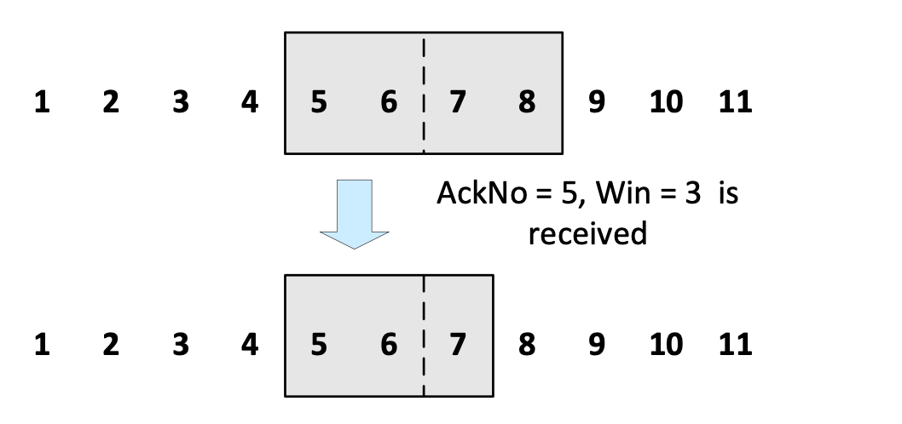
Sliding window: window shrinks
Acknowledgement is received that reduces the window from the right (AckNo = 5, Win=3):
Windows should not never shrink. Why?

Slide 12
Sliding Window: Example

