Slide 1
TCP Congestion Control

Slide 2
TCP Congestion Control
TCP has binary congestion control:
ACK received → no congestion
RTO Timeout → congestion
The mechanism is implemented at the sender by setting a congestion window
The window size at the sender is set as follows:
Send Window = MIN (flow control window, congestion window)
where
flow control window is advertised by the receiver
congestion window is adjusted based on congestion information

Slide 3
TCP Congestion Control
TCP congestion control is governed by two parameters:
Congestion Window (cwnd)
Slow-start threshhold Value (ssthresh)
Initial value is advertised window
Congestion control works in two modes:
slow start (cwnd < ssthresh)
congestion avoidance (cwnd ≥ ssthresh

Slide 4
Summary of TCP congestion control
Initially:
cwnd = 1;
ssthresh = advertised window size;
New Ack received:
if (cwnd < ssthresh)
/* Slow Start*/
cwnd = cwnd + 1;
else
/* Congestion Avoidance */
cwnd = cwnd + 1/cwnd;
Timeout:
/* Multiplicative decrease */
ssthresh = cwnd/2;
cwnd = 1;
Additive increase
Multiplicative decrease

Slide 5
Slow Start Example
The congestion window size grows very rapidly
For every ACK, we increase cwnd by 1 irrespective of the number of segments ACK’ed
TCP slows down the increase of cwnd when cwnd > ssthresh

Slide 6
Congestion Avoidance
Congestion avoidance phase is started if cwnd has reached the slow-start threshold value
If cwnd ≥ ssthresh then each time an ACK is received, increment cwnd as follows:
cwnd = cwnd + 1/cwnd
Then cwnd is (roughly) increased by one if all cwnd segments have been acknowledged.

Slide 7
Example of Slow Start/Congestion Avoidance
Assume that ssthresh = 8
ssthresh
Cwnd (in segments)
Roundtrip times

Slide 8
Responses to Congestion
So, TCP assumes there is congestion if it detects a packet loss
A TCP sender can detect lost packets via:
Timeout of a retransmission timer
Receipt of a duplicate ACK
TCP interprets a Timeout as a binary congestion signal. When a timeout occurs, the sender performs:
cwnd is reset to one:
cwnd = 1
ssthresh is set to half the current size of the congestion window:
ssthressh = cwnd / 2
and slow-start is entered

Slide 9
Summary of TCP congestion control
Initially:
cwnd = 1;
ssthresh = advertised window size;
New Ack received:
if (cwnd < ssthresh)
/* Slow Start*/
cwnd = cwnd + 1;
else
/* Congestion Avoidance */
cwnd = cwnd + 1/cwnd;
Timeout:
/* Multiplicative decrease */
ssthresh = cwnd/2;
cwnd = 1;

Slide 10
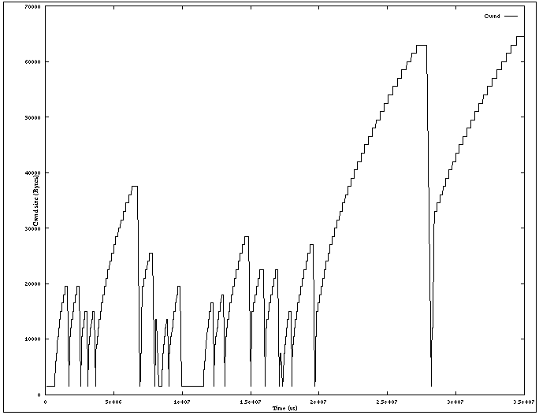
Slow Start / Congestion Avoidance
A plot of cwnd for a TCP connection (MSS = 1500 bytes) with slow start and congestion avoidance:

Slide 11
Flavors of TCP Congestion Control
TCP Tahoe (1988, FreeBSD 4.3 Tahoe)
Fast Retransmit
TCP Reno (1990, FreeBSD 4.3 Reno)
Fast Retransmit/ Fast Recovery
New Reno (1996)
BIC (2005)
CUBIC (2008)
Compound TCP or CTPC (2008)
Based on estimates of queueing delays
Many more: ECN, RED, Fast TCP
Linux and Mac
Windows
Notes:
sysctl -a

Slide 12
Acknowledgments in TCP
Receiver sends ACK to sender
ACK is used for flow control, error control, and congestion control
ACK number sent is the next sequence number expected
Lost segment

Slide 13
Acknowledgments in TCP
Receiver sends ACK to sender
ACK is used for flow control, error control, and congestion control
ACK number sent is the next sequence number expected
Out-of-order arrivals

Slide 14
Fast Retransmit
If three or more duplicate ACKs are received in a row, the TCP sender believes that a segment has been lost.
Then TCP performs a retransmission of what seems to be the missing segment, without waiting for a timeout to happen.
Enter slow start:
ssthresh = cwnd/2
cwnd = 1

Slide 15
Fast Retransmit / Fast Recovery
Fast recovery avoids slow start after a fast retransmit
Intuition: Duplicate ACKs indicate that data is getting through
After three duplicate ACKs set:
Retransmit packet that is presumed lost
ssthresh = cwnd/2
cwnd = ssthresh+3
(note the order of operations)
Increment cwnd by one for each additional duplicate ACK
When ACK arrives that acknowledges “new data” (here: AckNo=6148), set:
cwnd=ssthresh
enter congestion avoidance

Slide 16
TCP Reno
Duplicate ACKs:
Fast retransmit
Fast recovery
→ Fast Recovery avoids slow start
Timeout:
Retransmit
Slow Start
TCP Reno improves upon TCP Tahoe when a single packet is dropped in a round-trip time.

Slide 17
TCP Tahoe and TCP Reno (for single segment losses)
cwnd
Taho
time
Reno
cwnd
time

