Slide 1
Domain Name System
(DNS)
ECE 461
Professor Jorg Liebeherr

Slide 2
Takeaways
Roles of locator address and identifier
Domain name terminology and acronyms:
FQDN, top-level domain, root, zone, resolver, name server
Organization of root servers
Recursive and iterative DNS queries

Slide 3
Domain names and IP addresses
People prefer to use easy-to-remember names instead of IP addresses
Domain names are alphanumeric names for IP addresses e.g., neon.ece.utoronto.ca, www.google.com, ietf.org
The domain name system (DNS) is an Internet-wide distributed database that translates between domain names and IP addresses

Slide 4
Terminology: Locator vs. identifer
Locator (routing locator, address): information where to find a resource
    If the resource moves its location, the locator address changes
Identifier: unique name for a resource
    The identifier does not depend on the location of the resource
The 'name' of a resource indicates what we seek,
an 'address' indicates where it is, and
a 'route' tells us how to get there.
A note on Inter-Network Naming, Addressing, and Routing, John F. Shoch, January 1978
An IP addresses is mostly a routing locator (to find a subnet), but parts of it are used as identifier (interface identifier)
Domain names are pure identifiers

Slide 5
Before there was DNS ….
…. there was the HOSTS.TXT file
Before DNS (until 1985), the name-to-IP address was done by downloading a single file (hosts.txt) from a central server via FTP
  Most operating systems still have a host file (e.g., /etc/hosts) for defining local names
Content of /etc/hosts on Linux Ubuntu 20.04
127.0.1.1 PC-1 127.0.0.1 localhost ::1 localhost ip6-localhost ip6-loopback fe00::0 ip6-localnet ff00::0 ip6-mcastprefix ff02::1 ip6-allnodes ff02::2 ip6-allrouters

Slide 6
Resolver and name server
An application program on a host accesses the domain system through a DNS client, called the resolver
Resolver contacts DNS server, called name server
DNS server returns IP address to resolver which passes the IP address to application
Reverse lookups are also possible, i.e., find the hostname for a given
IP address

Slide 7
Design principle of DNS
The naming system of DNS is based on a hierarchical tree structure called the domain namespace
An organization obtains authority for parts of the name space, and can add additional layers to the hierarchy
Names of hosts can be assigned without regard to location on a link layer network, IP network, or autonomous system
In practice, allocation of the domain names generally follows the allocation of IP address, e.g.,
  All hosts with network prefix 128.100/16 have domain name suffix toronto.edu (and utoronto.ca)
  However, not the other way around: yhe domain name www.utoronto.ca returns (among others) the IP address 99.84.168.113. This address does not belong to UofT

Slide 8
DNS hierarchy
The domain name space can be represented as a tree
Root and top-level domains are administered by a registration authority (ICANN)
Below top-level domain, administration of the name space is delegated to organizations
Each organization can delegate further
Managed
by UofT
Managed by
ECE Dept.

Slide 9
Domain name system
Each node in the DNS tree represents a domain name
Each branch below a node is a DNS domain
  DNS domain can contain hosts or other domains (subdomains)
Example:
DNS domains are
., ca, utoronto.ca, ece.utoronto.ca

Slide 10
Fully Qualified Domain Name (FQDN)
Hosts and DNS domains are named based on their position in the domain tree
Every node in the DNS domain tree can be identified by a unique Fully Qualified Domain Name (FQDN). The FQDN gives the position in the DNS tree
A FQDN consists of labels (“cs”,“utoronto”,”ca”) separated by a period (“.”)
There can be a period (“.”) at the end
Each label can be up to 63 characters long
FQDNs are not case-sensitive
FQDN contains ASCII characters, numerals, and dash character (“-”)
Since early 2000s: Translation of Unicode symbols to ASCII enables the use of international character/symbol sets

Slide 11


Top-level domains
Creation of top-level domains (TLDs) are administered by ICANN
Original top-level domains : .com, .edu, .org, .net, .gov, .mil
There are now >1500 top-level domains
Types of domains:
  generic TLD (gTLD):
    Examples: .dog, .fashion, .dental, .museum
    Now has >1200 domains
  country-code TLD (ccTLD): 2-character country or region code
    Examples: .ca, .jp, .de
    Internationalized: (DNS: xn--nod), (DNS: xn--o3cw4h)
  special domains: .in-addr.arpa and .ip6.arpa are used for IPv4 and IPv6 address-to-name mapping

Slide 12
Hierarchy of name servers
The resolution of the hierarchical name space is done by a hierarchy of name servers
Root server is at the top of the hierarchy
Each name server is responsible (authoritative) for a portion of the DNS namespace, called a zone
A name server responds to queries about domain names in its zone

Slide 13
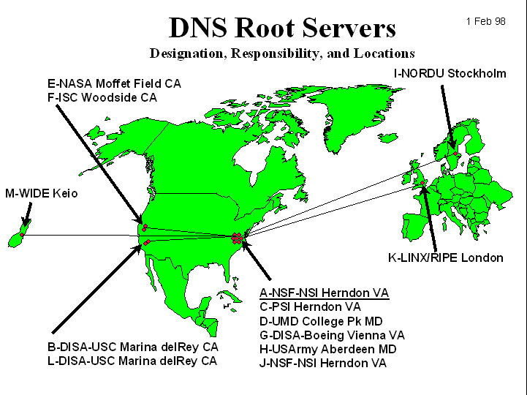
Root name servers (see www.root-servers.org)
The root name servers know how to find the authoritative name servers for all top-level zones
There are 13 root name servers
  Root servers are duplicated many times
Root servers are critical for the proper functioning of name resolution
Original DNS root servers
Notes:
Zone file for root server: http://www.internic.net/domain/root.zone

Slide 14
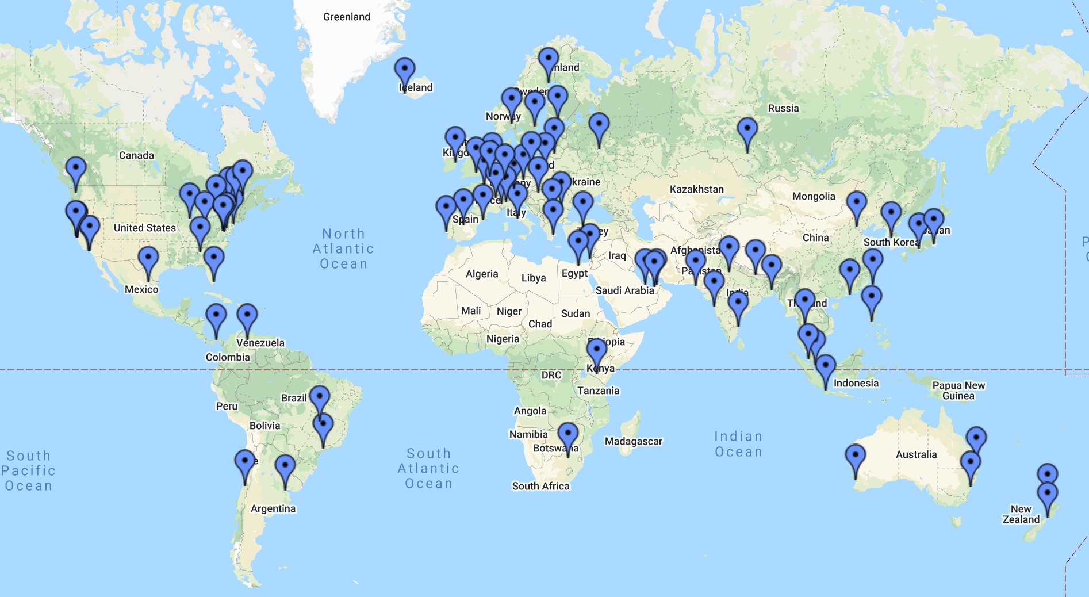
Current location of root servers

Slide 15
Addresses of root servers
A.ROOT-SERVERS.NET. 198.41.0.4 2001:503:ba3e::2:30
B.ROOT-SERVERS.NET. 199.9.14.201 2001:500:200::b
C.ROOT-SERVERS.NET. 192.33.4.12 2001:500:2::c
D.ROOT-SERVERS.NET. 199.7.91.13 2001:500:2d::d
E.ROOT-SERVERS.NET. 192.203.230.10 2001:500:a8::e
F.ROOT-SERVERS.NET. 192.5.5.241 2001:500:2f::f
G.ROOT-SERVERS.NET. 192.112.36.4 2001:500:12::d0d
H.ROOT-SERVERS.NET. 198.97.190.53 2001:500:1::53
I.ROOT-SERVERS.NET. 192.36.148.17 2001:500:1::53
J.ROOT-SERVERS.NET. 192.58.128.30 2001:503:c27::2:30
K.ROOT-SERVERS.NET. 193.0.14.129 2001:7fd::1
L.ROOT-SERVERS.NET. 199.7.83.42 2001:500:9f::42
M.ROOT-SERVERS.NET. 202.12.27.33 2001:500:9f::42
Notes:
Location of root server info on MAC OS: /var/named/named.ca

Slide 16
Authority and delegation
Authority for the root domain is with the Internet Corporation for Assigned Numbers and Names (ICANN)
ICANN delegates to accredited registrars (for gTLDs) and countries for country code top level domains (ccTLDs)
Authority can be delegated further
Chain of delegation can be obtained by reading domain name from right to left
Unit of delegation is a zone

Slide 17
DNS domain and zones
A DNS domain is a branch of the DNS namespace
A zone is the part of the namespace that is handled by a name server
A name server can divide part of its zone and delegate it to other name servers
  Zone of a server is all or part of a DNS domain (the part that is not delegated)
  Zone may also consist of multiple domains

Slide 18
Primary and secondary name servers
For each zone, there must be a primary name server and a secondary name server
  The primary server (master server) maintains a zone file which has information about the zone. Updates are made to the primary server
  The secondary server copies data stored at the primary server.
Adding/removing a host:
When a new host is added to/removed from a zone, the administrator adds/removes the IP information on the host (IP address and name) to the zone file on the primary server

Slide 19
Domain name resolution
An application issues a request for the IP address of a hostname
Local resolver formulates a DNS query to the name server of the host
Name server checks if it is authorized to answer the query.
  If yes, it responds.
  Otherwise, it will query other name servers, starting at the root tree
When the name server has the answer it sends it to the resolver.

Slide 20
Recursive and Iterative Queries
Queries can be recursive or iterative (non-recursive)
  The type of query is determined by a flag in the DNS query
Recursive query:
  Here, the server must resolve the query (or send an error message)
  When the name server of a host cannot resolve a query, the server issues a query to some other server to resolve the query
Iterative queries:
  Here, the server returns its best possible answer: (1) the matching answer or (2) a referral to another server
  When the name server does not find an exact match, it sends a referral to the resolver a referral which specifies another name server

Slide 21
Iterative queries
We assume that the name server cannot supply answer
With iterative queries, the name server sends a referral to a closest known authoritative name server
This involves more work for the resolver

Slide 22
Recursive queries
In a recursive query, the resolver expects the requested record from its name server
Server cannot just send a referral to another name server
A recursive requires that the name server maintains state information on the query
Root servers and TLD servers do not handle recursive queries due to the workload
The scenario on the right with only recursive queries is therefore not realistic
Notes:
Non-recursive question to root server: dig @f.root-servers.net. www.cnn.com +norecurs
Recursive question to local name server:

Slide 23
Most common method of DNS resolution
Host (resolver) sends a recursive query to its configured name server
Name server performs iterative queries to resolve the name
Name server performs iterative queries
If the server cannot supply the answer, it will send the query to the “closest known” authoritative name server (here: In the worst case, the closest known server is the root server)
The root sever sends a referral to the “edu” server. Querying this server yields a referral to the server of “virginia.edu”
… and so on
Notes:
Non-recursive question to root server: dig @f.root-servers.net. www.cnn.com +norecurs
Recursive question to local name server:

Slide 24
Caching
To reduce DNS traffic, name servers caches information on domain name/IP address mappings
When an entry for a query is in the cache, the server does not contact other servers
Note: If an entry is sent from a cache, the reply from the server is marked as “non-authoritative”

Slide 25
Resource Records
The database records of the distributed data base are called resource records (RR)
Resource records are stored in configuration files (zone files) at name servers
Resource records for a zone:

Slide 26
Resource Records
Max. age of cached data
in seconds
Start of authority (SOA) record.
Meaning: “This name server is
authoritative for the zone
Mylab.com”
PC4.mylab.com is the name server
hostmaster@mylab.com is the
email address of the person
in charge
Name server (NS) record.
One entry for each authoritative
name server
Address (A) records.
Entry for an IPv4 address

