Slide 1
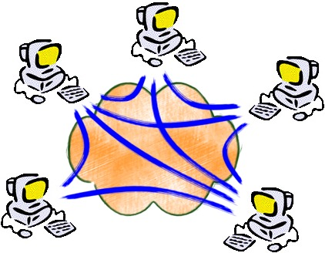
Evolution of Internetworking
Jorg Liebeherr
University of Toronto

Slide 2
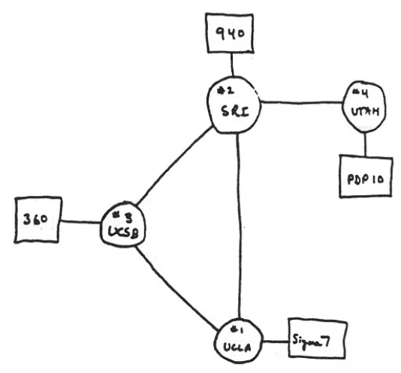
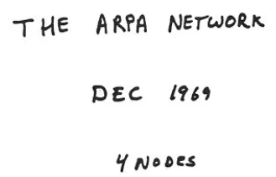
The Internet began small …

Slide 3
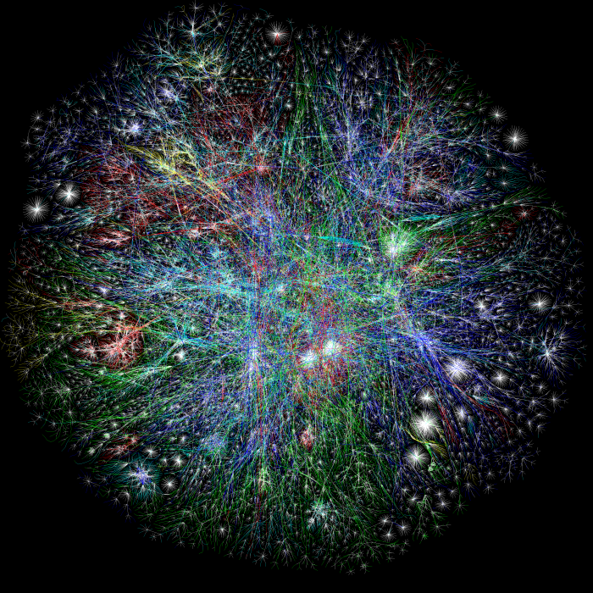
… to become one of the largest engineering artifacts in history

Slide 4


In the Beginning...
There were many competing networks & architectures.
DataPAC
DECNet
TransPAC
ARPANet

Slide 5
"Internetwork Layer"
IP started out as an overlay, designed to interconnect
all kinds of other networks – both LANs and WANs.
DataPAC
DECNet
TransPAC
IP Gateway
IP Gateway
ARPANet
K. Calvert, ICNP 2017 Panel (used with permission from author)

Slide 6
"Internetwork Layer"
"Network Layer"
As router technology matured...
...most of those underlying technologies faded away.
DataPAC
DECNet
TransPAC
ARPANet
K. Calvert, ICNP 2017 Panel (used with permission from author)

Slide 7






"Hollowing Out"
Software-Defined Networking replaces routers with
switches that are [semi]-oblivious to protocol standards.
K. Calvert, ICNP 2017 Panel (used with permission from author)

Slide 8

"Network Layer"
"Internetwork Layer"
This allows the domain owner to define the semantics of
header bits – inside the domain...
... and leaves the inter-domain interface to ossify.
K. Calvert, ICNP 2017 Panel (used with permission from author)

Slide 9
Internet Infrastructure (the way I teach it)

Slide 10
Internet Infrastructure (after a reality check)

