Slide 1
September 29
Agenda:
  General Q&A
  4:15-4:30: Quiz
  4:30-5:00: Q&A on lecture material from previous week

Slide 2
Review of
Networking Concepts
ECE 461
Professor Jorg Liebeherr

Slide 3
Takeaways
Review:
  Layered protocol suite
  Interactions between layered protocols
  Encapsulation and decapsulation

Slide 4
Sending a packet from Argon to Neon

Slide 5
Sending a packet from Argon to Neon
128.143.71.21 is not on my subnet.
Therefore, I need to send the packet to my
default gateway with address 128.143.137.1
128.143.71.21 is on one of my local subnets.
Therefore, I can send the packet directly.
DNS: The IP address of “neon.tcpip-lab.edu” is 128.143.71.21
DNS: What is the IP address
of “neon.tcpip-lab.edu”?
ARP: What is the MAC address of 128.143.137.1?
ARP: The MAC address of 128.143.137.1 is 00:e0:f9:23:a8:20
ARP: What is the MAC address of 128.143.71.21?
ARP: The MAC address of 128.143.137.1 is 00:20:af:03:98:28
frame
frame
Notes:
[‘;’

Slide 6
Internet protocol suite
The Internet protocol suite is the
protocol architecture of the Internet
The Internet protocol suite has four layers:
Application, Transport, Internet,
and Link Layer
A host implements all layers. Routers
only have link and Internet layers
Note:
  Internet protocols do not actually specify a link layer
  They specify how to interface with existing link layers

Slide 7
Internet protocols and OSI reference model
The Internet protocols do not define the lower layers of a complete protocol stack
Layer 7
Layer 6
Layer 5
Layer 4
Layer 3
Layer 2
Layer 1

Slide 8
Assignment of protocols to layers

Slide 9
Layered communications
A module of a given layer communicates with:
  1. a remote module a the same layer using a common protocol
  2. adjacent module at the local system via a service interface
Node A
Node B

Slide 10
Layers in the example

Slide 11
Layers in the example
Send HTTP Request to neon
Establish a connection to 128.143.71.21 at port 80
Open TCP connection to 128.143.71.21 port 80
IP datagram is a TCP segment for port 80
Send IP data-gram to 128.143.71.21
Send a datagram (which contains a connection request) to 128.143.71.21
Send IP datagram to 128.143.71.21
Frame is an IP datagram
Frame is an IP datagram
Send the datagram to 128.143.137.1
Send the datagram
to 128.143.7.21
Send Ethernet frame to 00:e0:f9:23:a8:20
Send Ethernet frame to 00:20:af:03:98:28

Slide 12
Encapsulation and decapsulation
As data is moving down the protocol stack, each protocol adds layer-specific control information

Slide 13
Encapsulation and decapsulation in the example
Let us look in detail at the Ethernet frame between Argon and the Router, which contains the TCP connection request to Neon.
This is the frame in hexadecimal notation.
00e0 f923 a820 00a0 2471 e444 0800 4500 002c 9d08 4000 8006 8bff 808f 8990 808f 4715 065b 0050 0009 465b 0000 0000 6002 2000 598e 0000 0204 05b4

Slide 14
Parsing the information in the frame

Slide 15
Encapsulation and decapsulation

Slide 16
Encapsulation and decapsulation:
Ethernet header

Slide 17
Encapsulation and decapsulation:
IP header

Slide 18
Encapsulation and decapsulation:
IP header

Slide 19
Encapsulation and decapsulation:
TCP header
Option: maximum segment size

Slide 20
Encapsulation and decapsulation:
TCP header

Slide 21
Encapsulation and decapsulation:
TCP header

Slide 22
Encapsulation and decapsulation:
Application data
No Application Data
in this frame

Slide 23
Different views of networking
Different Layers of the protocol stack have a different view of the network. This is HTTP’s and TCP’s view of the network

Slide 24
Network view of IP

Slide 25
Network view of Ethernet

Slide 26
Data Link Protocols
ECE 461
Professor Jorg Liebeherr

Slide 27
Takeaways
Types of data link networks
Format of a MAC address
Difference between an Ethernet switch and Ethernet hub
Format of Ethernet frames
Types of point-to-point links

Slide 28
Internet protocol suite
The Internet protocol suite does not define data link and physical layers
Instead it takes advantage of existing lower layers, and defines interfaces to access them
Data link layers are specified by other bodies (e.g., IEEE 802)
In Internet terminology, any data link network is referred to as a “link”

Slide 29
Data link layer (Layer 2)
The main tasks of the data link layer are:
    Transfer data from the network layer of one node to the network layer of another node
    Convert the raw bit stream of the physical layer into groups of bits (frames)

Slide 30
Types of networks at the data link layer
  Broadcast networks: All stations share a single communication channel
    Most local area networks (LANs), e.g., Ethernet and WiFi, are broadcast networks
    Needs addresses, e.g., MAC addresses
  Point-to-Point networks: Pairs of hosts (or routers) are directly connected
    Wide area networks (WANs) are mostly point-to-point
    Addresses are not needed

Slide 31
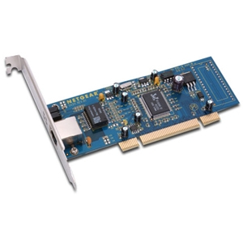
Medium Access Control (MAC)
In a broadcast network, the stations must ensure that only one station transmits at a time on the shared communication channel
Protocols to determine who can transmit at any time are called Medium Access Control (MAC) protocols
  Ethernet: CSMA/CD
  WiFi: CSMA/CA
MAC protocol is running on a NIC (network interface controller):
  NIC has a MAC address
Ethernet NIC

Slide 32
MAC Addresses
A MAC address is an address of a NIC
  Also called “hardware address” or “physical address”
  Length of a MAC address is typically 6 bytes
MAC addresses are in hexadecimal notation, using “:” or “-” for byte separation: c8:2a:14:04:0a:81
    Set by manufacturer of NIC
    Intended to be permanent and globally unique
    Today, most hardware allows to change MAC addresses
Broadcast MAC address: ff:ff:ff:ff:ff:ff
Multicast MAC address: Last bit of first byte is set to “1”

Slide 33
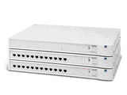
Ethernet Topology
There are many (>50) Ethernet variants
  Speed: 2 Mbps - 400 Gbps
  Frame formats: 802.3, Ethernet II (DIX)
Ethernet was originally designed as a bus topology
Since mid-1990s, nodes are connected to a hub or switch in a star configuration

Slide 34
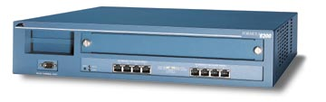
Ethernet Hubs vs. Ethernet Switches
Ethernet hub
Does not perform buffering
Collisions occur if two frames arrive at the same time
Frame that arrives on one port is sent out on all ports
Ethernet switch
Packet switch for Ethernet frames
Has routing table based on MAC addresses
Buffering of frames prevents collisions
Switch
Hub

Slide 35
Two Ethernet frame formats
Two Ethernet frame formats are in use, with subtle differences:
  Ethernet II (DIX)
    An industry standard from 1982 that is based on the first implementation of CSMA/CD by Xerox.
    Most commonly used format
  802.3:
    IEEE’s version of CSMA/CD from 1985.
Difference for our purposes:
Ethernet II and 802.3 use different methods to encapsulate IP datagrams

Slide 36
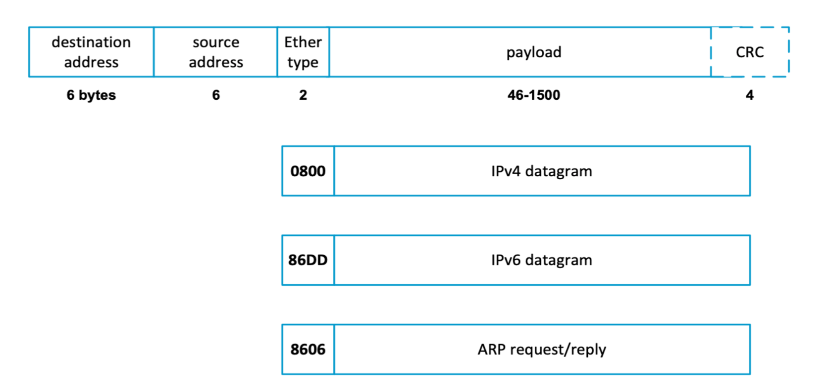
Ethernet II encapsulation (RFC 894)

Slide 37
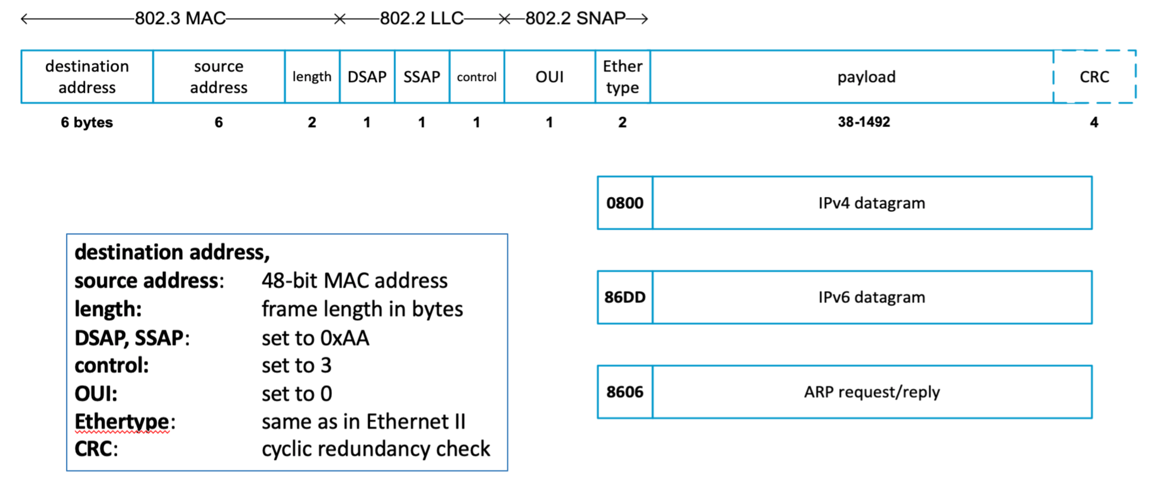
IEEE 802.2/802.3 encapsulation (RFC 1042)

Slide 38
Point-to-point links
Many data link connections are point-to-point serial links:
  Dial-in or DSL access connects hosts to access routers
  Long-distance links
Data link layer protocols for point-to-point links are simple:
  Main role is encapsulation of IP datagrams
  No media access control needed
  No address needed

Slide 39
Data link protocols for point-to-point links
HDLC (High-Level Data Link)
  Widely used and influential standard (1979)
  Default protocol for serial links on Cisco routers
PPP (Point-to-Point Protocol)
  Based on a variant of HDLC
  Used for dial-in and for high-speed routers
Ethernet point-to-point
  Used for long-distance point-to-point links (up to 100 Gbps)

Slide 40
PPP - IP encapsulation
The frame format of PPP is similar to HDLC and the 802.2 LLC frame format:
PPP assumes a duplex circuit
Note: PPP does not use addresses
Usual maximum frame size is 1500
Notes:
PPP suports an asynchronous link (8 data bits/no parity) or a bit-oriented synchronous link

Slide 41
Additional PPP functionality
In addition to encapsulation, PPP supports:
  Link configuration
  Link quality testing
  Error detection
  Option negotiation
  Address notification
  Authentication
The above functions are supported by helper protocols:
  LCP
  PAP, CHAP
  NCP

Slide 42
Tunneling protocols
Tunnels are logical point-to-point links
  They appear to the endpoints as a point-to-point links
  The link is realized as a sequence of subnets

Slide 43
Switched networks
Some data link technologies can be used to build complete networks, with their own addressing, routing, and forwarding mechanisms.
These networks are often called switched networks
At the IP layer, a switched network may appear as a point-to-point link or a broadcast link

Slide 44
Switched networks
Data link layer technologies:
  Switched Ethernet
  Multiprotocol Label Switching (MPLS)
  ATM (Asynchronous Transfer Mode)
  Frame Relay
Some switched networks are intended for enterprise networks (Switched Ethernet), wide area networks (MPLS, Frame Relay), or both (ATM)

Slide 45
Neighbor Discovery
Part 1
ECE 461
Professor Jorg Liebeherr

Slide 46
Takeaways
Roles of neighbor discovery (ND) and address resolution
Address resolution in IPv4 (ARP)
Address resolution in IPv6 (NDP)
Address resolution for multicast

Slide 47
Neighbor discovery
Neighbor discovery refers protocol functions that determine link-layer addresses of nodes that are attached to the same link
In IP terminology, “link” refers to any data link-layer network (point-to-point, broadcast)

Slide 48
Need for address translation
Note:
  The Internet protocols are based on IP addresses
  Many link-layer networks use MAC addresses
A translation is required between IP and MAC layer addresses
  → “Given an IP address, what is the MAC address?”
IPv4 and IPv6 use different protocols for the translation:
  IPv4: Address Resolution Protocol (ARP)
  IPv6: Neighbor Discovery Protocol (NDP)

Slide 49
Address Resolution Protocol
(ARP)

Slide 50
Overview

Slide 51
Processing of IP packets by network device drivers
No

Slide 52
Address translation with ARP
ARP Request: Argon broadcasts an ARP request to all stations on the network: “What is the MAC address of 128.143.137.1?”

Slide 53
Address translation with ARP
ARP Reply: Router 137 responds with an ARP Reply which contains the MAC address
An ARP Reply is sent as a unicast Ethernet message

Slide 54
ARP packet format

Slide 55
Example
ARP Request from Argon:
Sender hardware address: 00:a0:24:71:e4:44
Sender protocol address: 128.143.137.144
Target hardware address: 00:00:00:00:00:00
Target protocol address: 128.143.137.1
ARP Reply from Router137:
Sender hardware address: 00:e0:f9:23:a8:20
Sender protocol address: 128.143.137.1
Target hardware address: 00:a0:24:71:e4:44
Target protocol address: 128.143.137.144

Slide 56
ARP cache / neighbor cache
Since sending an ARP request/reply for each IP datagram is inefficient, hosts maintain a cache (ARP Cache) of current entries.
Contents of the ARP Cache: (128.143.71.37) at 00:10:4B:C5:D1:15 [ether] on eth0
  (128.143.71.36) at 00:B0:D0:E1:17:D5 [ether] on eth0
  (128.143.71.35) at 00:B0:D0:DE:70:E6 [ether] on eth0
  (128.143.136.90) at 00:05:3C:06:27:35 [ether] on eth1
  (128.143.71.34) at 00:B0:D0:E1:17:DB [ether] on eth0
Entries in the ARP cache have an expiration time:
  Entries that are not updated before their expiration time are removed
ARP cache is updated when an ARP message is received
We will also use the term neighbor cache to refer to an ARP cache

Slide 57
Proxy ARP
Proxy ARP: Router responds to ARP Requests that arrive from one of its connected networks for a host that is on another of its connected networks

Slide 58
Things to know about ARP
ARP Request to a non-existing host
  Several ARP requests are made with increasing time intervals between requests. Eventually, ARP gives up
Refreshing ARP cache
  On some systems, hosts periodically send ARP Requests for all addresses listed in the neighbor cache. This refreshes the neighbor cache, but also introduces traffic
Unicast ARP Requests
  Some systems send ARP Requests as unicast whenever possible
Gratuitous ARP:
  A host sends an ARP Reply with its own IP address and MAC address as a broadcast.
  Can be used to update remote neighbor caches when when a host has changed its IP address
ARP Probing
  An ARP request for ones own IP address
  Useful for detecting if an IP address has already been assigned

Slide 59
Vulnerabilities of ARP
Since ARP does not authenticate requests or replies, ARP Requests and Replies can be forged
ARP is stateless: ARP Replies can be sent without a corresponding ARP Request
According to the ARP protocol specification, a node receiving an ARP packet (Request or Reply) must update its local ARP cache with the information in the sender field, as long as the receiving node already has an entry for the IP address of the source in its neighbor cache
Typical exploitation of these vulnerabilities:
A forged ARP Request or Reply can be used to update the neighbor cache of a remote system with a forged entry (ARP Poisoning)
This can be used to redirect IP traffic to other hosts

Slide 60
Neighbor Discovery
Part 2
ECE 461
Professor Jorg Liebeherr

Slide 61
Neighbor Discovery Protocol (NDP)

Slide 62
Neighbor Discovery Protocol
Uses several ICMPv6 messages types:
    Neighbor Solicitation / Neighbor Advertisement
    Router Solicitation / Router Advertisement,
    Route Redirect
Functions:
  Address resolution
  Duplicate Address Detection (DAD)
  Router/prefix/parameter discovery
  Address autoconfiguration
  Next-hop determination
  Neighbor unreachable detection
Notes:
RFC 2461, Dec 1998

Slide 63
Neighbor Discovery Protocol (NDP)
In IPv6, the Neighbor Discovery Protocol (NDP) replaces ARP
  No broadcast: NDP messages are sent as multicast or unicast
  No separate protocol: NDP messages are sent as ICMP messages
  Enhanced functions: Detection of duplicate addresses
Each node has a neighbor cache that stores (IPv6, MAC) address mappings
Two messages
  ICMP Neighbor Solicitation
  ICMP Neighbor Advertisement

Slide 64
Node Solicitation packet format
Target address is the IPv6 address to be resolved
Option is used unless source IPv6 address is “::”
It contains the MAC address of the sender of the solicitation. The address is used for the reply to the solicitation

Slide 65
Node Advertisement packet format
Target address is the IPv6 address to be resolved
Bit flags:
R (Router flag): set if sender is a router
S (Solicited flag): set if this is a reply to a solicitation
O (Override flag): set if this advertise-ment should override neighbor cache entry
Option is required
It contains the MAC source address of the sender of the advertisement

Slide 66
ICMP Neighbor Solicitation
ICMP Neighbor Advertisement
Function:
Replacement for ARP
Duplicate Address Detection
Messages are sent via
  unicast, or
  solicited node multicast

Slide 67
Solicited node multicast address
Suppose H1 looks for the MAC address of H3
Problem: How can H1 reach H3 without broadcast?

Slide 68
Solicited node multicast address
Solicited node multicast address: Derive an IPv6 multicast address from unicast IPv6 address
  Fixed prefix: FF02::1:FF00:0/104
  Last 3 bytes are the last 3 bytes from unicast address and copy
13 bytes
3 bytes
unicast IPv6 address
1B00:0408:135D:FD0B:0D4B:2607:F2
C0:92C7
solicited IPv6
multicast address
FF02:0000:0000:0000:0000:0001:FF
C0:92C7

Slide 69
Solicited node multicast address
Suppose H1 looks for the MAC address of H3
Problem: How can H1 reach H3 without broadcast?
When H3 configures its IPv6 unicast address, it starts listening to messages sent to its solicited multicast address
When H1 looks for the MAC address of H3, it sends a Neighbor Solicitation to the solicited multicast address derived from H3’s IPv6 address

Slide 70

NDP example
2606::PC1
2606::PC2
Example:
Scenario: PC1 issues a ping to PC2
Observe: NDP resolves configured and link-local addresses
PC1
PC2
2606::PC1 (2606::PC2) Configured IPv6 address of PC1 (PC2)
FE80::PC1 (FE80::PC2) Link-local IPv6 address of PC1 (PC2)
FF02:PC2 Solicited node multicast address of PC2

Slide 71
NDP Example
2606::PC1 (2606::PC2) : Configured IPv6 address of PC1 (PC2)
FE80::PC1 (FE80::PC2) : Link-local IPv6 address of PC1 (PC2)
FF02:PC2: Solicited node multicast address for address of PC2.
ICMP messages are omitted
PC1
PC2
Source IPv6
Destination IPv6
Neighbor Solicitation for 2606::PC2
2606::PC1
FF02::PC2
2606::PC2
2606::PC1
Neighbor Advertisement for 2606::PC2
FE80::PC2
2606::PC1
Neighbor Solicitation for 2606::PC1
Neighbor Advertisement for 2606::PC1
2606::PC1
FE80::PC2
Neighbor Solicitation for FE80::PC2
FE80::PC1
FE80::PC2
FE80::PC2
FE80::PC1
Neighbor Advertisement for FE80::PC2
FE80::PC2
FE80::PC1
Neighbor Solicitation for FE80::PC1
Neighbor Advertisement for FE80::PC1
FE80::PC1
FE80::PC2

Slide 72
Duplicate Address Detection (DAD)
Used to determine uniqueness of an IPv6 address on a link
When a network address is configured at H1:
  H1 starts listening to the solicited node multicast address (derived from H1’s configured address)
  H1 sends an ICMP Neighbor Solicitation with its own address as target
  (with source address :: and the destination set to H1’s solicited node multicast address)
    If there is no response, the configured address is considered unique
    If there is a response, a duplicate address has been detected.
    H1 marks the address as unavailable and stops listening to the solicited node multicast address.

Slide 73
Address Resolution for Multicast

Slide 74
Address Translation
Unicast
128.100.11.60
00:a0:24:71:e4:44
Local broadcast
255.255.255.255
ff:ff:ff:ff:ff:ff
Multicast
224.1.2.3
?
ARP or
NDP
IPv4 only
IPv4/IPv6

Slide 75


IP Multicast
Recall: A message with a multicast destination address is sent to all receivers that have declared interest in receiving data sent to this address
Interest in 224.1.2.3
No interest
224.1.2.3
224.1.2.3
224.1.2.3
Ethernet
No interest
Sender of 224.1.2.3
No interest
Interest

Slide 76
Approach 1: Address resolution by ARP
Send an ARP message using the MAC broadcast address ff:ff:ff:ff:ff:ff
Problem: Multiple hosts send their
IP unicast address. This is not useful
I am interested!
My MAC is a0:27
Interest in 224.1.2.3
No interest
Who is interested in 224.1.2.3?
Who is interested in 224.1.2.3?
Who is interested in 224.1.2.3?
Who is interested in 224.1.2.3?
Who is interested in 224.1.2.3?
Who is interested in 224.1.2.3?
Ethernet
No interest
Sender of 224.1.2.3
I am interested!
My MAC is fe:3c
No interest
Interest

Slide 77
Approach 2: Use MAC broadcast
Send every IP multicast message with destination address ff:ff:ff:ff:ff:ff in MAC header
  Messages are effectively broadcast
  Messages are filtered at non-receivers
Problem: Filtering happens in IP layer
→ processing overhead
Interest in 224.1.2.3
No interest
224.1.2.3
224.1.2.3
224.1.2.3
224.1.2.3
224.1.2.3
224.1.2.3
Sender of 224.1.2.3
No interest
No interest
Interest

Slide 78
Multicast MAC address
A multicast MAC address is identified by setting the 8th bit of the first byte to “1”
A priori, a multicast Ethernet message at an Ethernet switch is sent out on all ports of the switch
    This is similar to broadcast
    Ethernet switches can mitigate the broadcast
Interfaces drop a multicast message if the receiving node is not interested in the message
    Dropping occurs at the NIC (in hardware)

Slide 79
Multicast address mapping (IPv4)
IPv4 multicast address is statically mapped to a multicast MAC address
Last 23 bit of IP address are copied to the MAC address with fixed initial 25 bits

Slide 80
Multicast address mapping (IPv6)
Also a static mapping
Initial 2 bytes of the MAC address are 0x3333. Remaining four bytes are copied from last four bytes of IPv6 address

