Slide 1
Internet: History and Governance

Slide 2
What defines the Internet ?
Use of a globally unique address space based on Internet Protocol (IP) Addresses
Support of the Transmission Control Protocol/Internet Protocol (TCP/IP) suite for communications
Offers end-to-end delivery service for applications

Slide 3
A Definition
On October 24, 1995, the FNC passed a resolution defining the term Internet.
RESOLUTION: The Federal Networking Council (FNC) agrees that the following language reflects our definition of the term "Internet". "Internet" refers to the global information system that --
(i) is logically linked together by a globally unique address space based on the Internet Protocol (IP) or its subsequent extensions/followons;
(ii) is able to support communications using the Transmission Control Protocol/Internet Protocol (TCP/IP) suite or its subsequent extensions/follow-ons, and/or other IP-compatible protocols; and
(iii) provides, uses or makes accessible, either publicly or privately, high level services layered on the communications and related infrastructure described herein.

Slide 4
History of the Internet
Mid 1960: Papers on “Packet Switching” emerge.
End 1969s: ARPA sponsors the development of a packet-switching network, called the ARPANET. First four nodes are UCLA, SRI, U. Utah, UCSB.
1974: The TCP/IP protocols and model are being proposed by Cerf/Kahn.
1983: ARPANET adopts TCP/IP. At this time, the ARPANET has 200 routers.
1984: NSF funds a TCP/IP based backbone network. This backbone grows into the NSFNET, which becomes the successor of the ARPANET.
1995: NSF stops funding of NSFNET. The Internet is completely commercial.

Slide 5
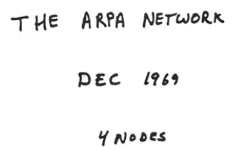
The Internet began small …

Slide 6
TCP/IP Internet Map (1986)

Slide 7
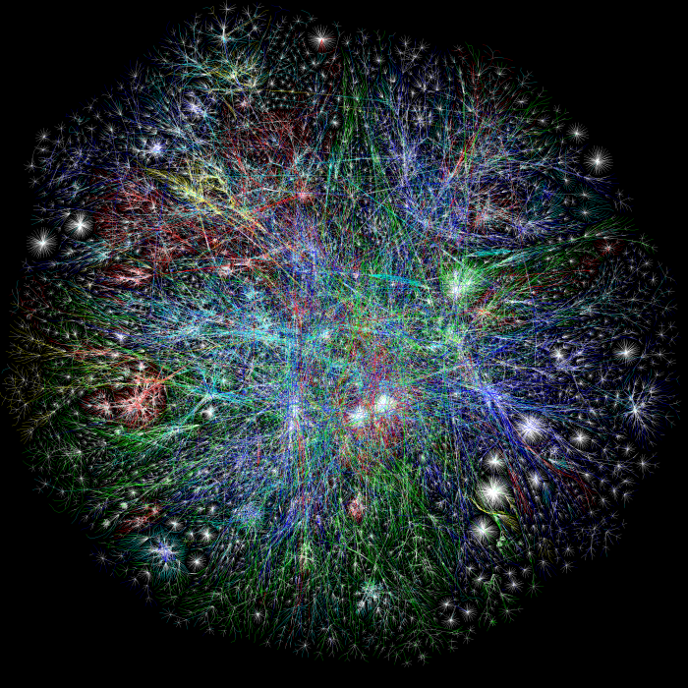
Internet is one of the largest engineering artifacts in history This is a map of the connectivity between AS’s
You are here

Slide 8
Growth of the Internet (2019)
“Measured” hosts on the public Internet

Slide 9
Governance of the Internet
There is no entity (government, organization, company) that own or runs the Internet
The Internet consists of a set of interconnected autonomous networs (AS’s)
There exists administrative bodies that ensure interoperability of various technologies and infrastructures. You should know:
ICANN (top-level domains, IP addresses, protocol parameters)
IETF (Internet standards)

Slide 10
Internet Corporation for Assigned Names and Numbers (ICANN)
Internationally organized, non-government, non-profit corporation
Responsible for the assignment of
technical protocol parameters,
allocation of the IP address space,
management of the domain name system,
and others.
Important roles:
Managing the Internet Assigned Numbers Authority (IANA)
IP address allocation:
Delegates address blocks to the Regional Internet Registries (RIRs)
Introduction of top-level domains (TLDs)
Accreditation of DNS registries

Slide 11
IANA
Important: It is not an organization, it is a set of functions
IANA allocates all numbers associated with the Internet protocols:
IP address blocks
Numbering of protocols
All protocol parameters
Also: Content of root name servers
Interesting:
Until 1998, IANA was managed by a single person: Jon Postel
1998: Transition to ICANN
Until 2016: ICANN had term-limited contracts about IANA with US Department of Commerce

Slide 12
IETF
IETF is a forum that coordinates the development of new protocols and standards.
Organized into working groups that are each devoted to a specific topic or protocol.
Working groups document their work in reports, called Request For Comments (RFCs).
IETF is where Internet protocols are defined
Operates mostly online
There global meetings each year
IETF mantra:
“We reject kings, presidents and voting. We believe in rough consensus and running code.”

Slide 13
Other organizations
Internet Society (ISOC): Founded in 1992, an international nonprofit professional organization that provides administrative support for the Internet. Founded in 1992, ISOC is the organizational home for the standardization bodies of the Internet.
IRTF (Internet Research Task Force): The Internet Research Task Force is a composed of a number of focused, long-term and small Research Groups.
Internet Architecture Board (IAB): a technical advisory group of the Internet Society, provides oversight of the architecture for the protocols and the standardization process
The Internet Engineering Steering Group (IESG): The IESG is responsible for technical management of IETF activities and the Internet standards process. Standards. Composed of the Area Directors of the IETF working groups.
ISOC
IETF
IAB
IRTF
IESG

Slide 14
Internet Standardization Process
Working groups present their work i of the Internet are published as RFC (Request for Comments).
RFCs are the basis for Internet standards.
Not all RFCs become Internet Standards ! (There are more than 8000 RFCs and around 100 Internet standards
A typical (but not only) way of standardization is:
Internet Drafts
RFC
Proposed Standard
Draft Standard (requires 2 working implementation)
Internet Standard (declared by IAB)

